Slide 1
Diffusion MRI Analysis
Sonia Pujol, Ph.D.
Surgical Planning Laboratory Harvard University

Slide 2
Brain Anatomy
•White matter ~45% of the brain
•Myelinated nerve fibers (~ 10 μm axon diameter)
Diffusion MRI Analysis
Sonia Pujol, Ph.D.

Slide 3
White Matter Exploration
Jules Joseph Dejerine
(Anatomie des centres
nerveux (Paris, 1890-1901): Atlas of Neuroanatomy based on myelin stained preparation
Diffusion MRI Analysis
Sonia Pujol, Ph.D.

Slide 4
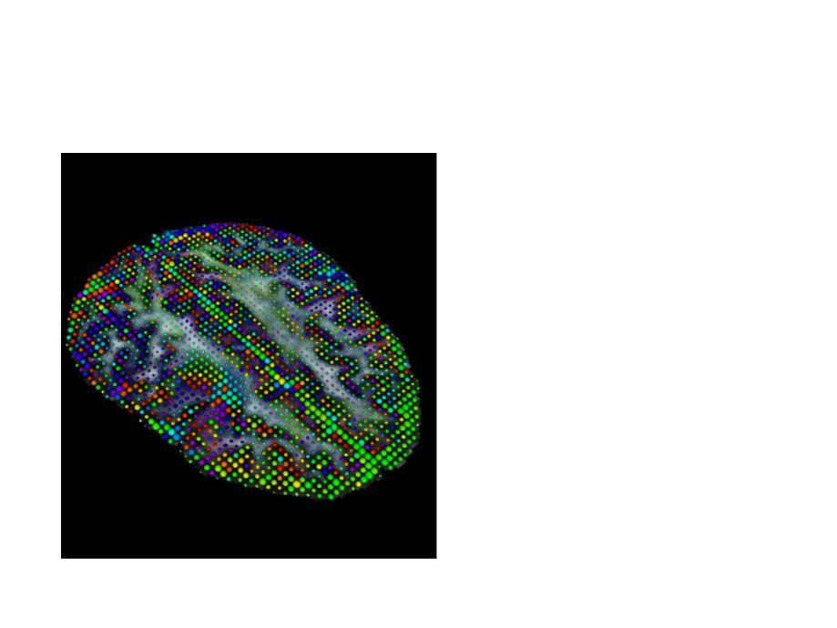
Diffusion Tensor Imaging (DTI)
• First non-invasive
window on white maJer anatomy
• Measurement of the moLon of water
molecules using MRI techniques.
• Three-dimensional reconstrucLon of the trajectory of white maJer bundles

Slide 5
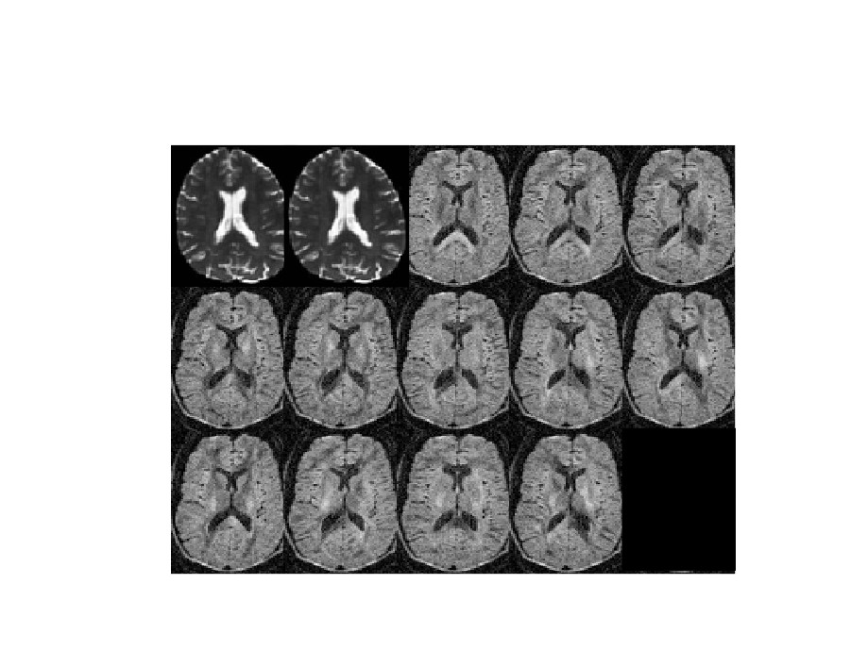
Diffusion Weighted Imaging (DWI)
S0
S0
S1
S2
S3
S4
S5
S6
S7
S8
S9
S10
S11
S12

Slide 6
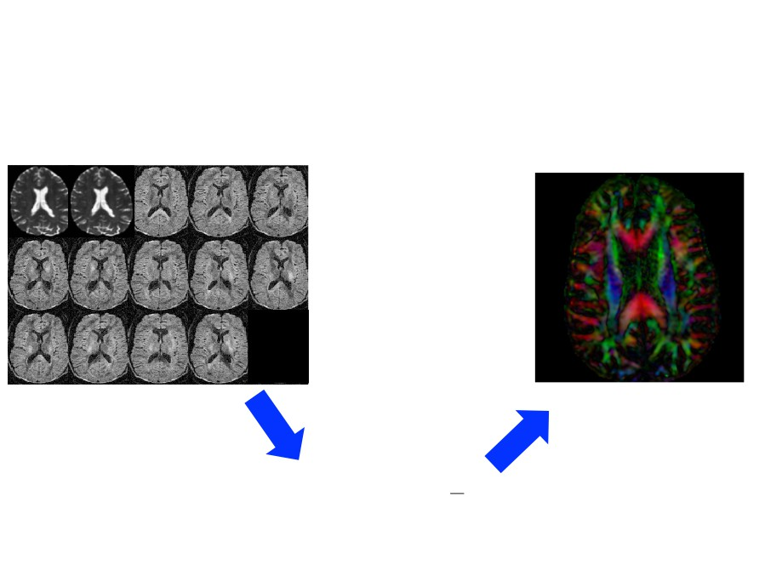
From DWI to DTI
DWI
DTI
S S S
S S
0 0 1
2 3
S S S
S S
4 5 6
7 8
S S1 S1
S1
9 0 1
2
DWI dataset acquired with
DTI dataset
12 gradient and 2 baseline
−bĝi Dĝ_{i}
T
S_{i} = S₀ e
_
Si: DWI volume acquired with ith gradient
Stejskal-Tanner (1965)
So: Baseline volume

Slide 7
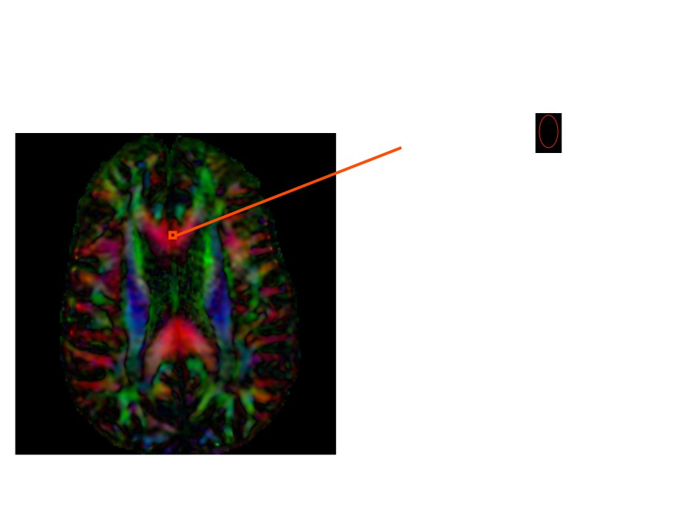
Diffusion Tensor Imaging
−bĝi Dĝ_{i}
T
S_{i} = S₀ e
_

Slide 8
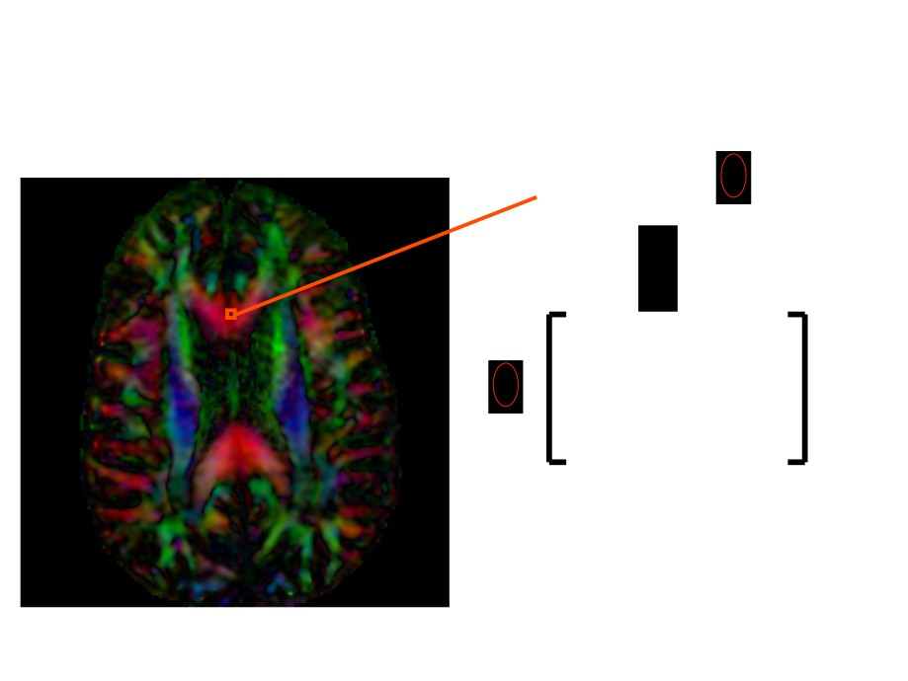
Diffusion Tensor Imaging
−bĝi Dĝ_{i}
T
S_{i} = S₀ e
_
Dxx
Dxy Dxz
D =
=
Dyy Dyz
Dyx
_
Dzx
Dzy Dzz

Slide 9
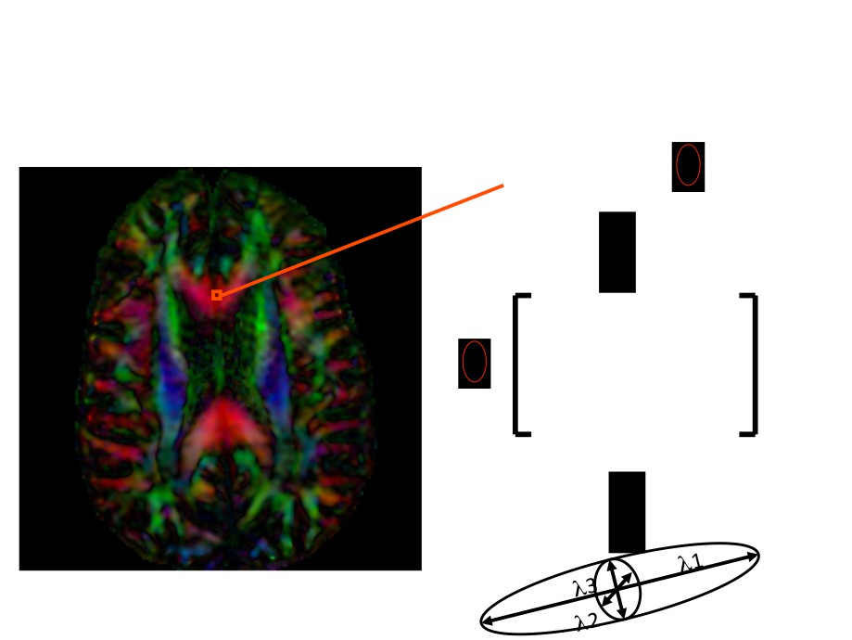
Diffusion Tensor Imaging
−bĝi Dĝ_{i}
T
S_{i} = S₀ e
_
Dxx
Dxy Dxz
D =
=
Dyy Dyz
Dyx
_
Dzx
Dzy Dzz

Slide 10
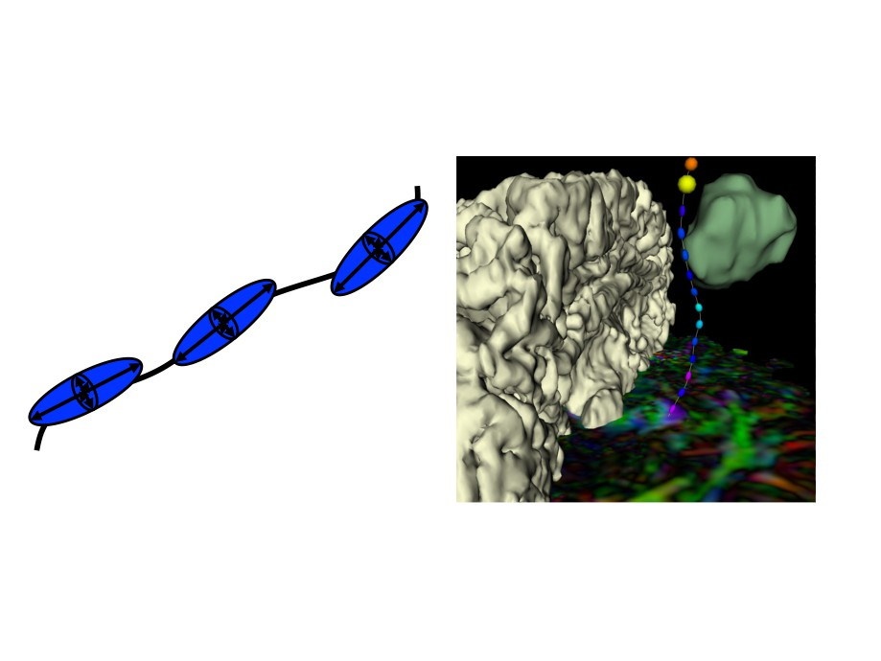
Tractography
DTI tractography provides 3D reconstrucLon of the trajectory of white maJer pathways

Slide 11
Tutorial Outline
This tutorial is an introduction to the fundamentals of
Diffusion MRI analysis, from the estimation of diffusion tensors to the interactive 3D
visualization of fiber tracts.
Diffusion MRI Analysis
Sonia Pujol, Ph.D.

Slide 12
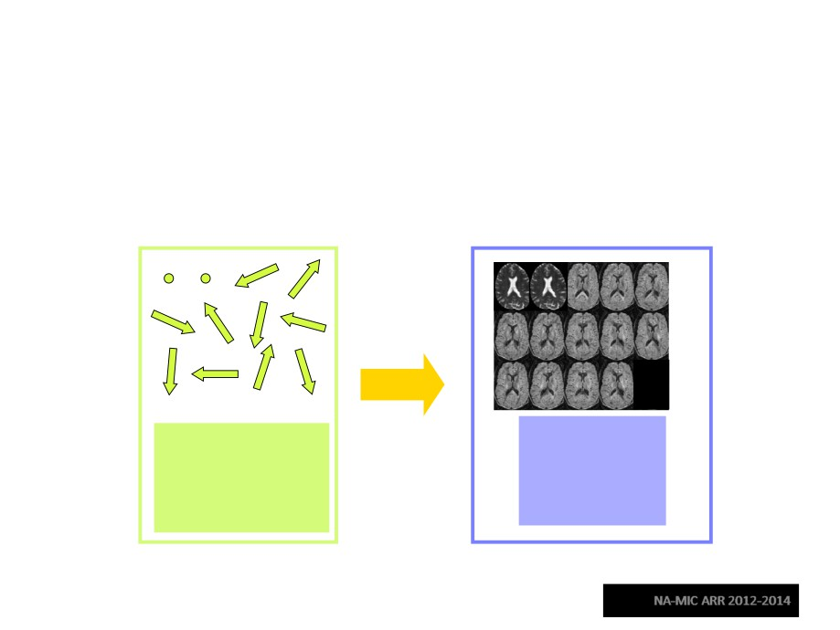
Tutorial Dataset
The tutorial dataset DiffusionMRI_tutorialData is a Diffusion Weighted MR scan of the brain acquired with41 gradient directions and one baseline.
Diffusion
Diffusion
Sensitizing Gradients
Weighted
Images
Diffusion MRI Analysis
Sonia Pujol, Ph.D.

Slide 13
Tutorial Software
The tutorial uses the 3DSlicer version 4.3
software available at www.slicer.org
Disclaimer
It is the responsibility of the user of 3DSlicer to comply with both the terms of the license and with the applicable laws, regulations and rules. Slicer is a tool for research, and is not FDA approved.
Diffusion MRI Analysis
Sonia Pujol, Ph.D.

Slide 14
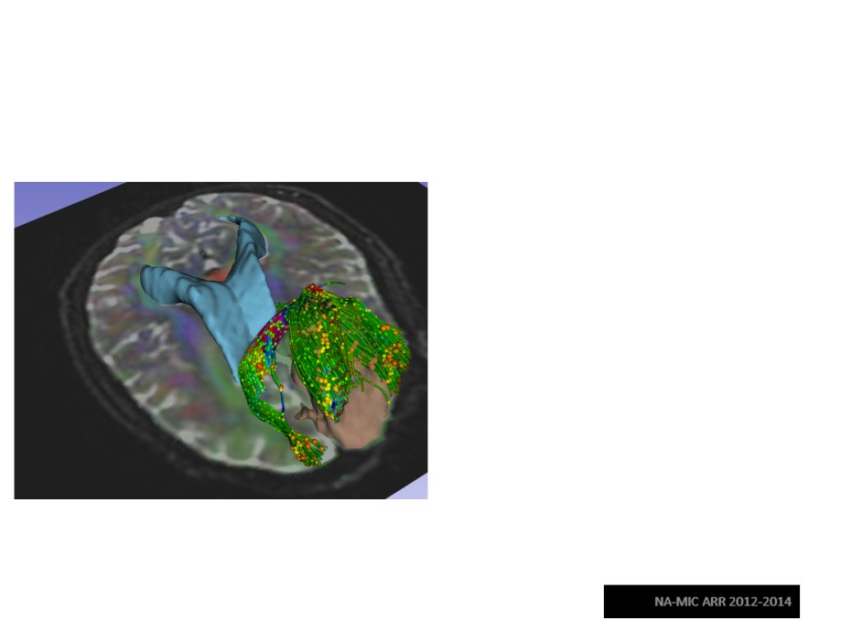
3DSlicer
• An end-user application for image analysis
• An open-source environment for
software development
• A software platform that is both easy to use for clinical researchers and
easy to extend for programmers
3D Slicer is a multi-institution effort supported by the National Institutes of Health.
Diffusion MRI Analysis Sonia Pujol, Ph.D.

Slide 15
Learning Objectives
Following this tutorial, you’ll be able to
1) Estimate a tensor volume from a set of Diffusion Weighted Images
2) Understand the shape and size of the diffusion ellipsoid
3) Reconstruct DTI tracts from a pre-defined region of interest
4) Interactively visualize DTI tracts seeded from a fiducial
Diffusion MRI Analysis
Sonia Pujol, Ph.D.

Slide 16
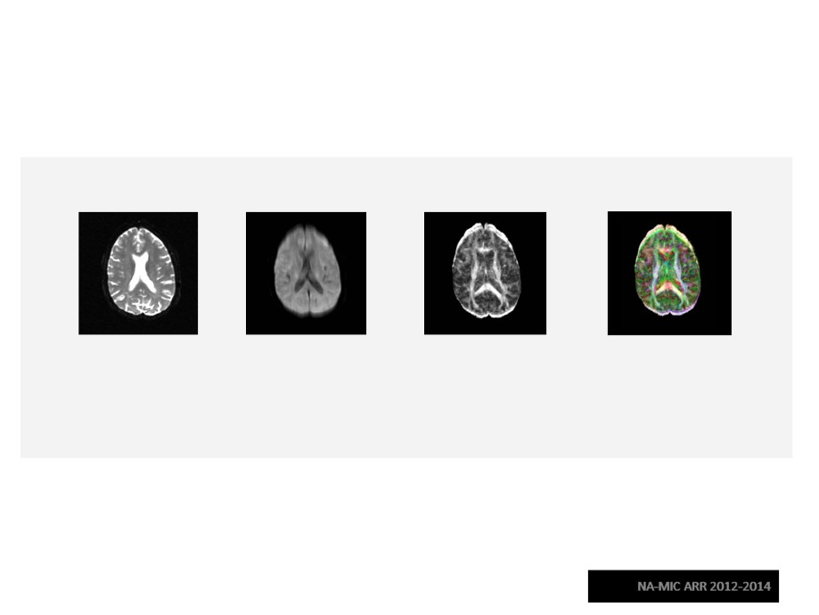
MR Diffusion Analysis Pipeline
DWI
Tensor
Scalar
3D
Acquisition
Calculation
Maps
Visualization
Diffusion MRI Analysis
Sonia Pujol, Ph.D.

Slide 17
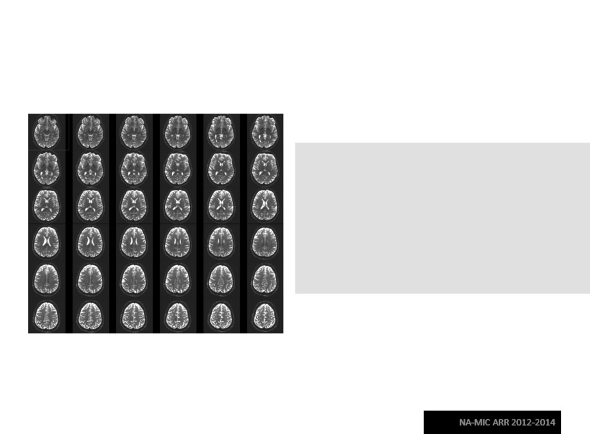
Part 1:
From DWI images to Tensors
Diffusion MRI Analysis
Sonia Pujol, Ph.D.

Slide 18
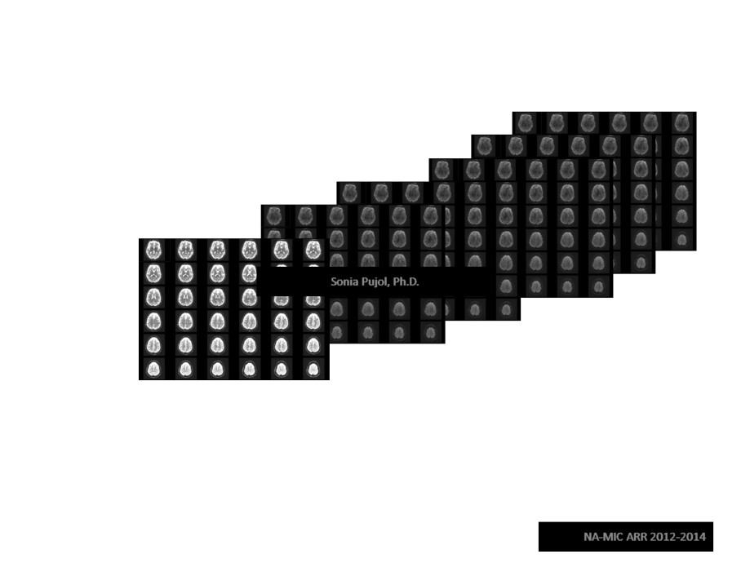
Understanding the DWI Dataset
The Diffusion Weighted Imaging (DWI) dataset is composed of
1 volume acquired without diffusion-sensitizing gradient, and
41 volumes acquired with 41 different diffusion-sensitizing gradient directions.
Diffusion MRI Analysis
Sonia Pujol, Ph.D.

Slide 19
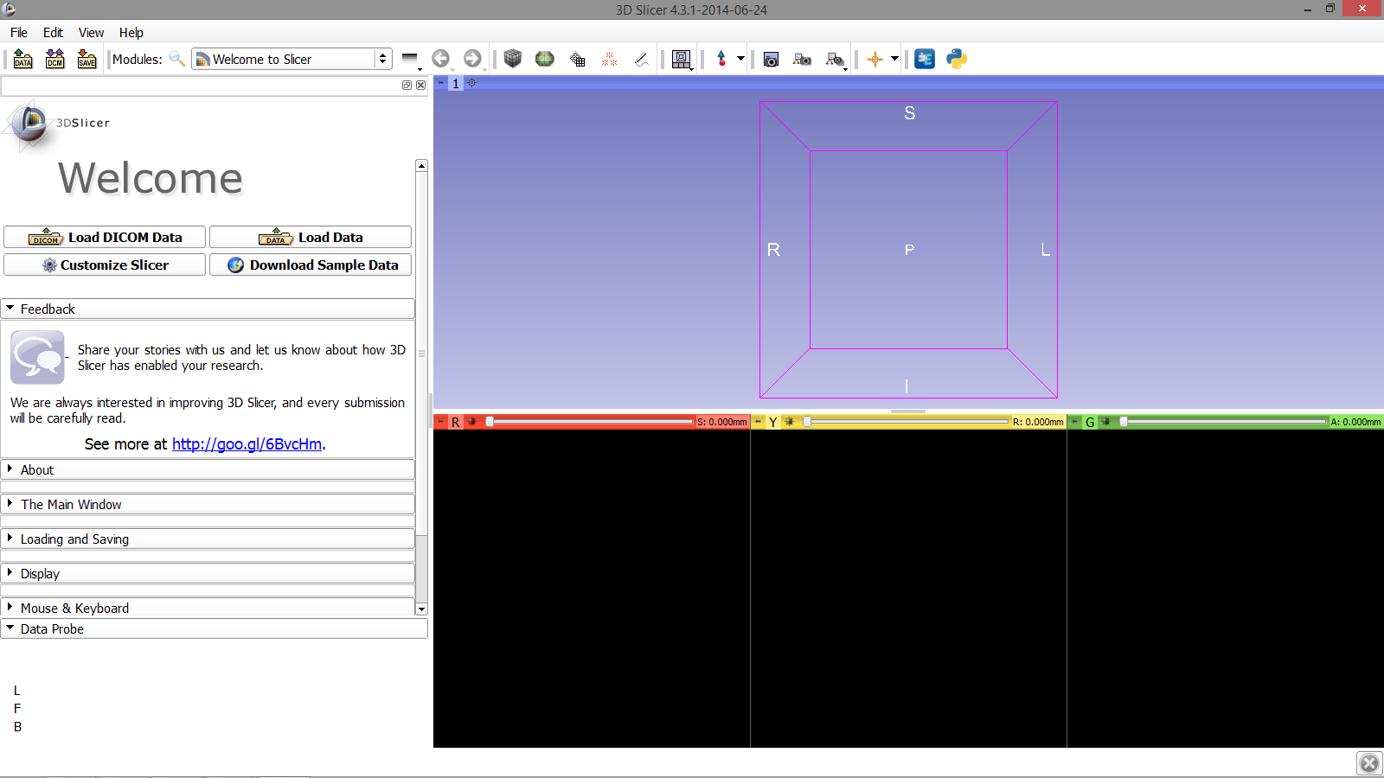
Loading the DWI Dataset
First, start Slicer 4.3.1
Diffusion MRI Analysis
Sonia Pujol, Ph.D.
NA-MIC ARR 2012-2014

Slide 20
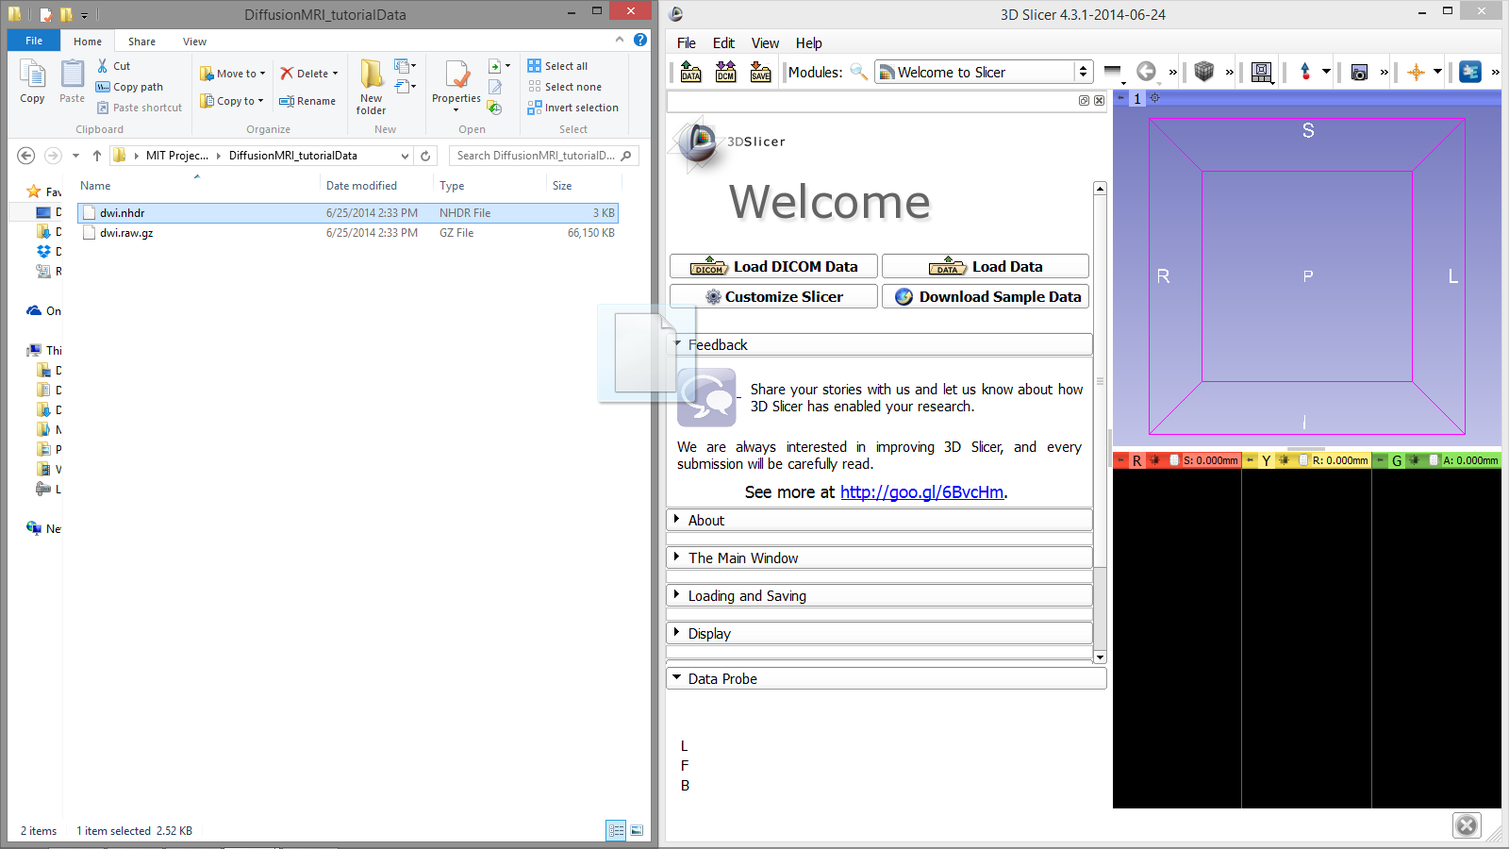
Loading the DWI Dataset
In your files archive, locate the file dwi.nhdr in the dataset folder for this tutorial.
Drag and drop the file dwi.nhdr into the Slicer viewer
Diffusion MRI Analysis
Sonia Pujol, Ph.D.
NA-MIC ARR 2012-2014

Slide 21
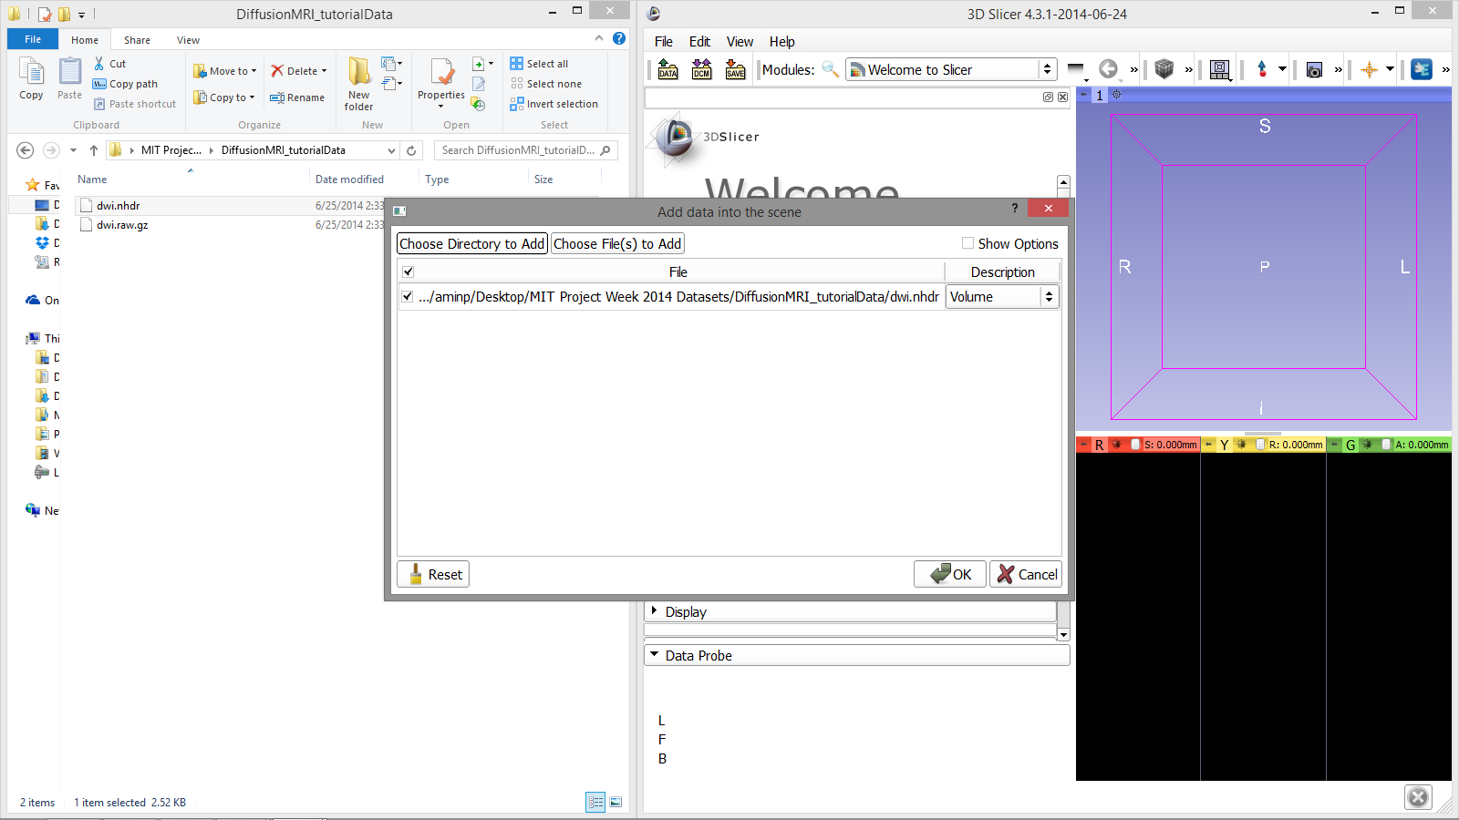
Loading the DWI Dataset
Click OK to load the dataset to Slicer
Diffusion MRI Analysis
Sonia Pujol, Ph.D.
NA-MIC ARR 2012-2014

Slide 22
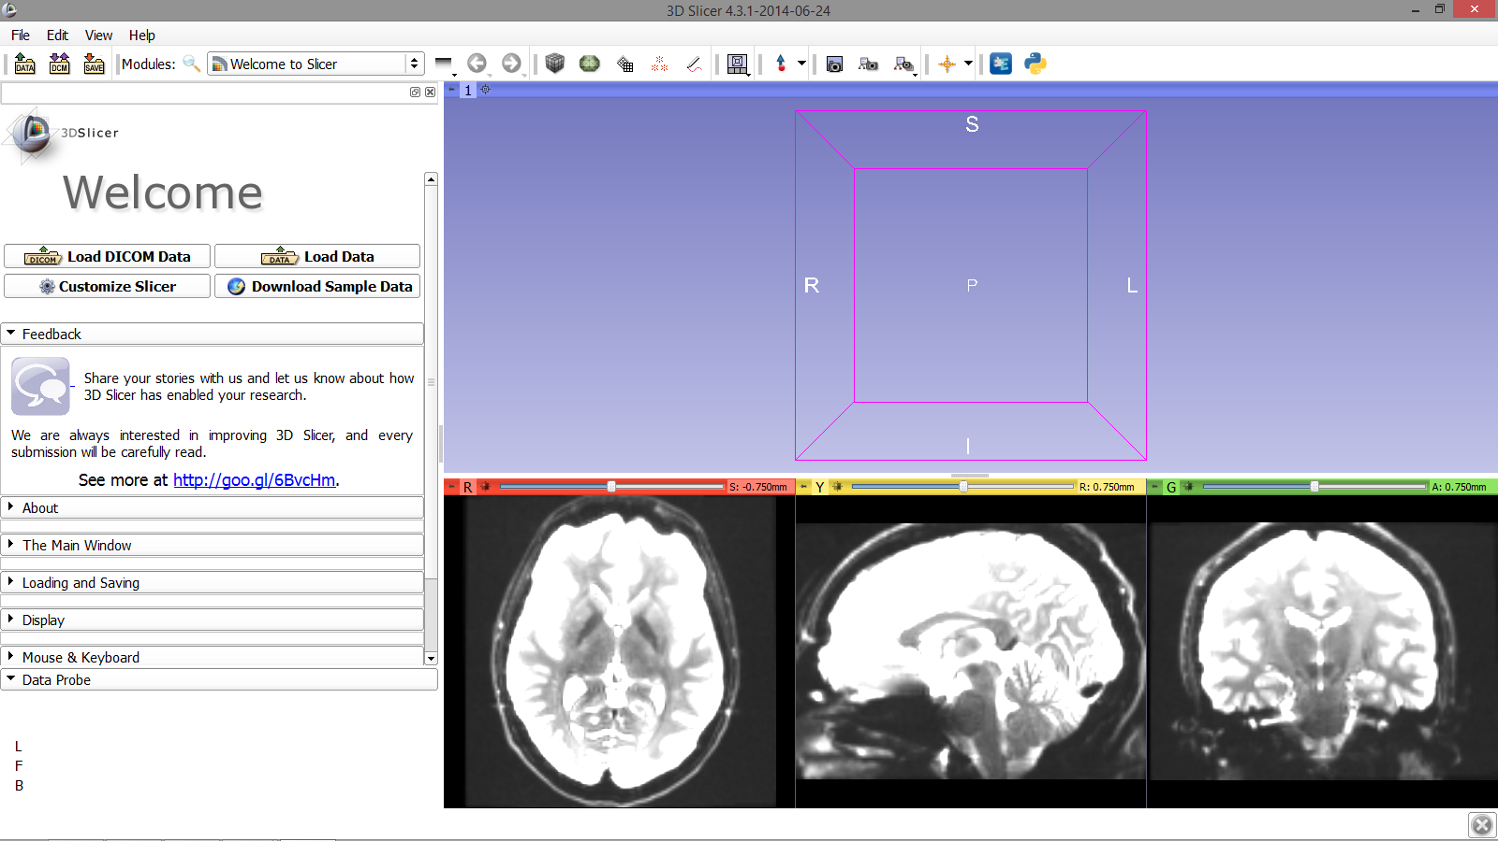
Loading the DWI Dataset
Slicer displays DWI volume of the brain
Diffusion MRI Analysis
Sonia Pujol, Ph.D.
NA-MIC ARR 2012-2014

Slide 23
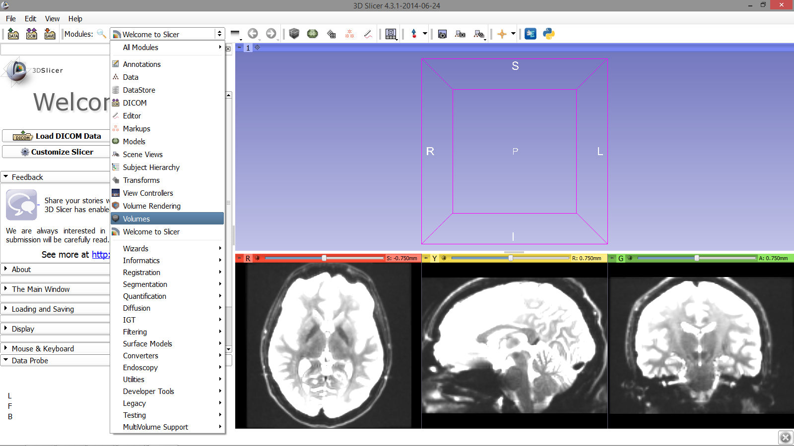
Loading the DWI Dataset
Click on the Modules
menu and select the module Volumes
Diffusion MRI Analysis
Sonia Pujol, Ph.D.
NA-MIC ARR 2012-2014

Slide 24
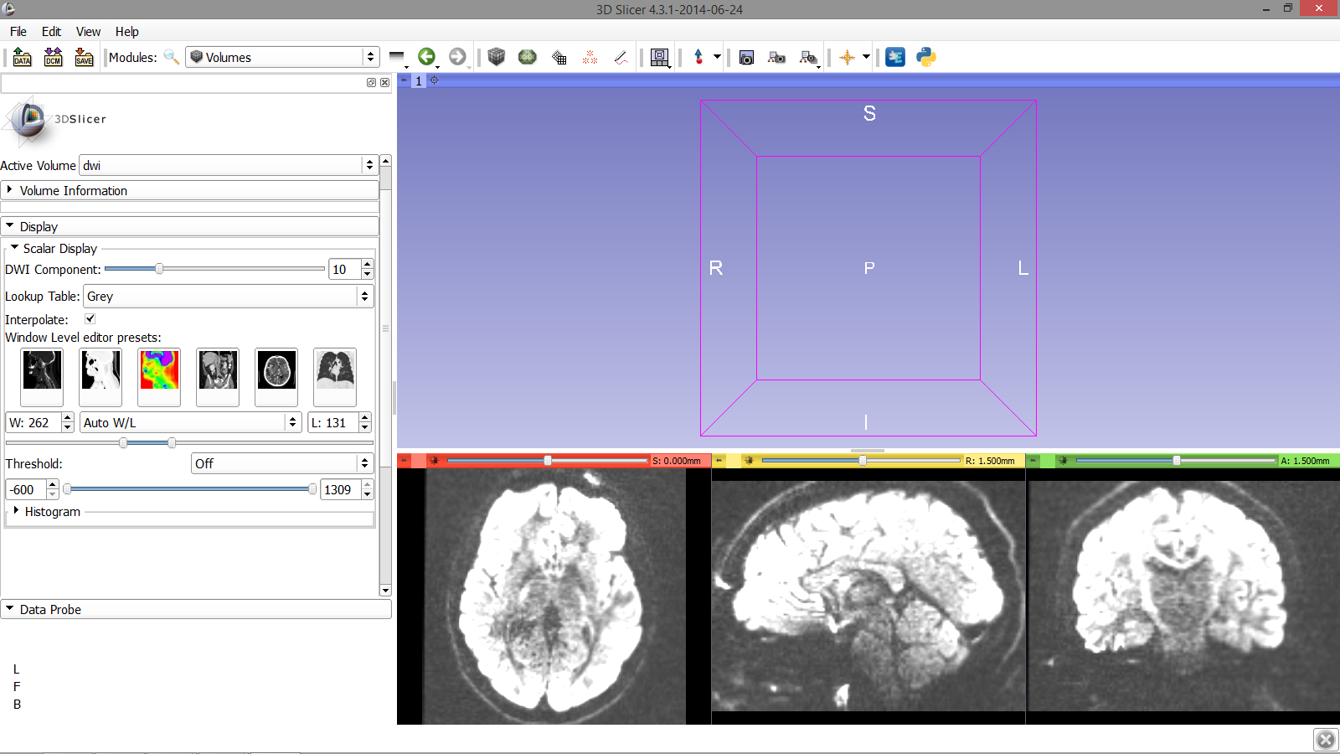
Loading the DWI Dataset
The baseline image
corresponds to the DWI Component #0.
Select the
DWI Component #10, which corresponds to the 10th diffusion sensitizing gradient
Diffusion MRI Analysis
Sonia Pujol, Ph.D.
NA-MIC ARR 2012-2014

Slide 25
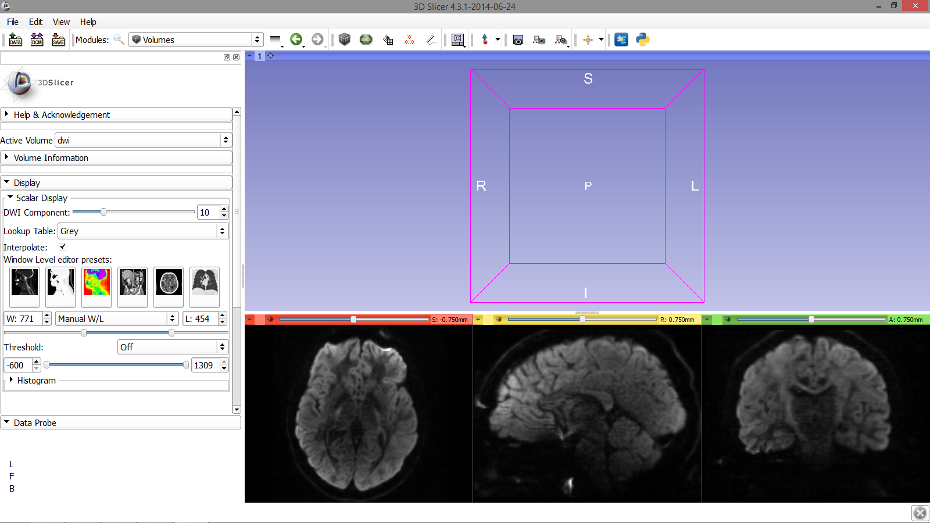
Loading the DWI Dataset
Adjust the Window Level editor pre-sets
with the Volume module menu
I
Diffusion MRI Analysis
Sonia Pujol, Ph.D.
NA-MIC ARR 2012-2014

Slide 26
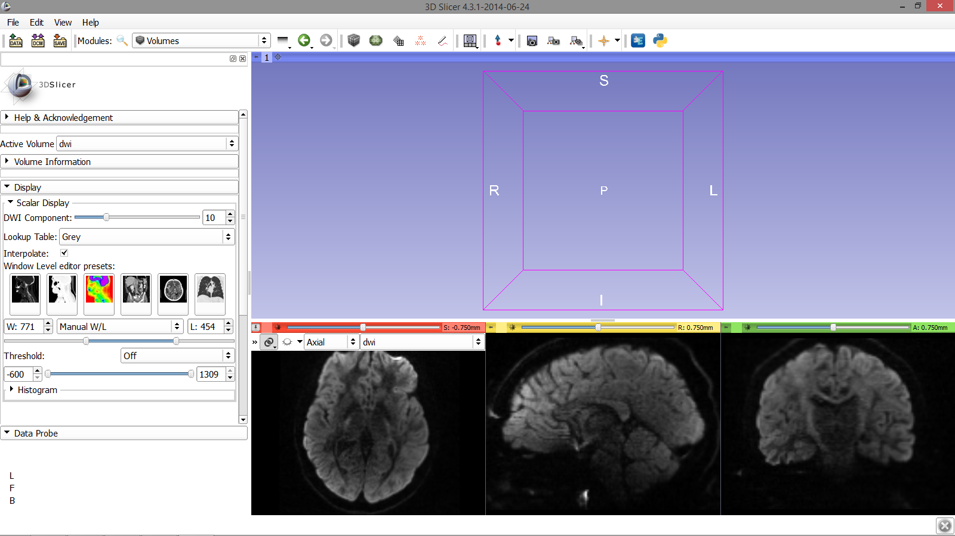
Loading the DWI Dataset
Position your mouse over the pin icon, then click on the link icon and the fit image to window icon
Diffusion MRI Analysis
Sonia Pujol, Ph.D.
NA-MIC ARR 2012-2014

Slide 27
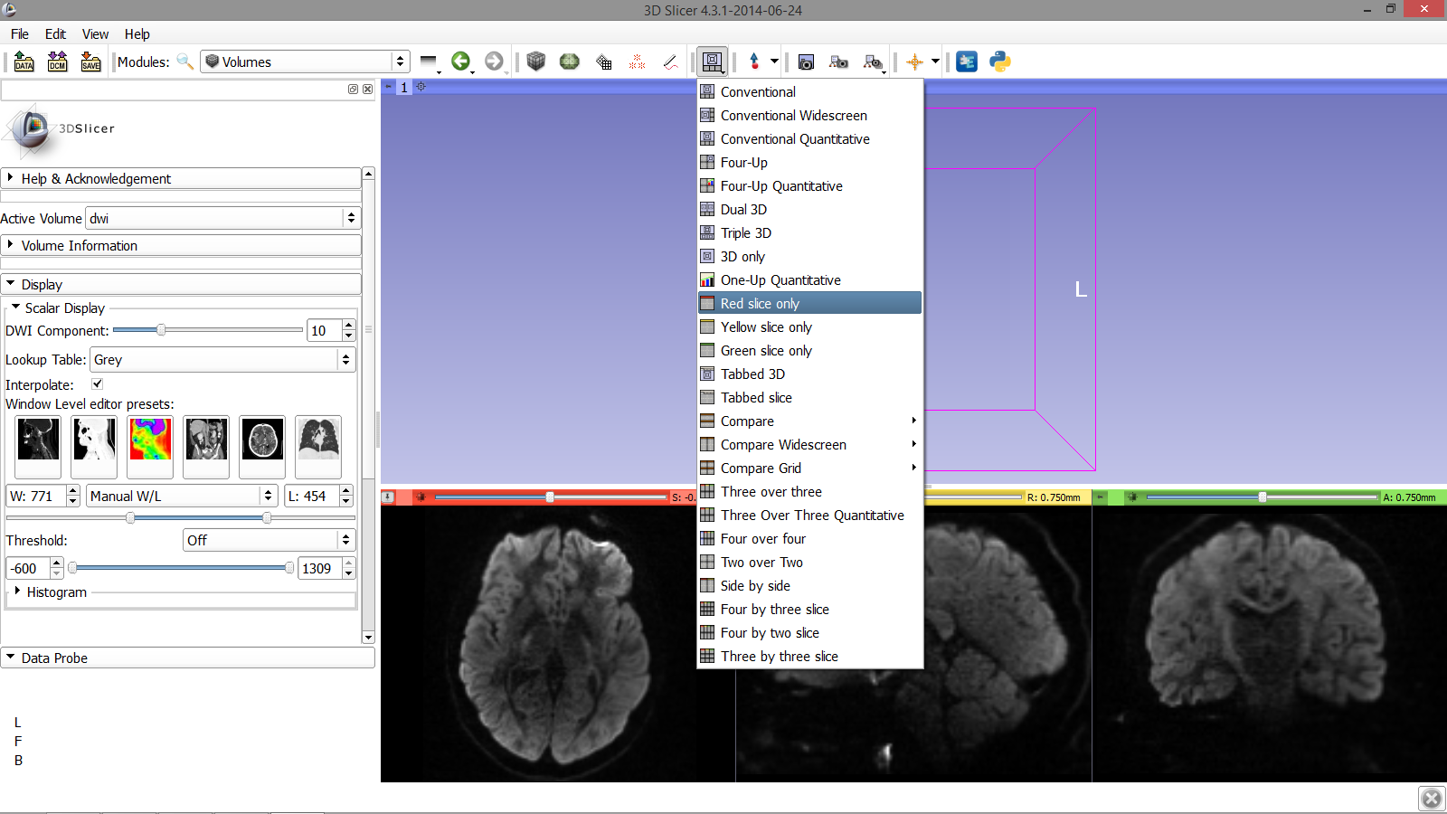
Loading the DWI Dataset
Click on the Slicer layout menu and select the Red slice only layout
Diffusion MRI Analysis
Sonia Pujol, Ph.D.
NA-MIC ARR 2012-2014

Slide 28
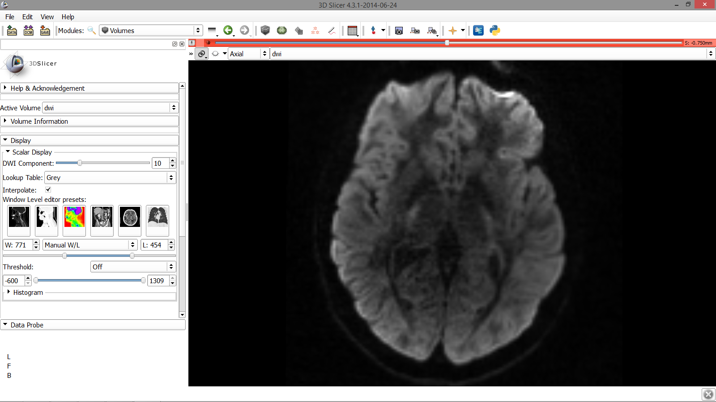
Loading the DWI Dataset
Slicer displays on the Axial anatomical slice in the Viewer
Diffusion MRI Analysis
Sonia Pujol, Ph.D.
NA-MIC ARR 2012-2014

Slide 29
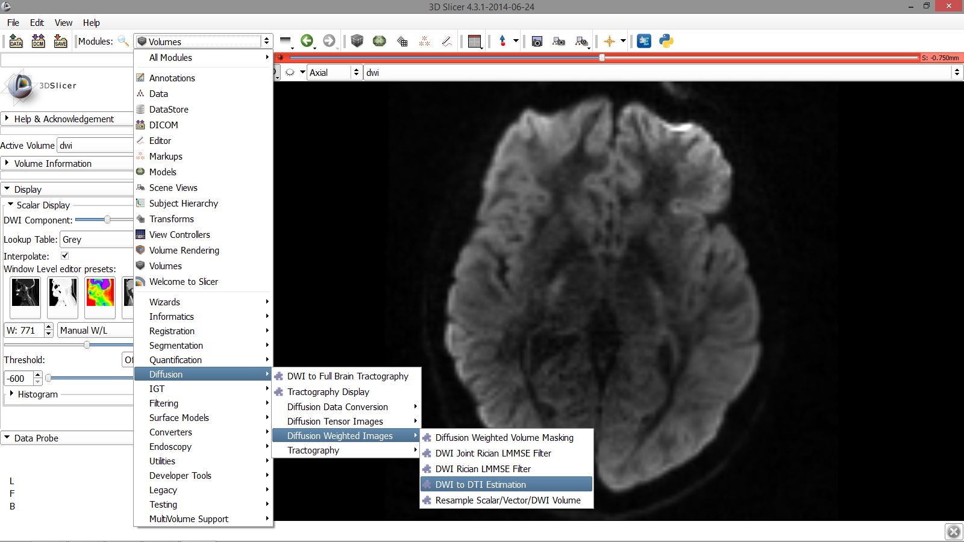
Exploring the DWI Dataset
Click on the Modules menu and select
the module DWI to DTI Estimation
Diffusion MRI Analysis
Sonia Pujol, Ph.D.
NA-MIC ARR 2012-2014

Slide 30
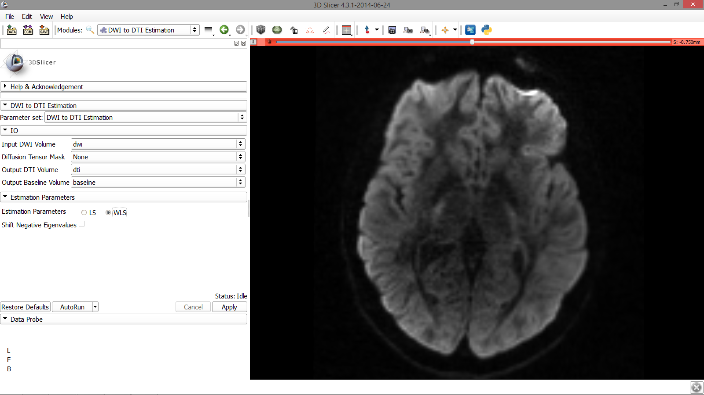
Exploring the DWI Dataset
Select the module DWI to DTI Estimation in the modules menu:
-select the Input DWI volume ‘dwi’
-select Output DTI Volume ‘Create and Rename New Volume’, and rename it ‘dti’
-select Output Baseline Volume
‘Create and Rename new Volume’, and rename it ‘baseline’
-select the Estimation Parameter
‘WLS’ (Weighted Least Squares) and click on Apply.
Diffusion MRI Analysis
Sonia Pujol, Ph.D.
NA-MIC ARR 2012-2014

Slide 31
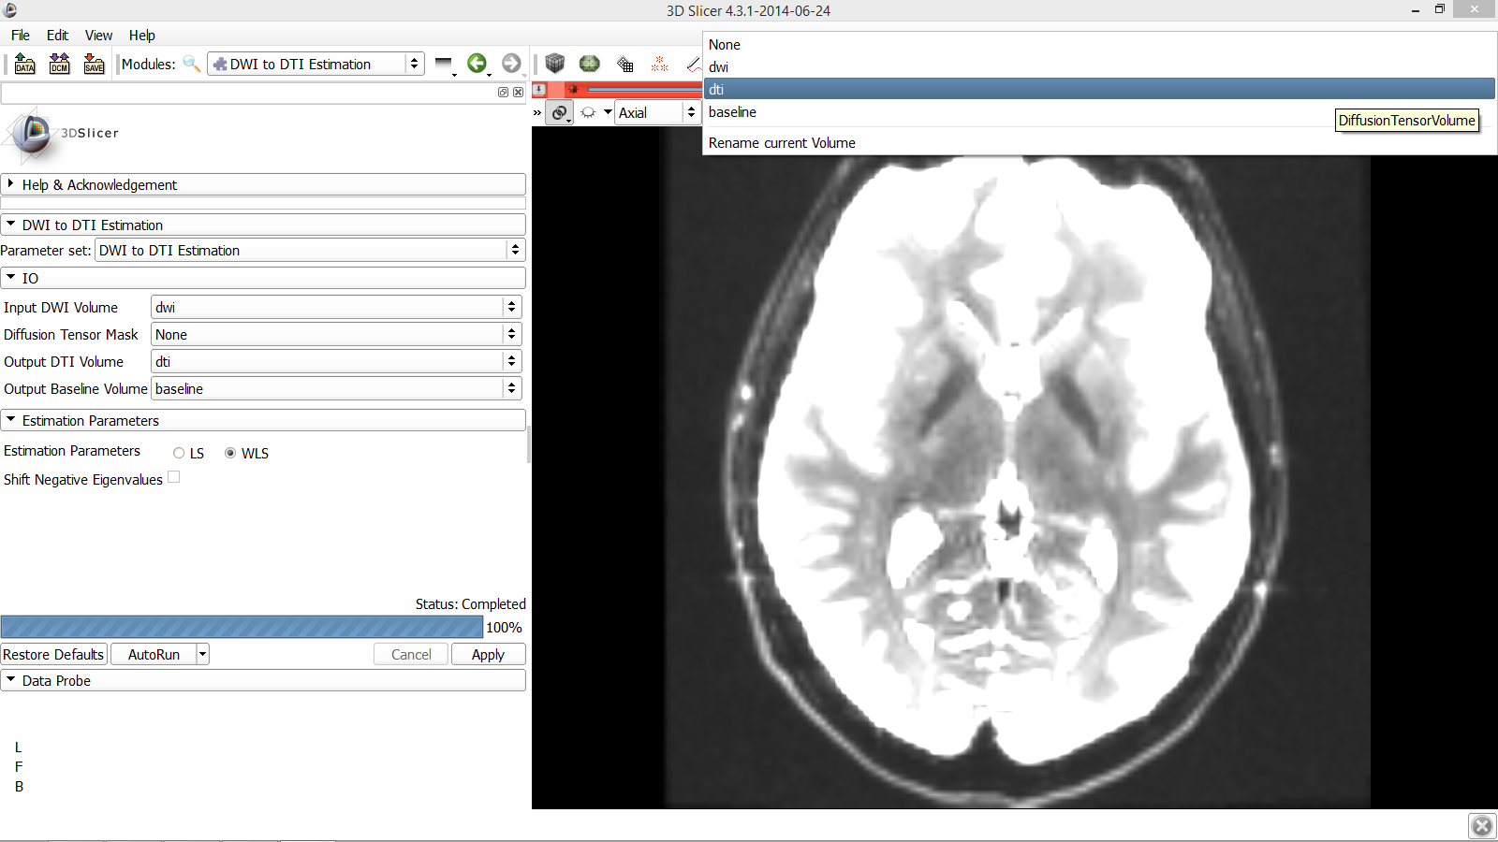
Exploring the DWI Dataset
Position your mouse over the pin icon and select the volume dti
Diffusion MRI Analysis
Sonia Pujol, Ph.D.
NA-MIC ARR 2012-2014

Slide 32
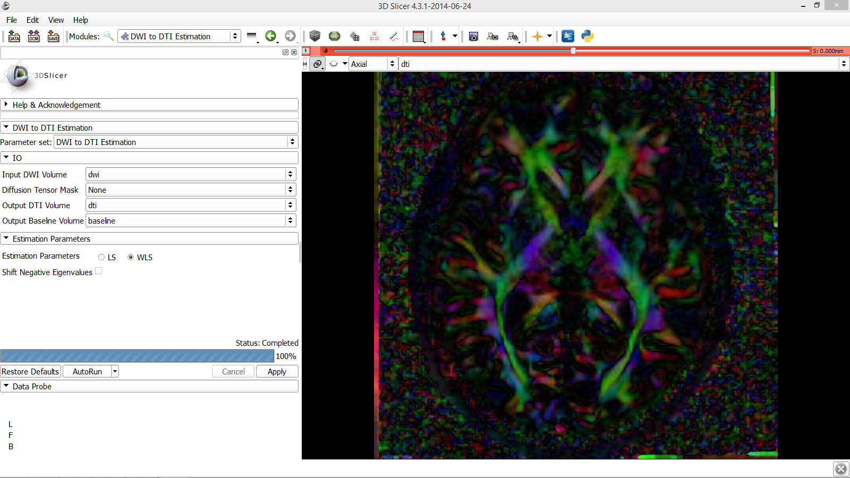
Exploring the DWI Dataset
Slicer displays the DTI volume in color by orientation mode:
Red: right-left
Green: anterior-posterior Blue: inferior-superior
Diffusion MRI Analysis
Sonia Pujol, Ph.D.
NA-MIC ARR 2012-2014

Slide 33
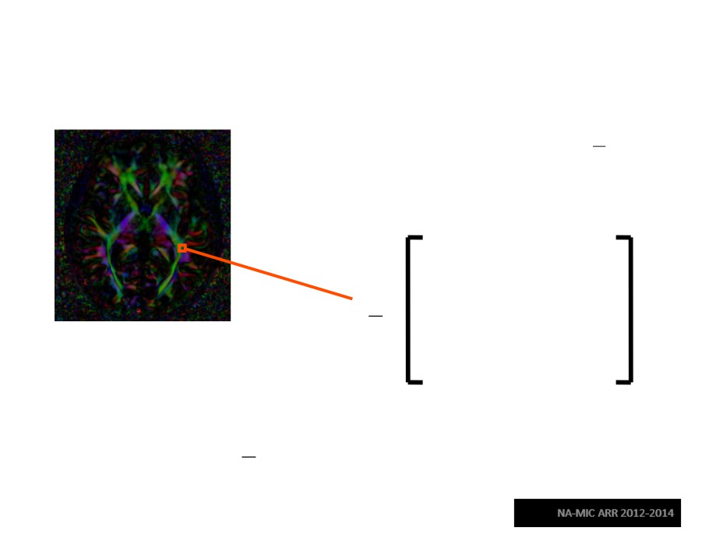
Diffusion Tensor Data
−bĝi Dĝ_{i}
S_{i} = S₀ e
T
Stejskal-Tanner equation (1965)
D
D
D
xx
xy
xz
D=
D
D
D
yx
yy
yz
D
D
D
zx
zy
zz
The diffusion tensor D in the voxel (I,J,K) is a 3x3 symmetric
matrix.
Diffusion MRI Analysis
Sonia Pujol, Ph.D.

Slide 34
Diffusion Tensor
• The diffusion tensor D in the voxel (I,J,K) can be
visualized as an ellipsoid, with the eigenvectors indicating the directions of the principal axes, and the square root of the eigenvalues defining the ellipsoidal radii.
• Scalar maps can be
derived from the
rotationally invariant
eigenvalues λ1, λ2, λ3 to characterize the size and shape of the
diffusion tensor.
Diffusion MRI Analysis
Sonia Pujol, Ph.D.

Slide 35
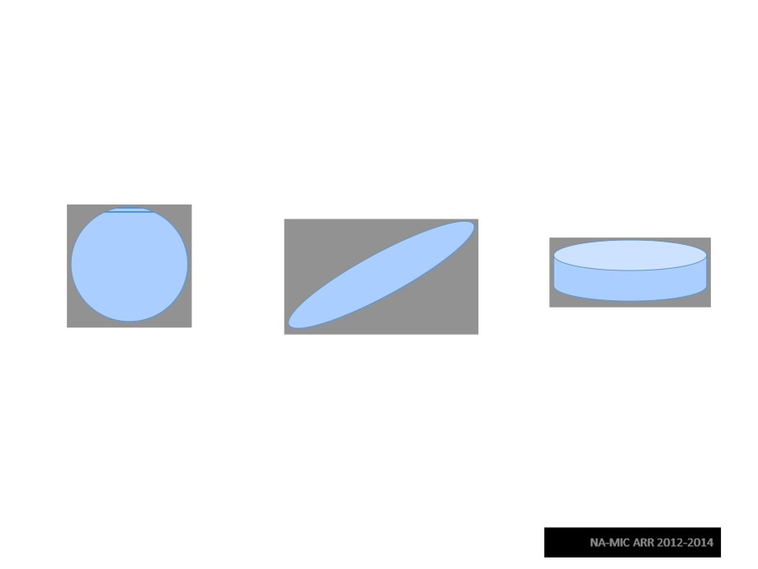
Diffusion Tensor Shape
λ1= λ2= λ3
λ1>> λ2, λ3
λ1~λ2>> λ3
Isotropic media
Anisotropic media
(CSF, gray matter)
(white matter)
Diffusion MRI Analysis
Sonia Pujol, Ph.D.

Slide 36
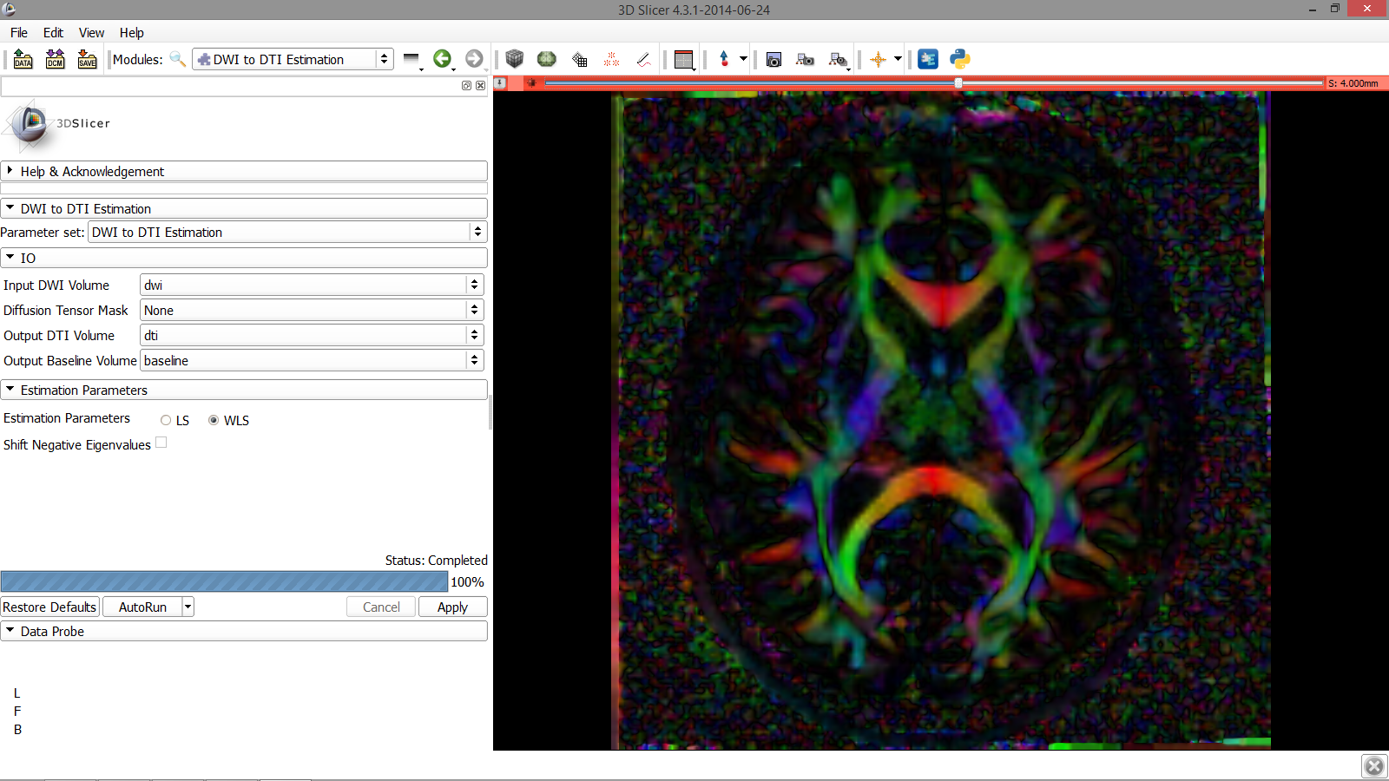
Exploring the DWI Dataset
Use the slider to browse through the dti volume, and try to locate the Corpus Callosum
Diffusion MRI Analysis
Sonia Pujol, Ph.D.
NA-MIC ARR 2012-2014

Slide 37
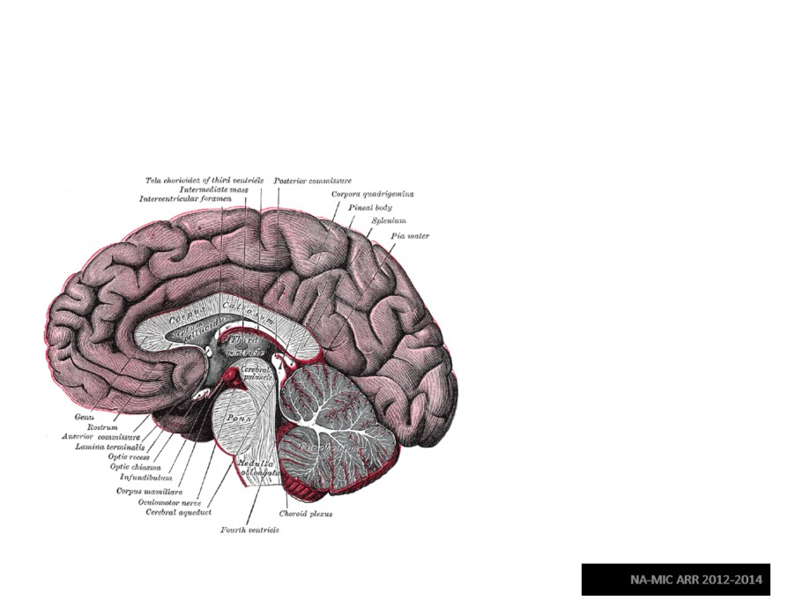
Corpus Callosum
The corpus callosum
is a broad thick bundle of dense myelinated fibers that connect the left and right
hemisphere. It is the largest white matter structure in the brain
Image from Gray’s Anatomy
Diffusion MRI Analysis
Sonia Pujol, Ph.D.

Slide 38
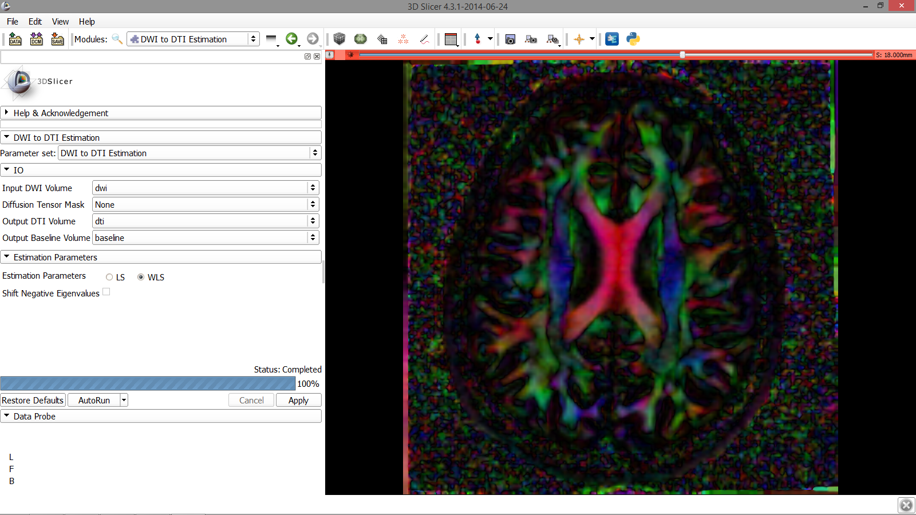
Corpus Callosum
Corpus Callosum
Diffusion MRI Analysis
Sonia Pujol, Ph.D.
NA-MIC ARR 2012-2014

Slide 39
Characterizing the Size of the tensor: Trace
Trace(D) = λ1+ λ2+λ3
•Trace(D) is intrinsic to the tissue and is independent of fiber orientation, and diffusion sensitizing gradient directions
•Trace(D) is a clinically relevant parameter for monitoring stroke and neurological condition ( degree of structural coherence in tissue)
•Trace(D) is useful to characterize the size of the diffusion ellipsoid
Diffusion MRI Analysis
Sonia Pujol, Ph.D.

Slide 40
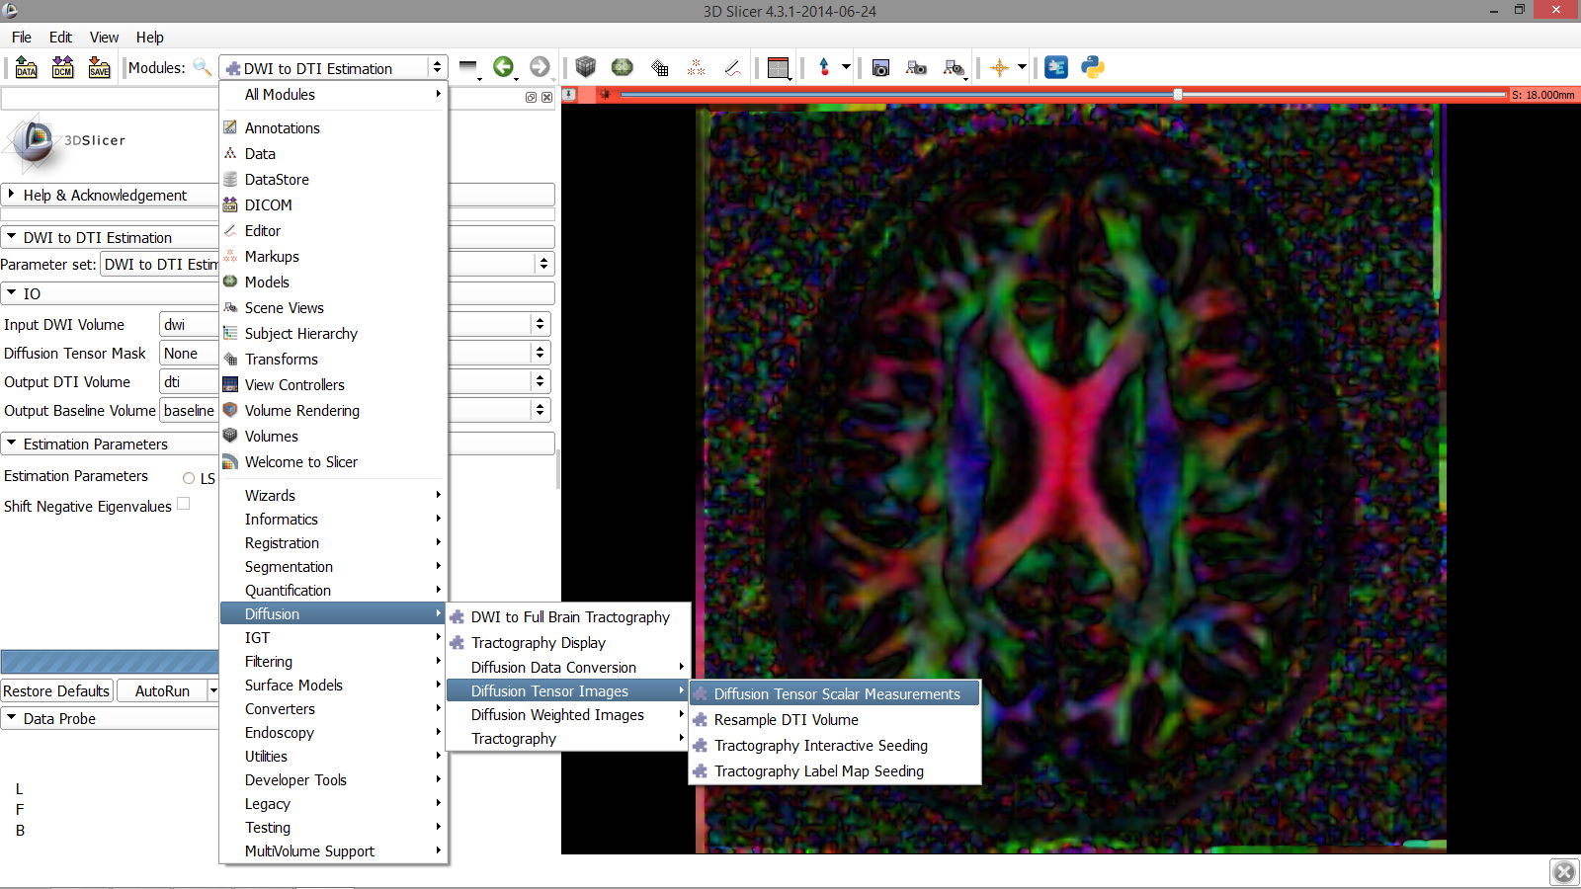
Trace
Click on the Modules menu and select the module Diffusion Tensor Scalar Measurements
Diffusion MRI Analysis
Sonia Pujol, Ph.D.
NA-MIC ARR 2012-2014

Slide 41
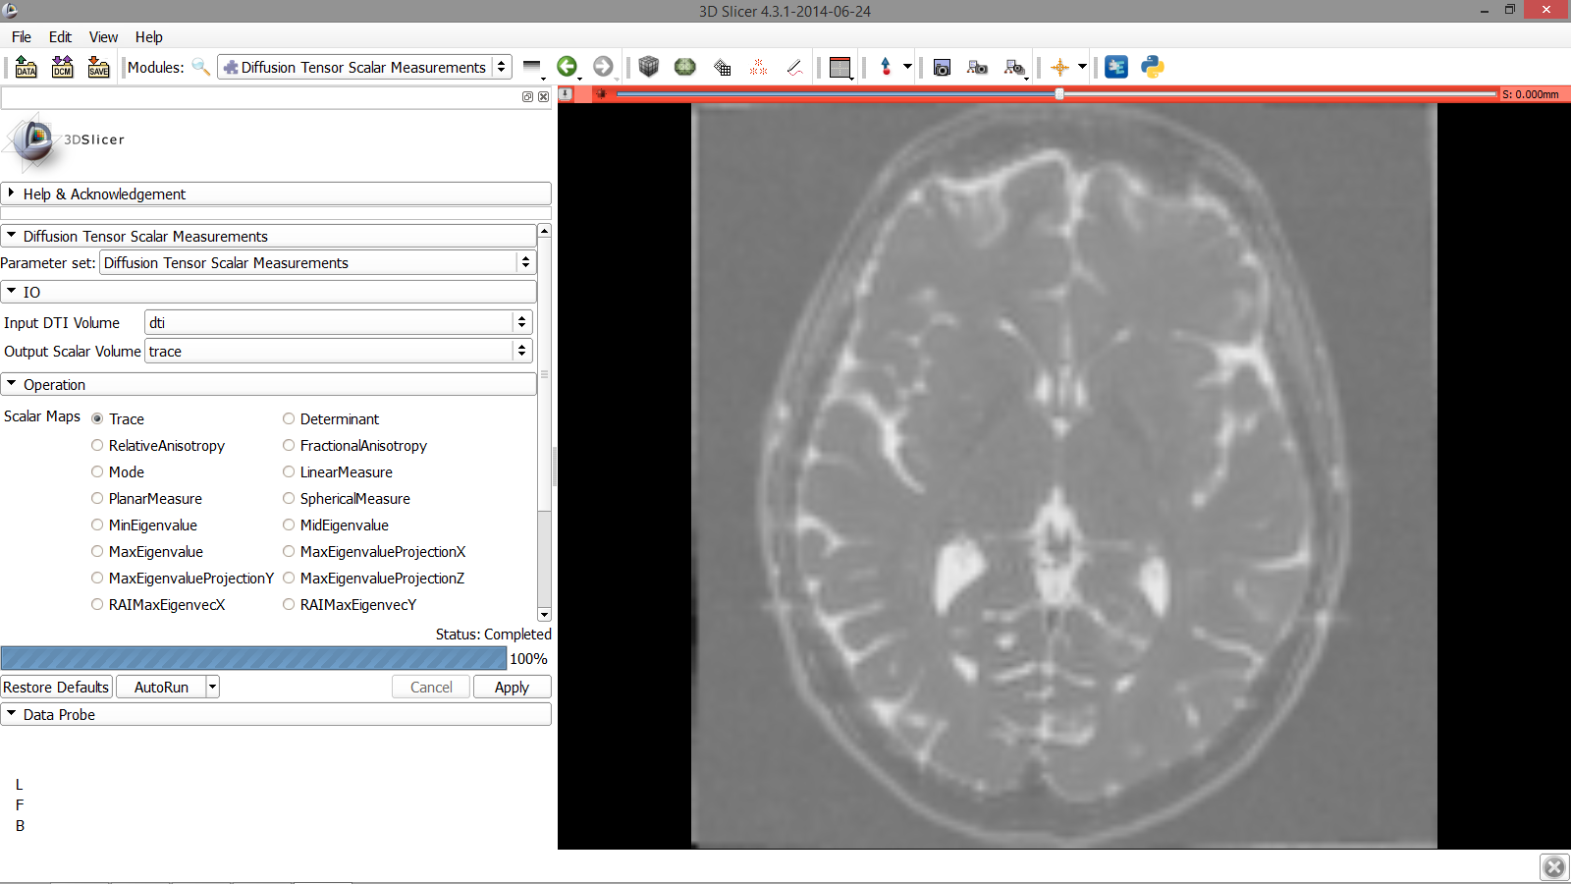
Trace
Type in the following information in the IO menu:
-set Input DTI Volume to ‘dti’
-select Output Scalar Volume
‘Create and Rename new Volume’ and rename it ‘trace’
-select the Operation ‘Trace’
-click on Apply to calculate the trace map of the tensor volume
Diffusion MRI Analysis
Sonia Pujol, Ph.D.
NA-MIC ARR 2012-2014

Slide 42
Trace
The trace image appears in the red slice viewer
Diffusion MRI Analysis
Sonia Pujol, Ph.D.
NA-MIC ARR 2012-2014

Slide 43
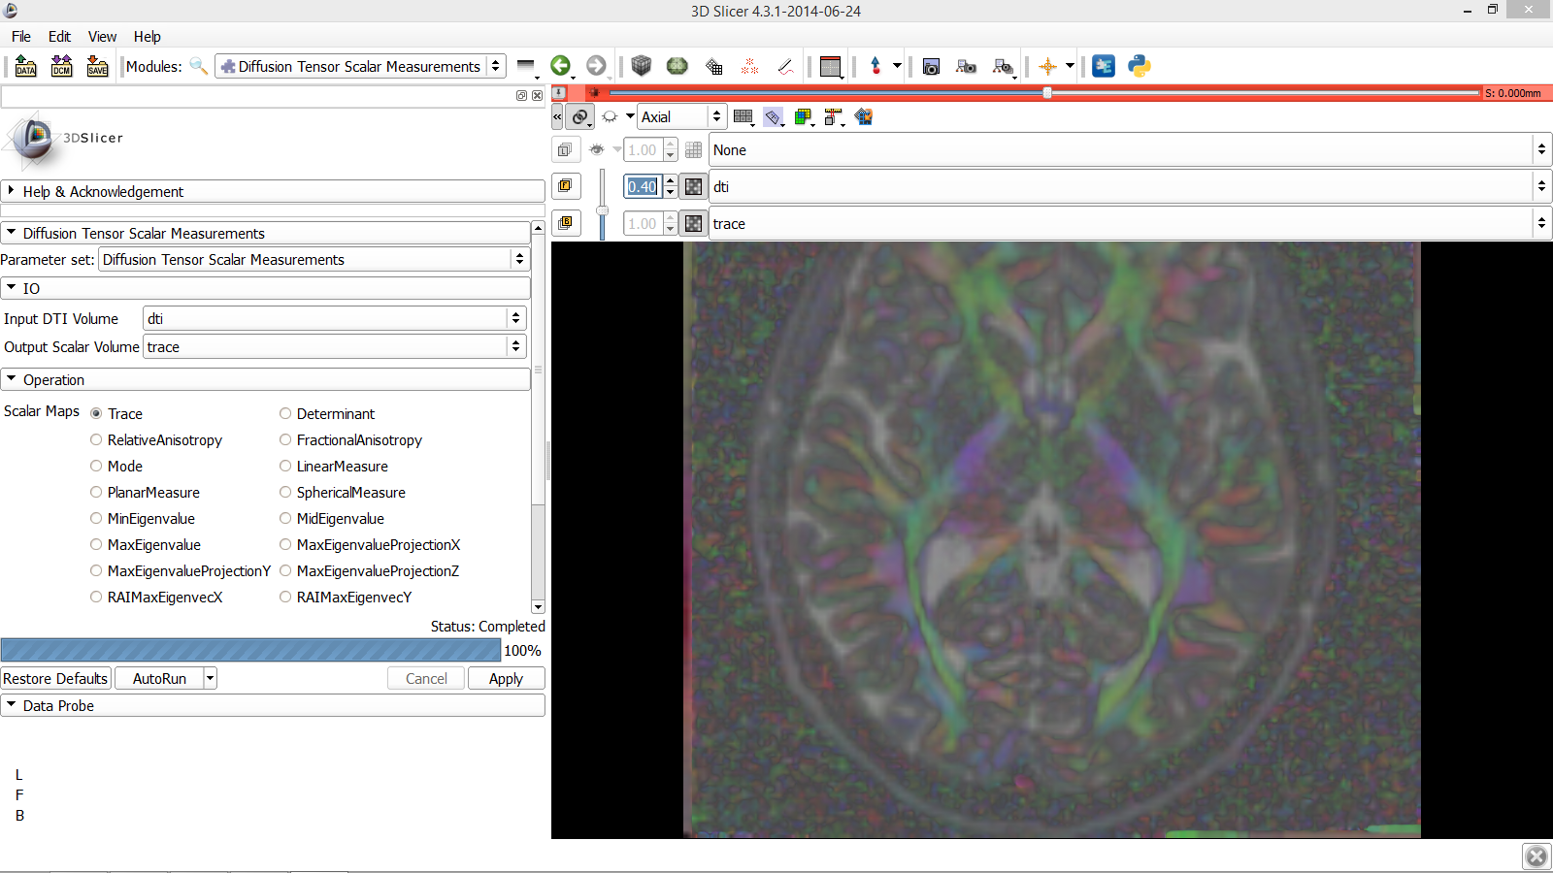
Trace
Position your mouse over the pin icon and then select the ‘>>’ icon to display this table and fill in the following information:
-Select the volume ‘dti’ in the Foreground viewer
-Select the volume ‘trace’ in the Background viewer
-Set the opacity of the dti volume to 0.40
Diffusion MRI Analysis
Sonia Pujol, Ph.D.
NA-MIC ARR 2012-2014

Slide 44
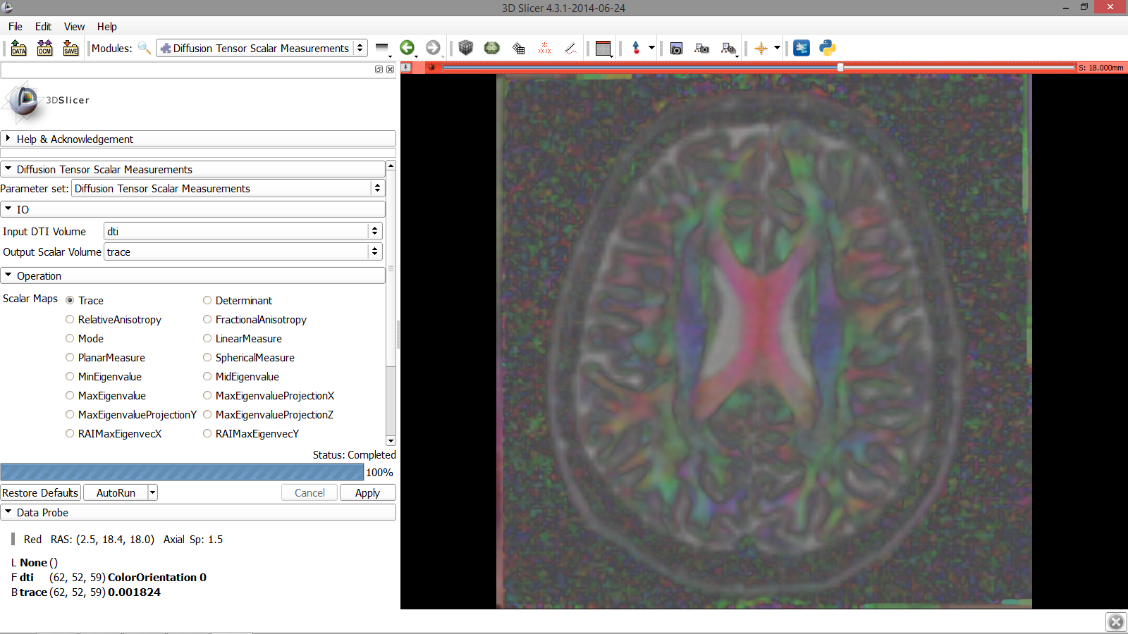
Trace
Position your mouse within the region of the Corpus Callosum and observe the trace values in the Data Probe
Diffusion MRI Analysis
Sonia Pujol, Ph.D.
NA-MIC ARR 2012-2014

Slide 45
Trace
Note how the Trace values are
fairly uniform in both white and gray matter, even if the tissues are different in structure
Diffusion MRI Analysis
Sonia Pujol, Ph.D.
NA-MIC ARR 2012-2014

Slide 46
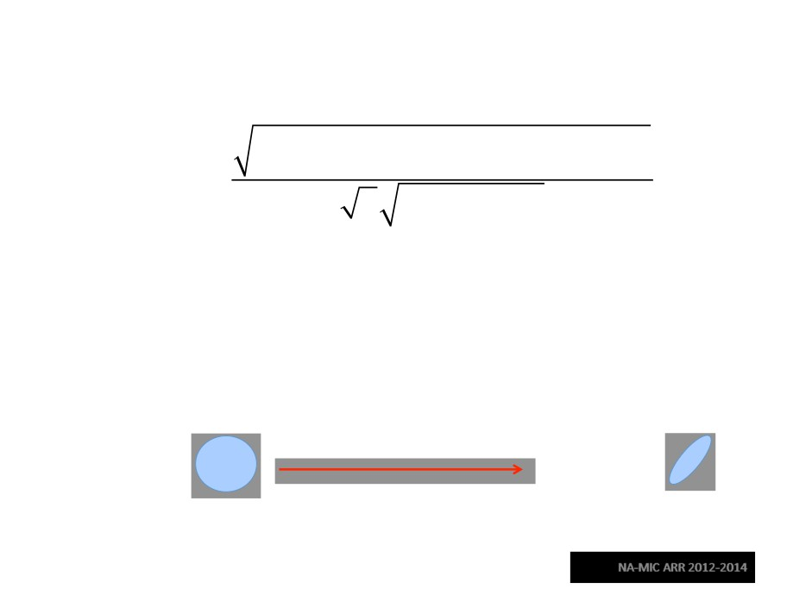
Scalar Maps: Fractional Anisotropy
2
2
2
(
)
+(λ
λ1 −λ2
) +(λ2 −λ3)
1 − λ3
FA(D) =
2
2
2
2
λ +λ3
1+λ2
•FA(D) is intrinsic to the tissue and is independent of fiber orientation, and diffusion sensitizing gradient directions
•FA(D) is useful to characterize the shape (degree of ‘out-of-roundness’) of the diffusion ellipsoid’
•Low FA:
High FA:
Diffusion MRI Analysis
Sonia Pujol, Ph.D.

Slide 47
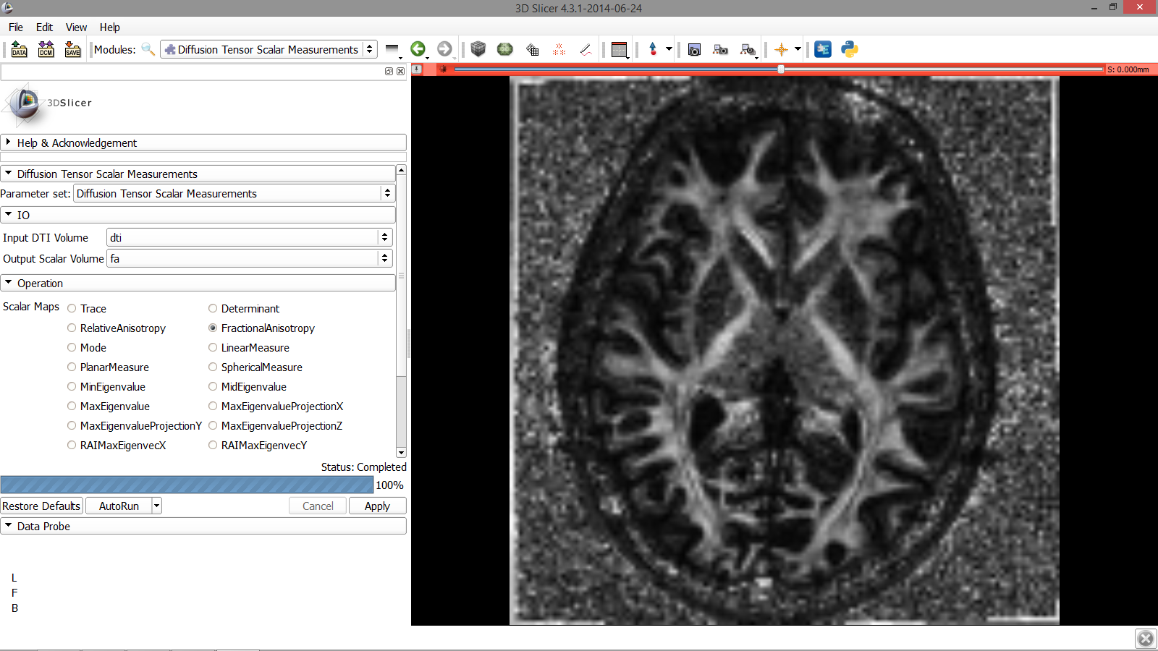
Fractional Anisotropy
Fill in the following information:
-Set Input DTI Volume to ‘dti’
-Select Output Scalar Volume ‘Create new Volume and rename it ‘fa’
-Select the Operation ‘FractionalAnisotropy
-Click on Apply to calculate the Fractional Anisotropy map of the tensor volume
Diffusion MRI Analysis
Sonia Pujol, Ph.D.
NA-MIC ARR 2012-2014

Slide 48
Fractional Anisotropy
The FA image appears in the red slicer viewer
Diffusion MRI Analysis
Sonia Pujol, Ph.D.
NA-MIC ARR 2012-2014

Slide 49
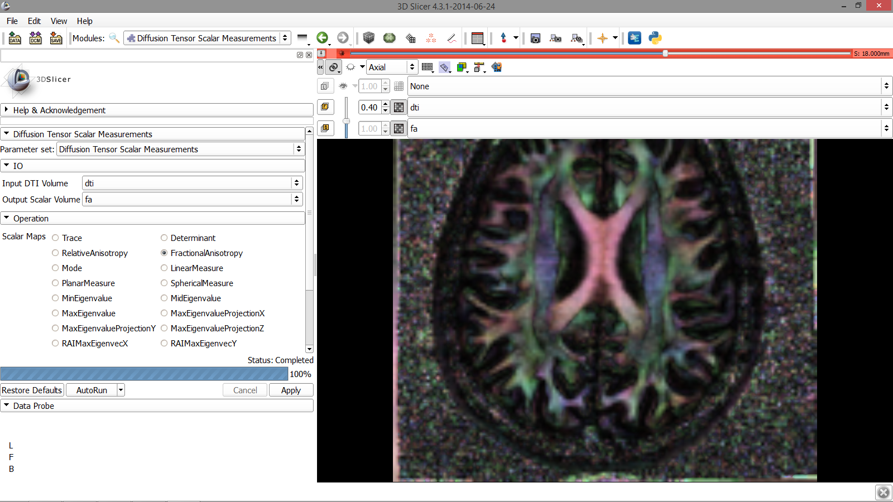
Fractional Anisotropy
Position your mouse over
the pin icon and click the ‘>>’ icon to display this table. Set the background volume to ‘fa’ and be sure the foreground volume is still set to ‘dti’ with Opacity at .40
Diffusion MRI Analysis
Sonia Pujol, Ph.D.
NA-MIC ARR 2012-2014

Slide 50
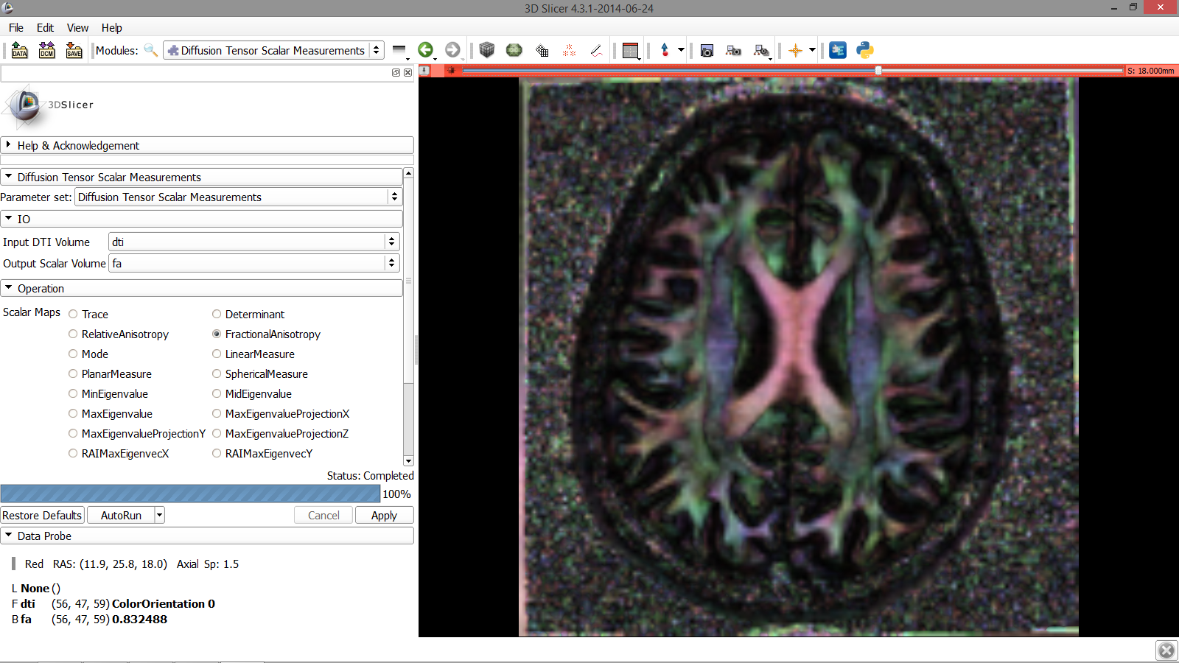
Fractional Anisotropy
Explore the FA values in the Corpus Callosum and in adjacent gray matter areas. Note how the FA values are high in the white matter areas, and low in gray matter regions
Diffusion MRI Analysis
Sonia Pujol, Ph.D.
NA-MIC ARR 2012-2014

Slide 51
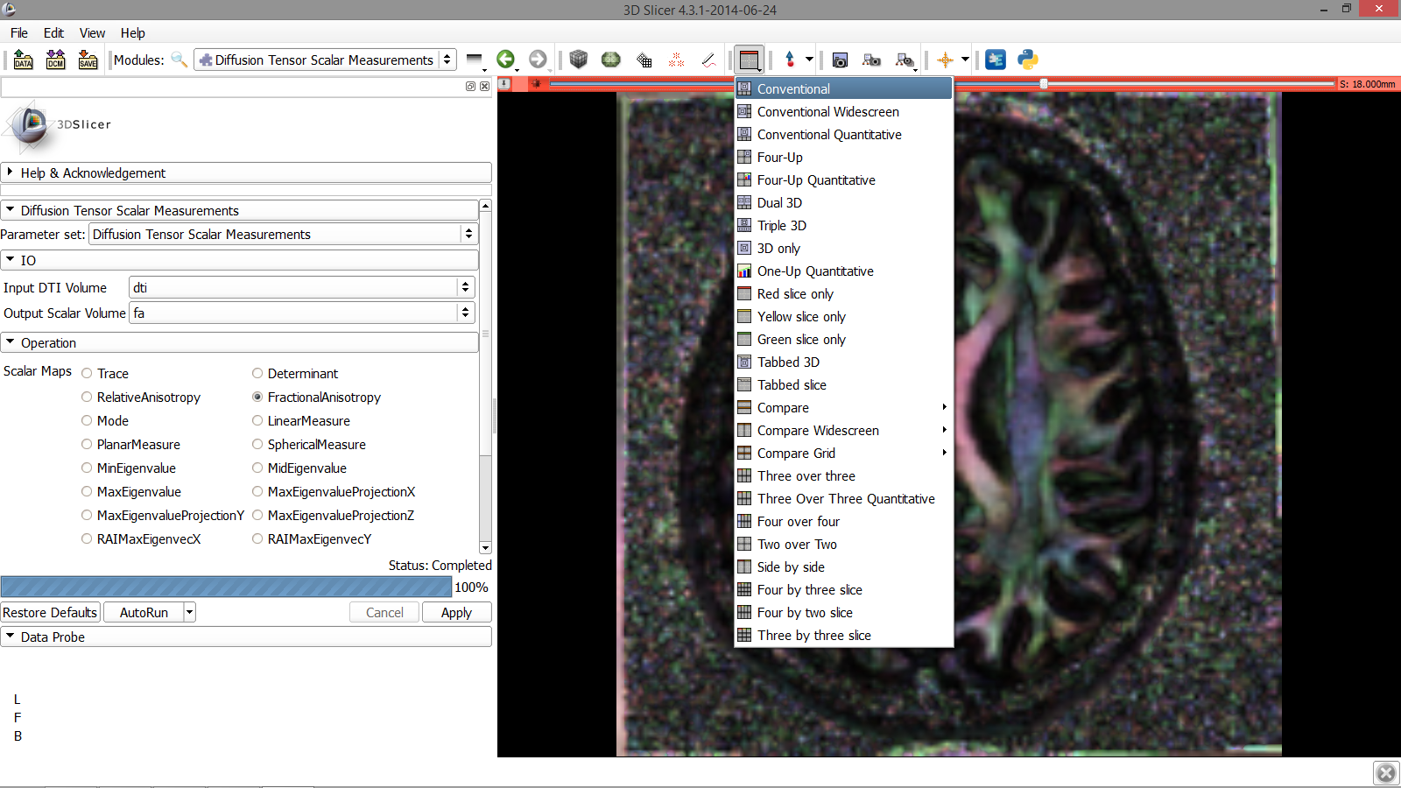
Fractional Anisotropy
Click on the Slicer layout menu and select Conventional layout
Diffusion MRI Analysis
Sonia Pujol, Ph.D.
NA-MIC ARR 2012-2014

Slide 52
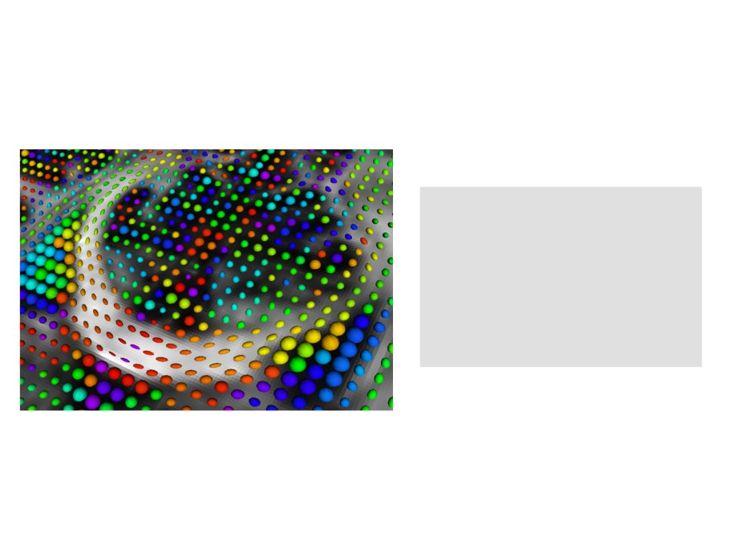
Part 2:
Visualizing the tensor data
Diffusion MRI Analysis
Sonia Pujol, Ph.D.
NA-MIC ARR 2012-2014

Slide 53
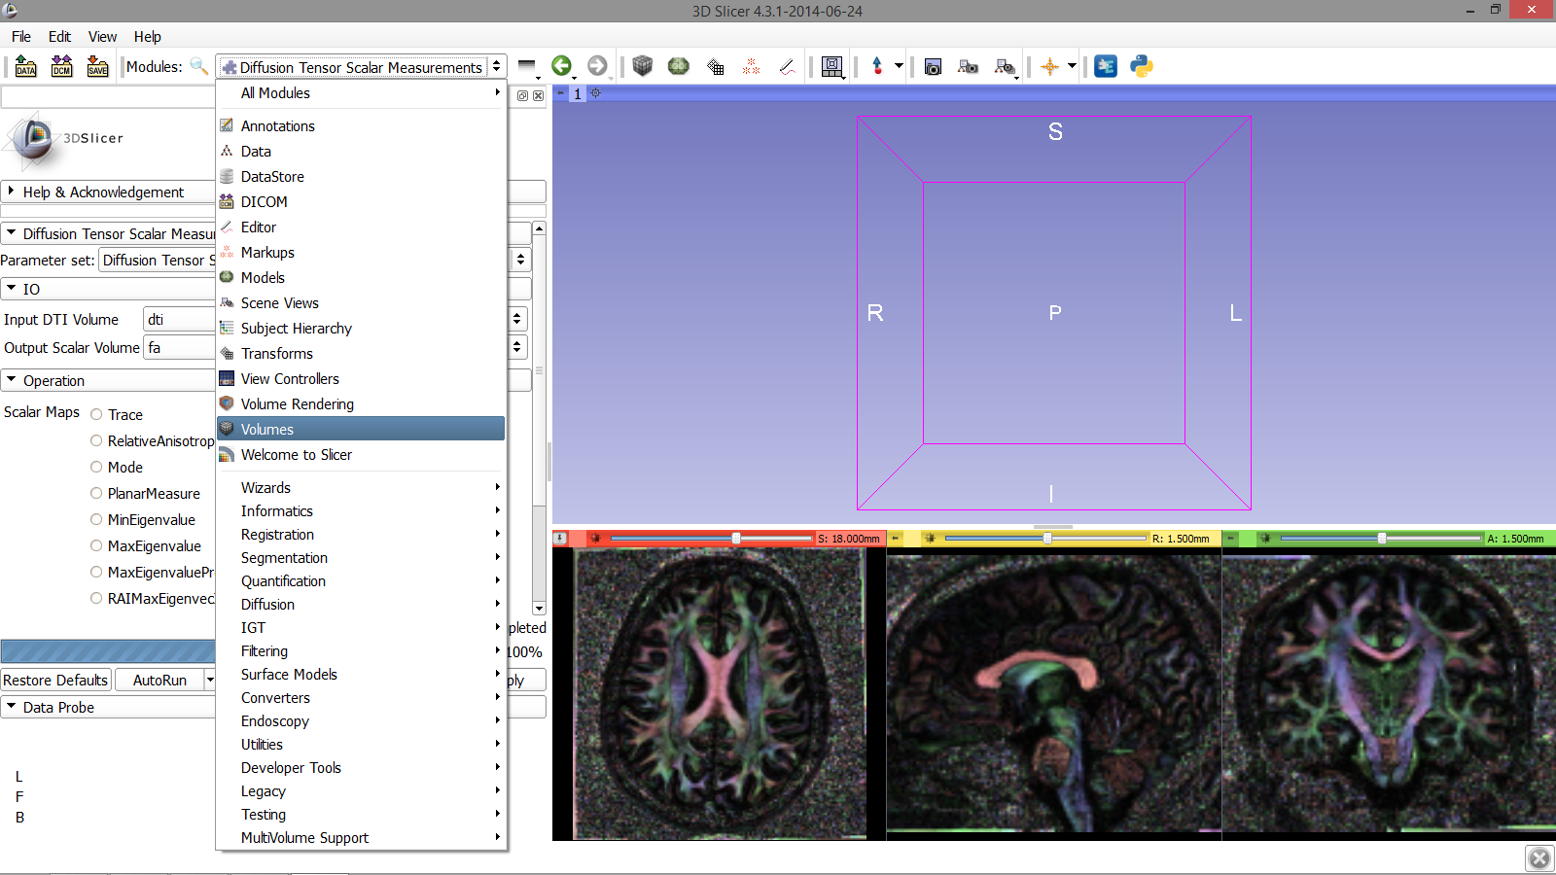
3D Visualization: Glyphs
Click on the Modules menu and select the module Volumes
Diffusion MRI Analysis
Sonia Pujol, Ph.D.
NA-MIC ARR 2012-2014

Slide 54
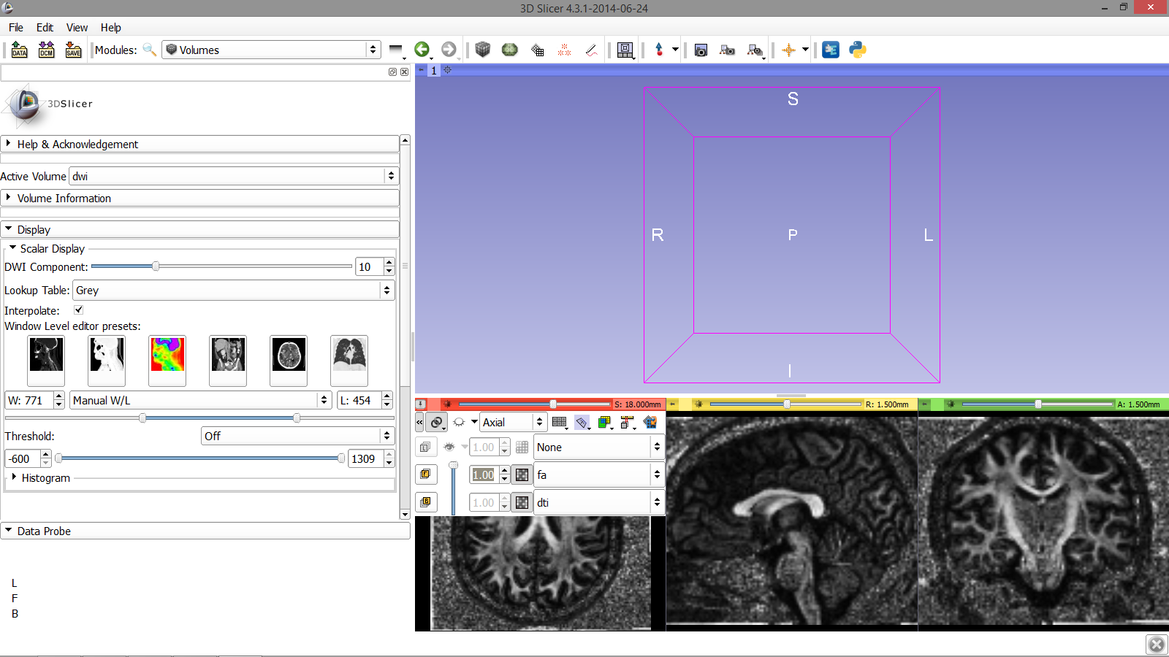
3D Visualization: Glyphs
Position the mouse over the pin icon and select the ‘<<’ icon to display the axial slice toolbar. Set the Foreground to ‘fa’ and the Background to ‘dti’, with the Foreground opacity set to 1.00
Diffusion MRI Analysis
Sonia Pujol, Ph.D.
NA-MIC ARR 2012-2014

Slide 55
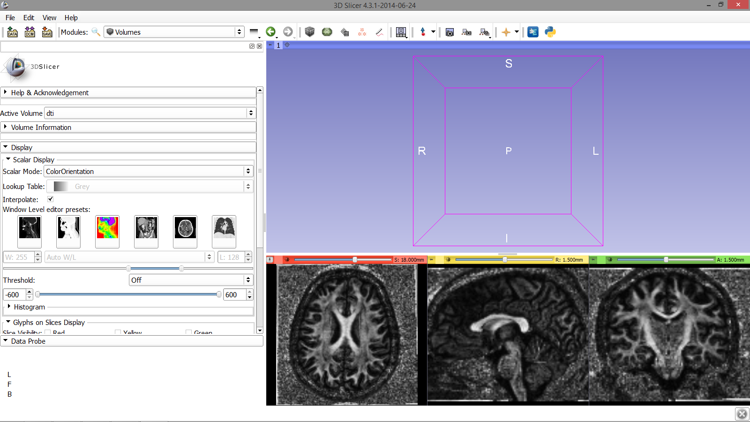
3D Visualization: Glyphs
Set the Active Volume to ‘dti’
and the Scalar Mode to ‘ColorOrientation’
Diffusion MRI Analysis
Sonia Pujol, Ph.D.
NA-MIC ARR 2012-2014

Slide 56
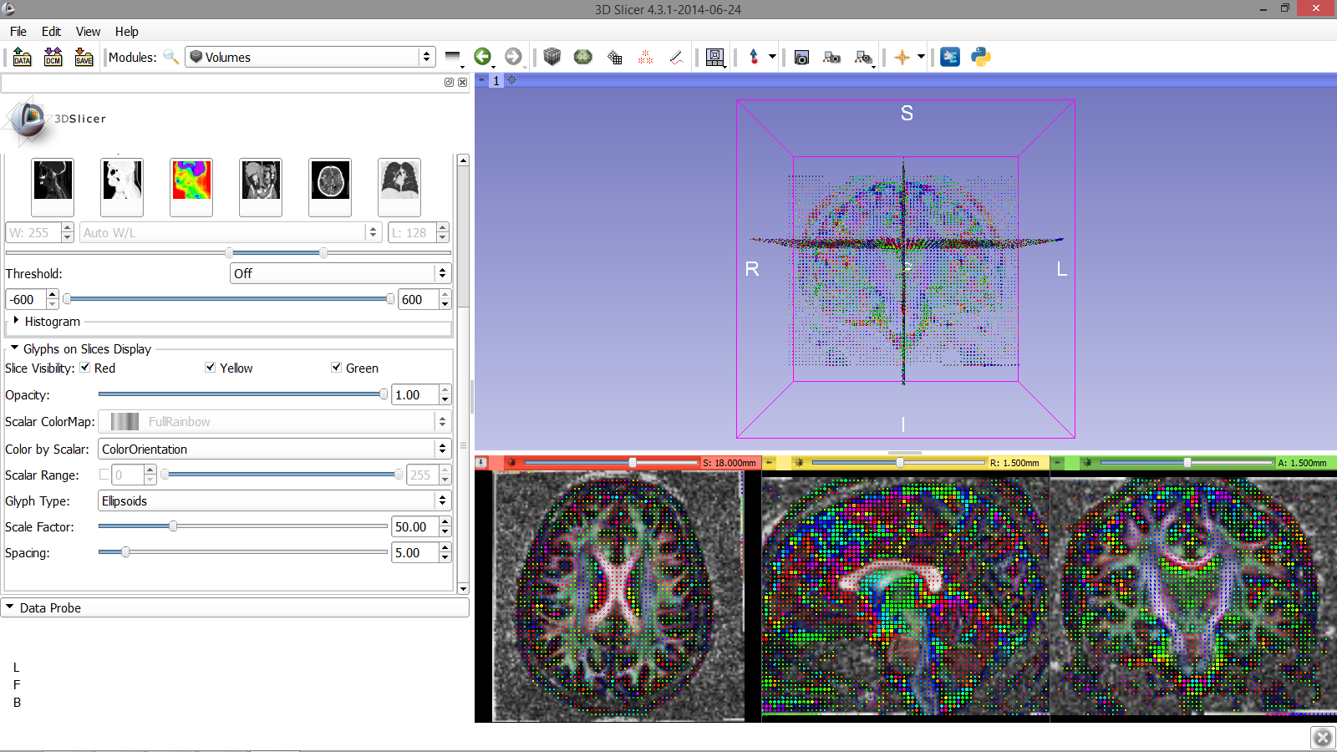
3D Visualization: Glyphs
Scroll down the module panel and:
-Check off the option for Red, Yellow, and Green Slice Visibility
-Set the Color by Scalar parameter to ‘ColorOrientation’
-Set the Glyph Type to ‘Ellipsoids’
Diffusion MRI Analysis
Sonia Pujol, Ph.D.
NA-MIC ARR 2012-2014

Slide 57
3D Visualization: Glyphs
The glyphs appear in all 3 slice viewers
Diffusion MRI Analysis
Sonia Pujol, Ph.D.
NA-MIC ARR 2012-2014

Slide 58
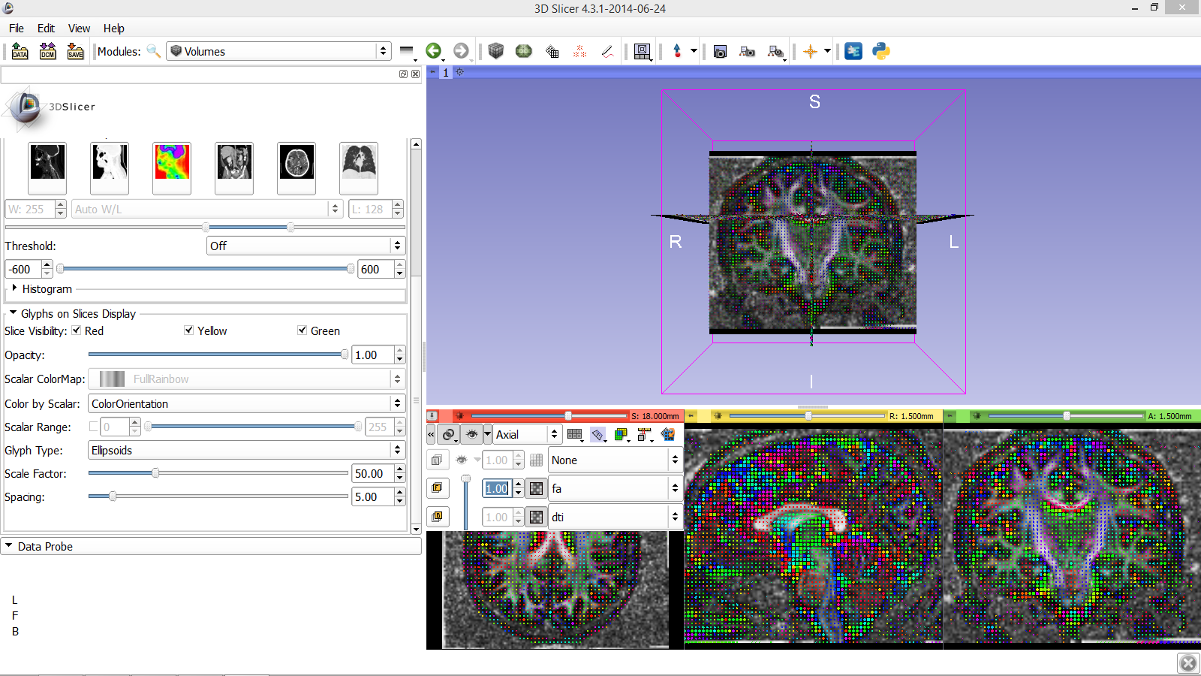
3D Visualization: Glyphs
Position your mouse over the
pin icon select the eye icon to display the axial, coronal, and sagittal slices in the 3D viewer
Diffusion MRI Analysis
Sonia Pujol, Ph.D.
NA-MIC ARR 2012-2014

Slide 59
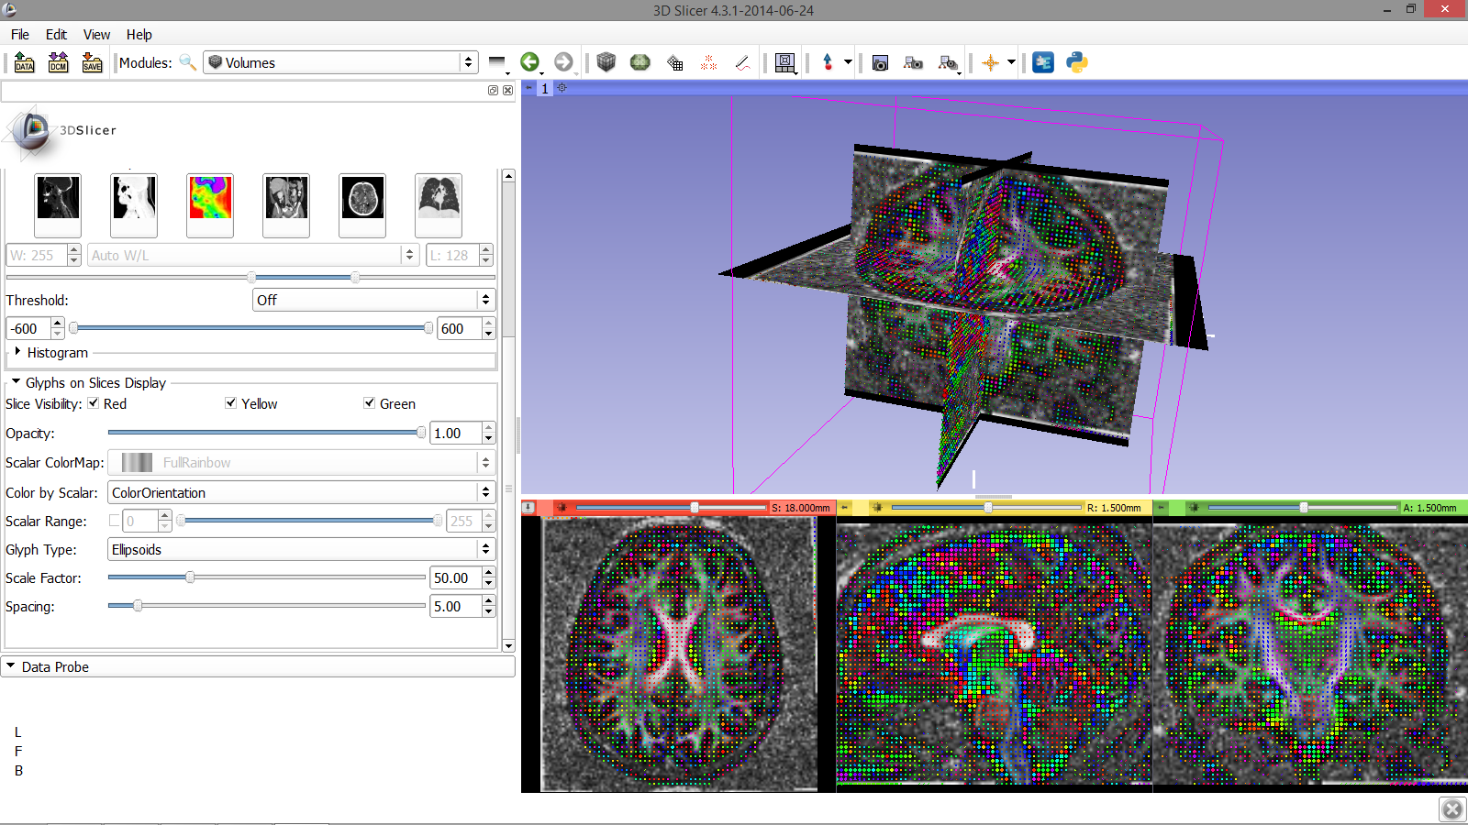
3D Visualization: Glyphs
Slicer displays the anatomical slices in the 3D viewer
Diffusion MRI Analysis
Sonia Pujol, Ph.D.
NA-MIC ARR 2012-2014

Slide 60
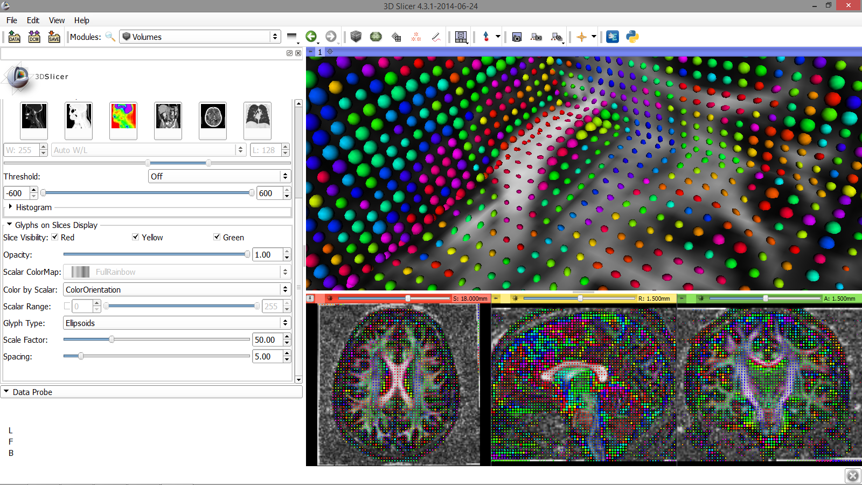
3D Visualization: Glyphs
Zoom in to observe the glyphs. The ellipsoids represent the principal direction of diffusion (main eigenvector)
Diffusion MRI Analysis
Sonia Pujol, Ph.D.
NA-MIC ARR 2012-2014

Slide 61
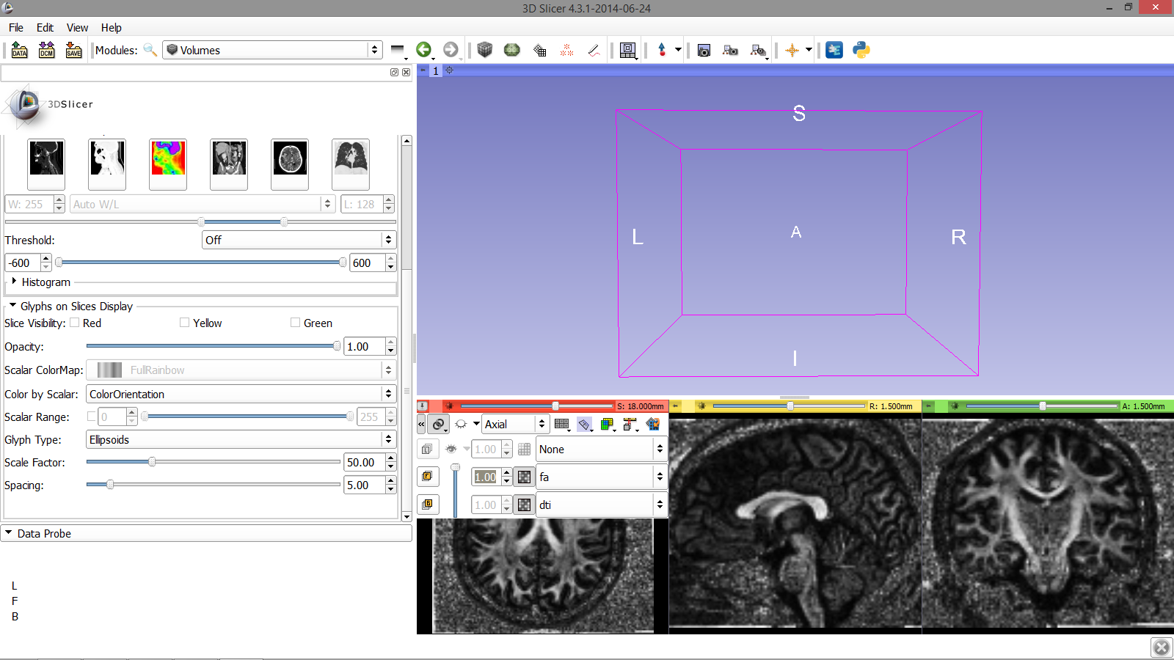
Diffusion MRI tractography
Deselect the option for Red,
Yellow, and Green Slice Visibility, and deselect the eye icon
Diffusion MRI Analysis
Sonia Pujol, Ph.D.
NA-MIC ARR 2012-2014

Slide 62
Diffusion MRI tractography
Position your mouse over the pin icon and change the Foreground to ‘None’ and the background to ‘fa’
Diffusion MRI Analysis
Sonia Pujol, Ph.D.
NA-MIC ARR 2012-2014

Slide 63
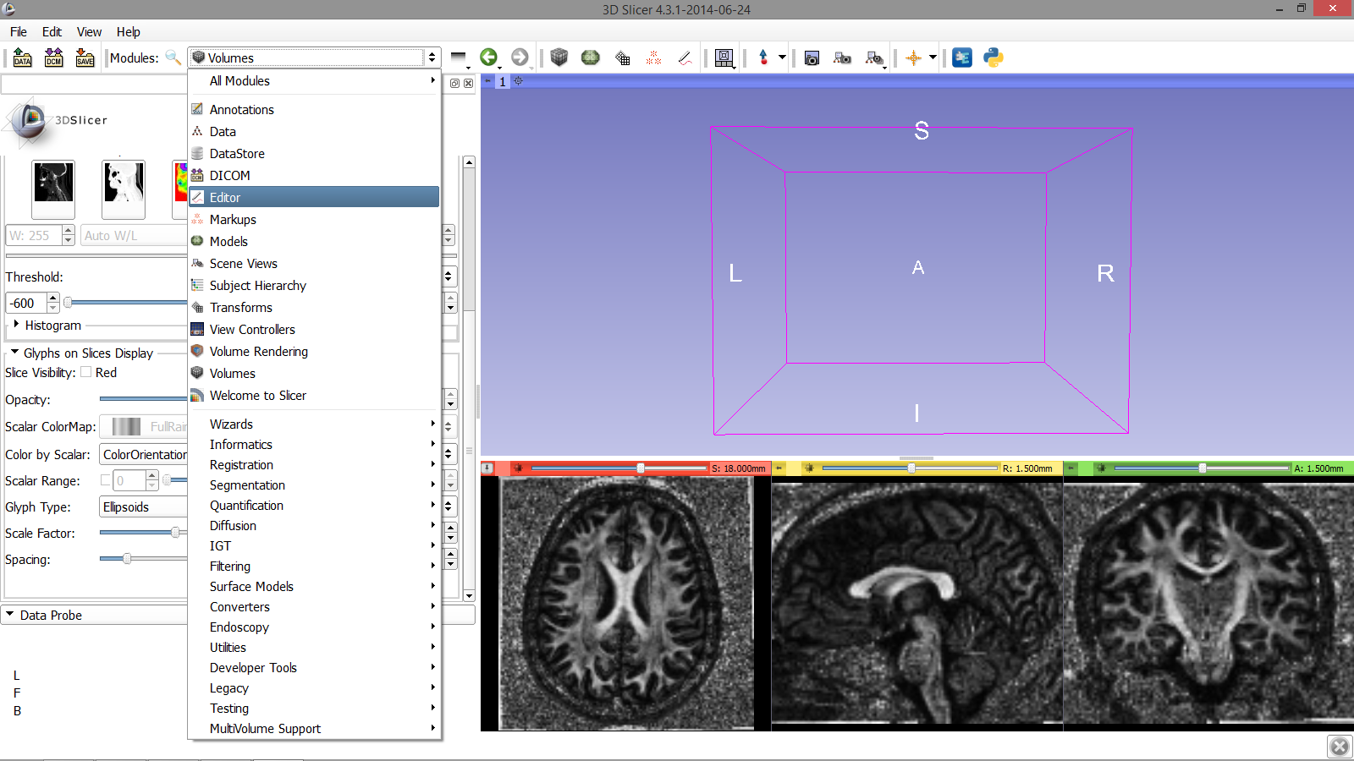
Diffusion MRI tractography
Select the module Editor
Diffusion MRI Analysis
Sonia Pujol, Ph.D.
NA-MIC ARR 2012-2014

Slide 64
Diffusion MRI tractography
Select Apply when the
‘label-map window’ appears, then
switch to the Yellow slice only layout
Diffusion MRI Analysis
Sonia Pujol, Ph.D.
NA-MIC ARR 2012-2014

Slide 65
Diffusion MRI tractography
Click on the fit to screen icon to adjust the dimensions of the yellow slice viewer to fit the screen
Diffusion MRI Analysis
Sonia Pujol, Ph.D.
NA-MIC ARR 2012-2014

Slide 66
Diffusion MRI tractography
Select the DrawEffect tool
Diffusion MRI Analysis
Sonia Pujol, Ph.D.
NA-MIC ARR 2012-2014

Slide 67
Diffusion MRI tractography
Outline the contour of the
Corpus Callosum with the
DrawEffect tool equipped and press enter. Repeat this step with 3 adjacent sagittal slices
Diffusion MRI Analysis
Sonia Pujol, Ph.D.
NA-MIC ARR 2012-2014

Slide 68
Diffusion MRI tractography
The tracts will be seeded from the region of interest defined in the Corpus Callosum area
Diffusion MRI Analysis
Sonia Pujol, Ph.D.
NA-MIC ARR 2012-2014

Slide 69
Diffusion MRI tractography
Select the module
Tractography Label Map Seeding
Diffusion MRI Analysis
Sonia Pujol, Ph.D.
NA-MIC ARR 2012-2014

Slide 70
Labelmap Seeding: I/O
-Set the Input DTI Volume to ‘dti’
-Set the Input Label Map to ‘fa-label’
-Set Output Fiber Bundle to ‘Create and Rename New Fiber Bundle’ and rename it ‘corpusCallosum’
Diffusion MRI Analysis
Sonia Pujol, Ph.D.
NA-MIC ARR 2012-2014

Slide 71
ROI Drawing
Under Seed Placement Options, check off the option for ‘Use Index Space’
Diffusion MRI Analysis
Sonia Pujol, Ph.D.
NA-MIC ARR 2012-2014

Slide 72
Labelmap Seeding: parameters
Select the default Tractography Seeding parameters:
-Minimum Path Length: 10 mm
-Maximum Length: 800 mm
-Stopping Criteria: FractionalAnistropy
-Stopping Value: 0.15
-Stopping Track Curvature: 0.80
-Integration Step Length: 0.50 mm
-Click on Apply
Diffusion MRI Analysis
Sonia Pujol, Ph.D.
NA-MIC ARR 2012-2014

Slide 73
Labelmap Seeding: Tracts
The tracts generated in the
corpus callosum area appear in the 3D viewer.
Diffusion MRI Analysis
Sonia Pujol, Ph.D.
NA-MIC ARR 2012-2014

Slide 74
Tractography Results
Position the mouse over the pin icon and click on the eye icon to display the axial slice in the 3D viewer
Diffusion MRI Analysis
Sonia Pujol, Ph.D.
NA-MIC ARR 2012-2014

Slide 75
Fiducial Seeding
Select the module Tractography Display
Diffusion MRI Analysis
Sonia Pujol, Ph.D.
NA-MIC ARR 2012-2014

Slide 76
Fiducial Seeding
Click on the arrow icon to create a fiducial
Diffusion MRI Analysis
Sonia Pujol, Ph.D.
NA-MIC ARR 2012-2014

Slide 77
Fiducial Seeding
Position the fiducial in the left cingulum of the coronal slice
Diffusion MRI Analysis
Sonia Pujol, Ph.D.
NA-MIC ARR 2012-2014

Slide 78
Fiducial Seeding
Double click on the fiducial and change the name to LeftCingulum
Diffusion MRI Analysis
Sonia Pujol, Ph.D.
NA-MIC ARR 2012-2014

Slide 79
Fiducial Seeding
Select the module Tractography Interactive Seeding
Select the Input DTI volume ‘dti’
Select the Input Fiduciala, Model or Label Map ‘F’ Select the Output Fiber Bundle ‘Create New Fiber Bundle’ and rename it ‘Cingulum’
Diffusion MRI Analysis
Sonia Pujol, Ph.D.
NA-MIC ARR 2012-2014

Slide 80
Fiducial Seeding
Set the tractography parameters as follows:
-Fiducial region size: 2.5 mm
-Fiducial Seeding Step Size: 1.0 mm
-Maximum number of seeds: 100
-Minimum Path Length: 10 mm
-Maximum Path Length: 800 mm
-Stopping Criteria: Fractional Anisotropy
-Stopping Value: 0.15
-Stopping Track Curvature: 0.8
-Integration step length: 0.5 mm
-Create Tracts Initially as Tubes
Diffusion MRI Analysis
Sonia Pujol, Ph.D.
NA-MIC ARR 2012-2014

Slide 81
Fiducial Seeding
Part of the left
cingulum appears in the 3D viewer.
Move the Left
Cingulum fiducial to explore the spatial relationship between the left cingulum and the corpus callosum
Diffusion MRI Analysis
Sonia Pujol, Ph.D.
NA-MIC ARR 2012-2014

Slide 82
Fiducial Seeding
Go to the Markups module
Diffusion MRI Analysis
Sonia Pujol, Ph.D.
NA-MIC ARR 2012-2014

Slide 83
Fiducial Seeding
Double click on the Name and change it to RightCingulum
Diffusion MRI Analysis
Sonia Pujol, Ph.D.
NA-MIC ARR 2012-2014

Slide 84
Fiducial Seeding
Part of the left and
right cingulum appear in the 3D viewer.
Move the fiducials to explore the spatial relationship between the left and right cingulum, and the corpus callosum
Diffusion MRI Analysis
Sonia Pujol, Ph.D.
NA-MIC ARR 2012-2014

Slide 85
Fiducial Seeding
Click on the arrow icon to
create a new fiducial, and position it in the 3D viewer
Diffusion MRI Analysis
Sonia Pujol, Ph.D.
NA-MIC ARR 2012-2014

Slide 86
Fiducial Seeding
Move the fiducial F-3 in
the 3D viewer to explore the dti dataset
Diffusion MRI Analysis
Sonia Pujol, Ph.D.
NA-MIC ARR 2012-2014

Slide 87
Tractography ‘on-the-fly’
The Fiducial Seeding functionality
allows you to do tractography ‘on- the-fly’ to explore white matter structures interactively
Diffusion MRI Analysis
Sonia Pujol, Ph.D.
NA-MIC ARR 2012-2014

Slide 88
DTI Analysis
Select the module Data to display the list of elements that have been generated in this tutorial
Diffusion MRI Analysis
Sonia Pujol, Ph.D.
NA-MIC ARR 2012-2014

Slide 89
Conclusion
This tutorial guided you through the different steps of a Diffusion MR Analysis pipeline, from tensor estimation to 3D tracts visualization, for exploring and studying the brain white matter pathways.
Diffusion MRI Analysis - Sonia Pujol, Ph.D. NA-MIC ARR 2012

Slide 90
Contact:
spujol@bwh.harvard.edu
Diffusion MRI Analysis - Sonia Pujol, Ph.D.
NA-MIC ARR 2012

Slide 91
Slicer Community
• www.slicer.org
• Mailing lists:
slicer-user@bwh.harvard.edu slicer-devel@bwh.harvard.edu
Diffusion MRI Analysis - Sonia Pujol, Ph.D.
NA-MIC ARR 2012

Slide 92
Acknowledgments
National Alliance for Medical Image
Computing (NA-MIC)
NIH U54EB005149
•
Neuroimage Analysis
NIH P41RR013218
Center
•
(NAC)
•
Parth Amin, WIT ’16
Farukh Kohistani, BC ’16
•
Diffusion MRI Analysis
Sonia Pujol, Ph.D.
National Alliance for
Medical Image Computing
ARR 2012-2014

