Slide 1
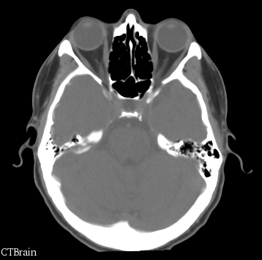
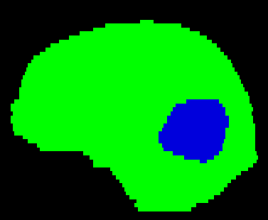



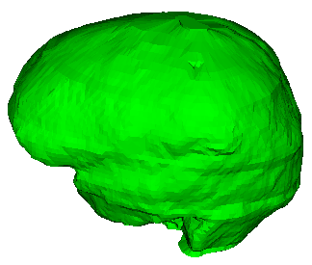

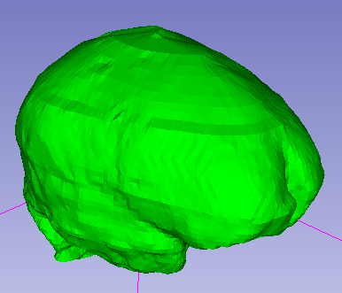
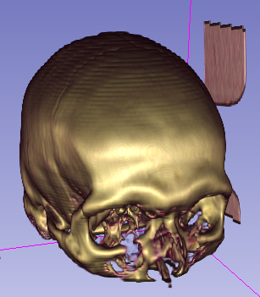
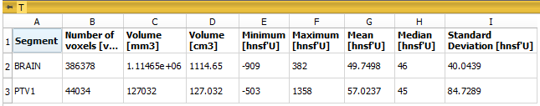
Segmentation (Patient)
Segment (Brain)
Segment (Tumor)
Binary labelmap representation
(master)
Segment Editor
Structures localized
Segmentation created
Segmentations Import/Export
Closed surface representation
3D image or volume
From DICOM, nrrd, etc.
Volumes module
Labelmap volume
nrrd, etc.
3D image
Volumes module
Volume Rendering
Only visualization
No data created!
Segmentation
Multiple representations
Segmentations module
Segment Statistics
Measurements
Table created
Statistics
Table: CSV, TSV
Surface model (mesh)
STL, VTK, OBJ, etc.
Connected triangles
Models module

