Slide 1


CARMA Registration
Alan Morris, Greg Gardner, Salma Bengali,
Josh Cates, Rob MacLeod
SCI Institute/CARMA Center
University of Utah
© 2012, All Rights Reserved

Slide 2
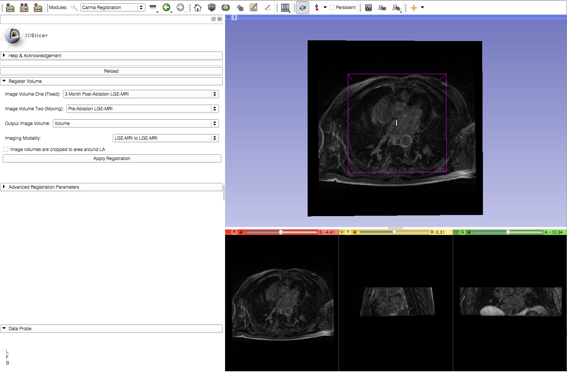
Learning Objective
Cardiac MRI image registration in Slicer
© 2012, All Rights Reserved

Slide 3
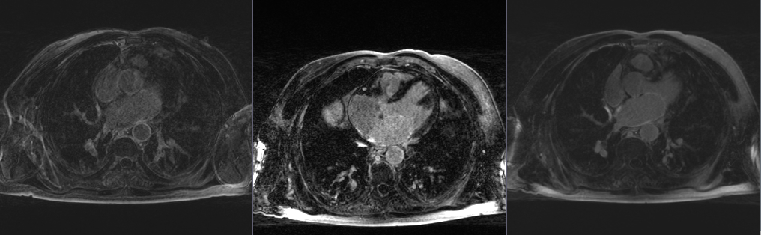
Current Workflow
Fixed Image
Moving Image
Registered Image
© 2012, All Rights Reserved

Slide 4

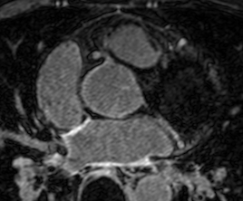
Required Materials
Slicer: Release 4.1
http://www.slicer.org/pages/Downloads/
Data: CARMA Slicer Extension Tutorial Data
http://hdl.handle.net/1926/1765
© 2012, All Rights Reserved

Slide 5

Additional Sample Data
60 patients
http://hdl.handle.net/1926/1757
© 2012, All Rights Reserved

Slide 6
Pre-requisite Tutorial
http://www.slicer.org/slicerWiki/index.php/Documentation/4.0/Training
© 2012, All Rights Reserved

Slide 7


Platforms
Developed
Tested
© 2012, All Rights Reserved

Slide 8
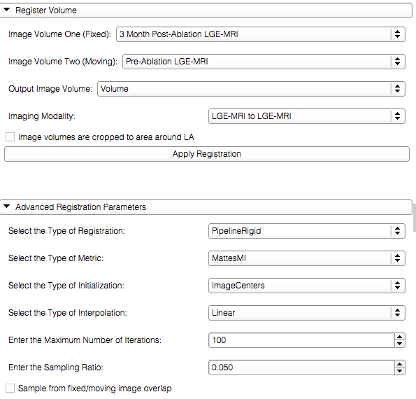
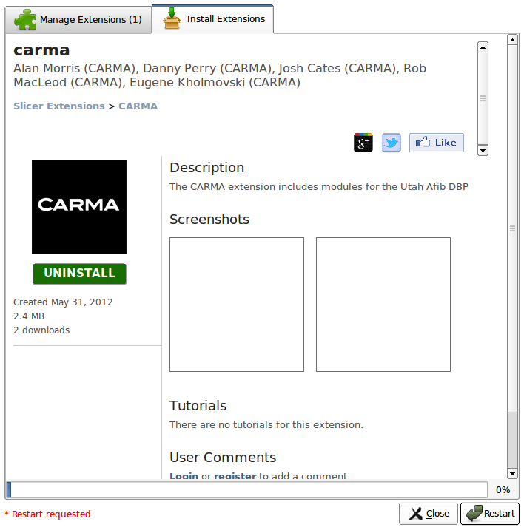
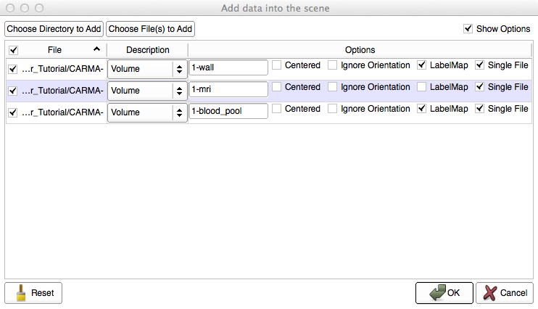
Overview
Load the module
Load the dataset
Image registration
© 2012, All Rights Reserved

Slide 9
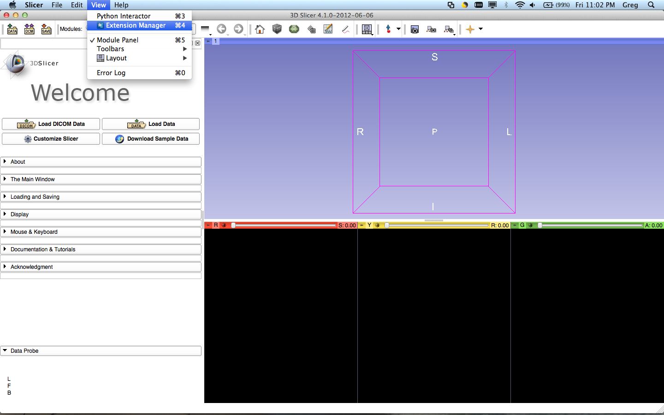
Loading the Module
Select View>Extension Manager in the menu bar (or push ⌘4)
If the Extension Manager isn’t revealed, see the next 2 slides; otherwise, skip them
© 2012, All Rights Reserved

Slide 10
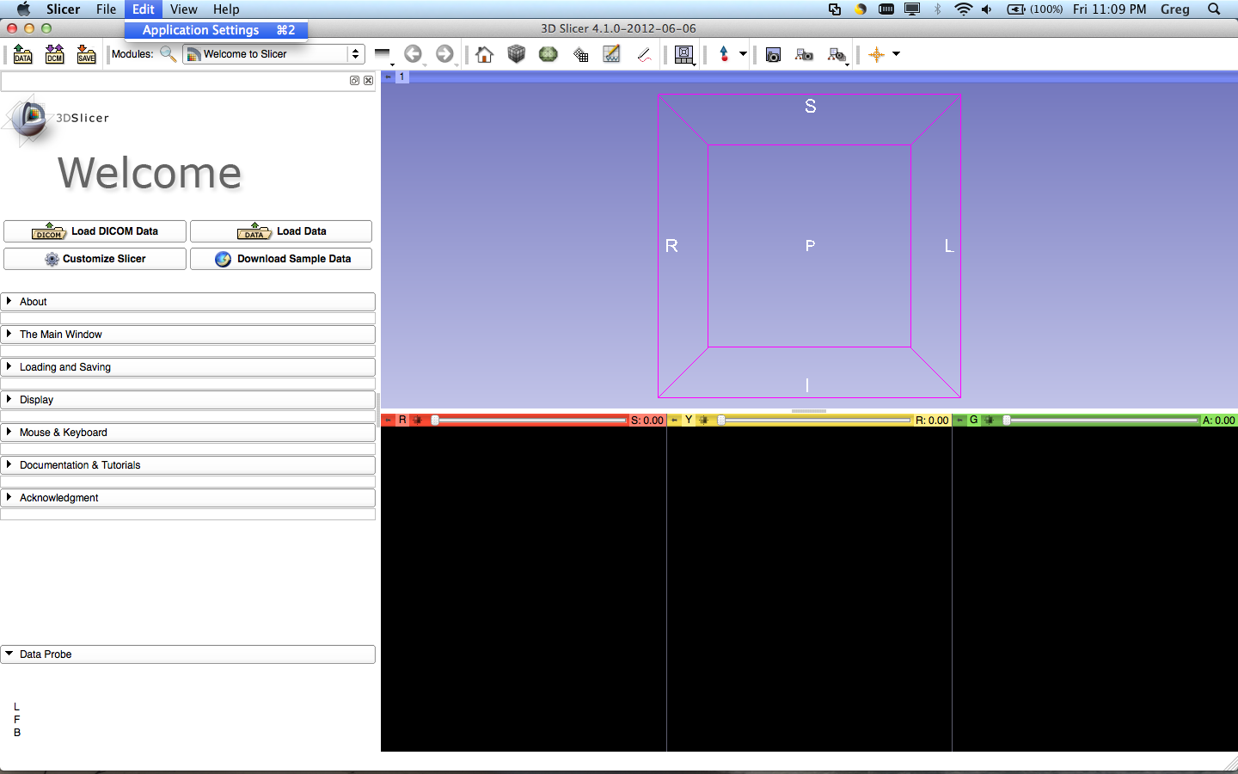
Loading the Module
To load the Extension Manager, Select Edit>Application Settings in the menu bar (or push ⌘2)
© 2012, All Rights Reserved

Slide 11
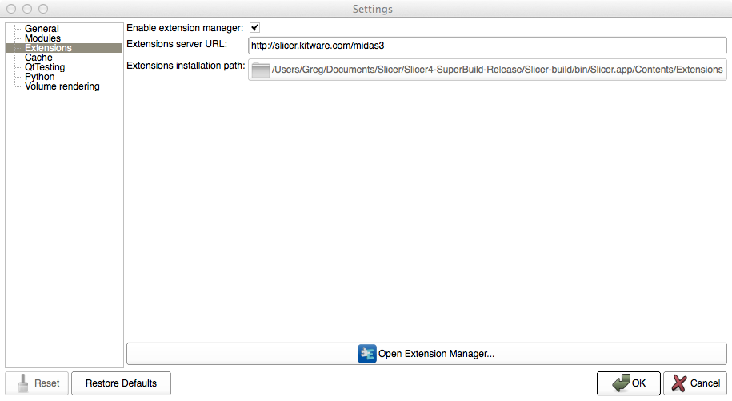
Loading the Module
Under the Extension menu, make sure ‘Enable extension manager’ is checked
© 2012, All Rights Reserved

Slide 12
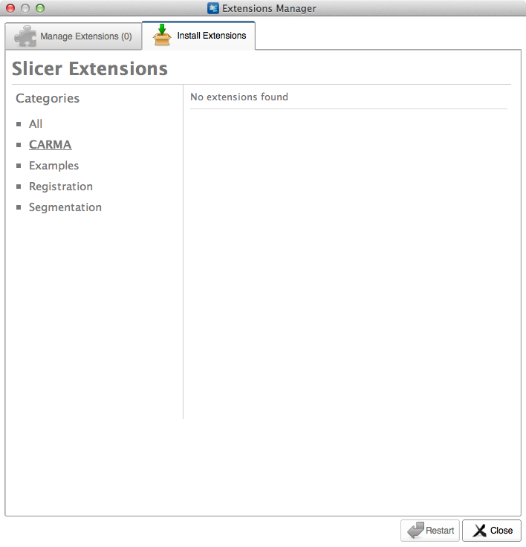
Loading the Module
Select CARMA in the sidebar and click the extensions
© 2012, All Rights Reserved

Slide 13
Loading the Module
Restart to install the extension
© 2012, All Rights Reserved

Slide 14
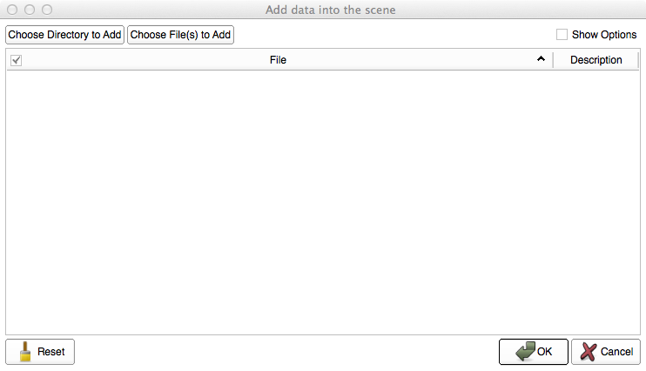
Loading the Data
Select ‘Choose Directory to Add’ in the pop-up menu
© 2012, All Rights Reserved

Slide 15
Loading the Data
Select the directory containing your dataset
© 2012, All Rights Reserved

Slide 16
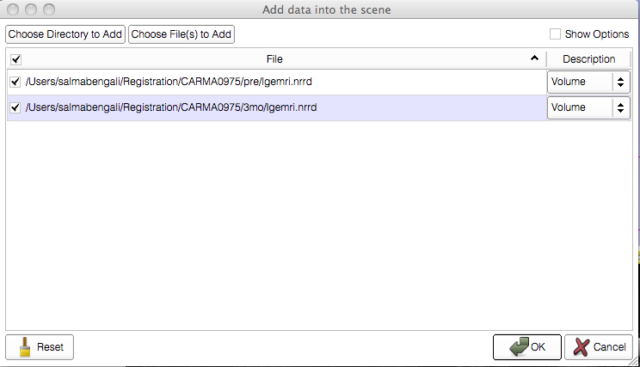
Loading the Data
© 2012, All Rights Reserved

Slide 17
Image Registration
Input volumes
{
Output volume
Parameter Sets
© 2012, All Rights Reserved

Slide 18
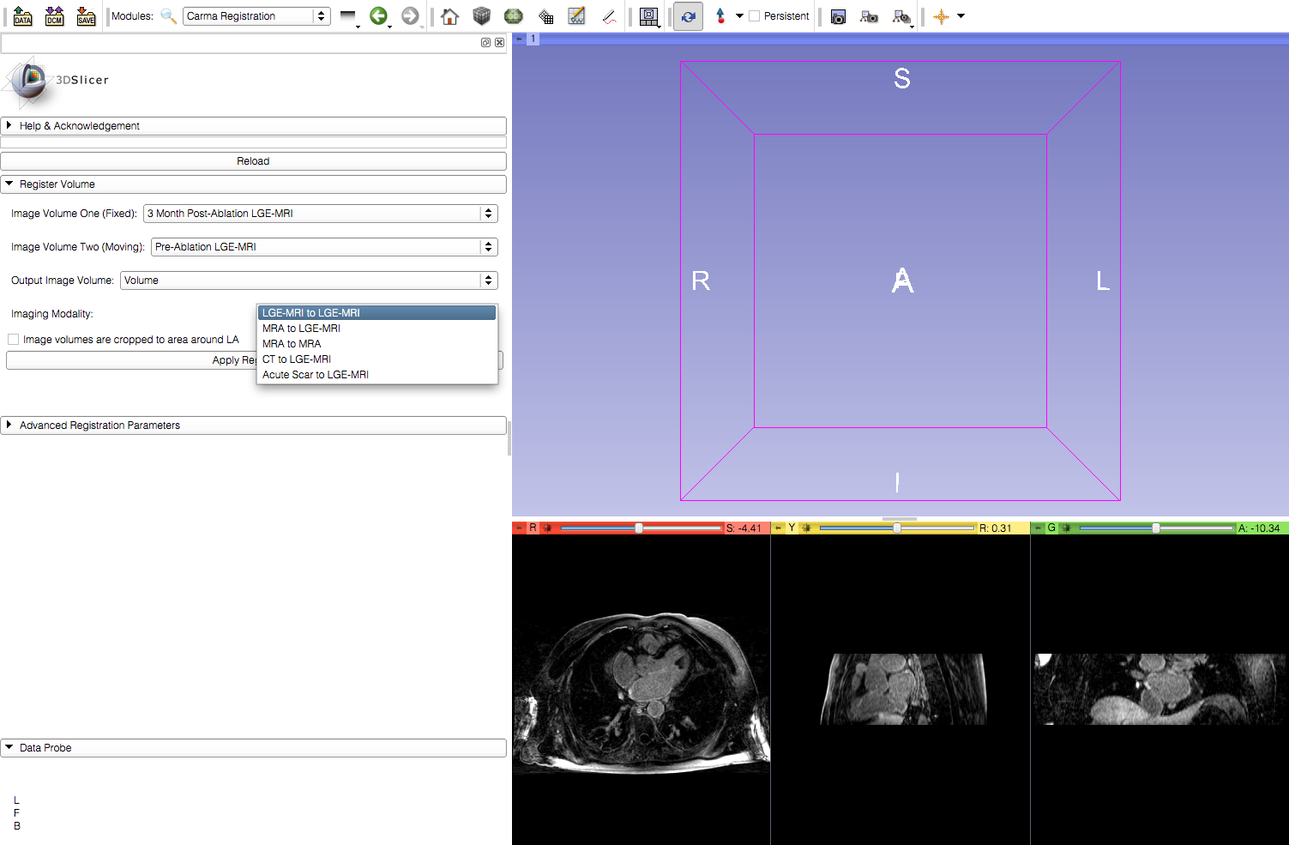
Image Registration
Under the Imaging Modality, select the appropriate option. (In this example it is LGE-MRI to LGE-MRI)
© 2012, All Rights Reserved

Slide 19
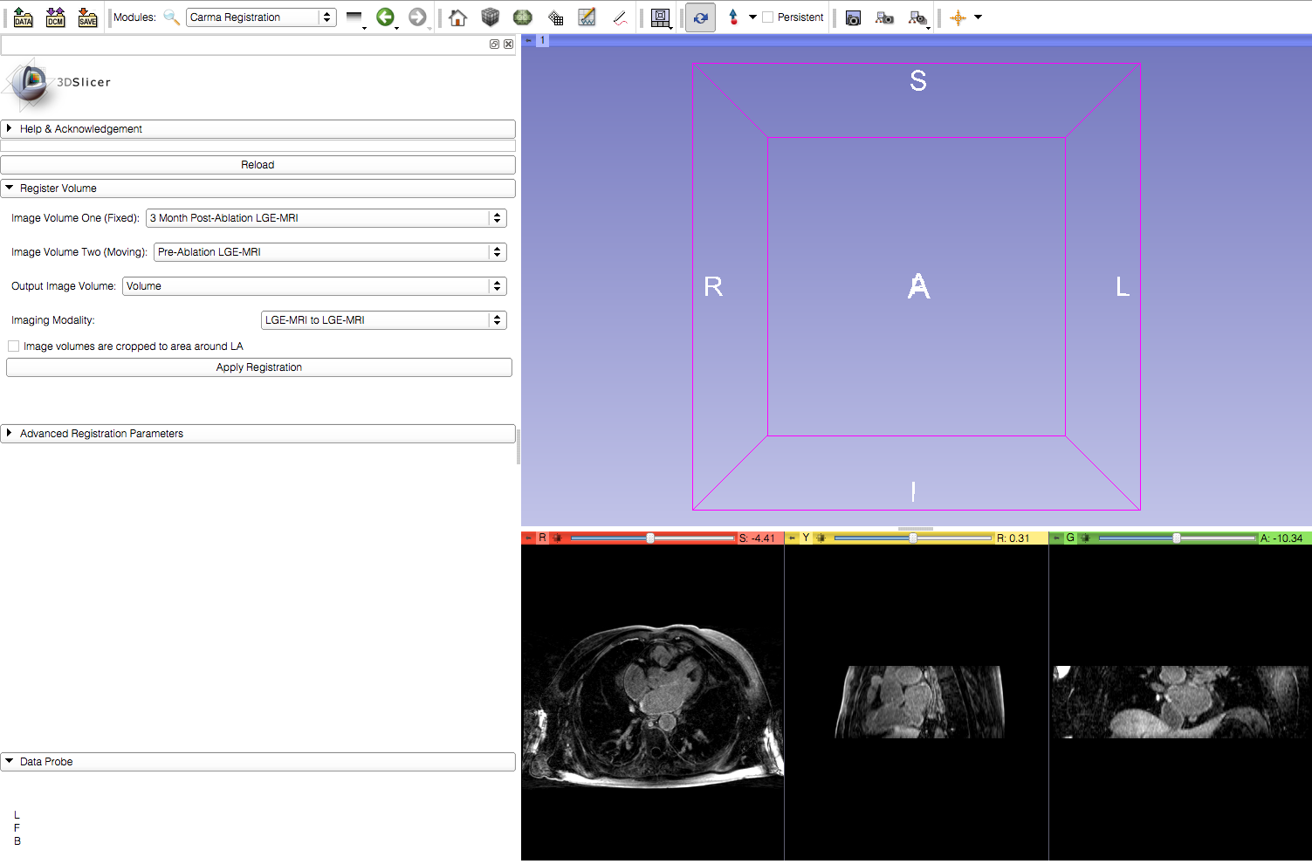
Image Registration
Indicate if input image volumes are cropped
© 2012, All Rights Reserved

Slide 20
Image Registration
Apply the registration
© 2012, All Rights Reserved

Slide 21
Image Registration
Viewer automatically updates to show the resulting output
© 2012, All Rights Reserved

Slide 22
Image Registration
Advanced registration parameters can be adjusted to check for improvements in the registration result.
© 2012, All Rights Reserved

Slide 23
Conclusion
This module can be used to register two cardiac MRI image volumes.
© 2012, All Rights Reserved

