Slide 1
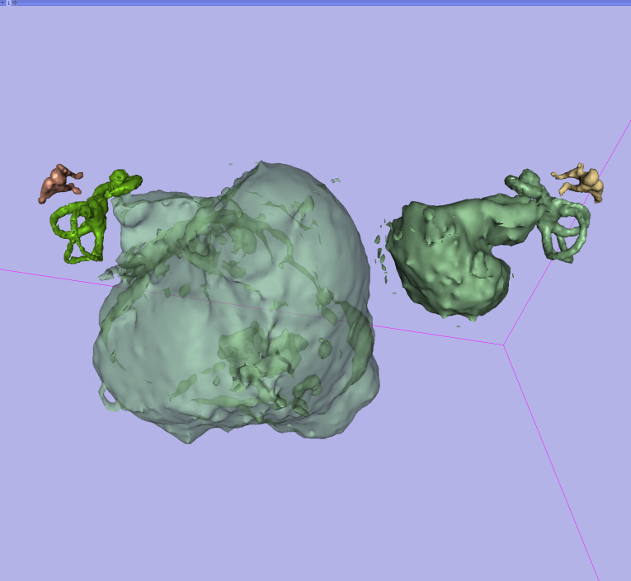
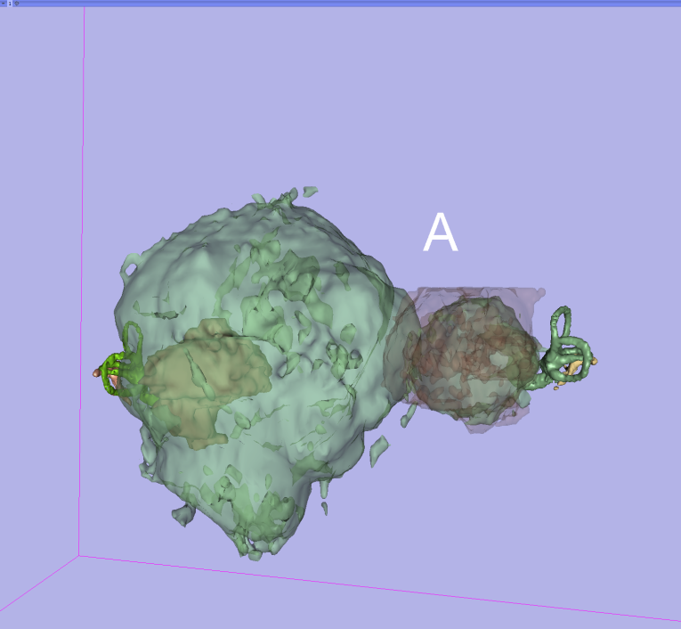
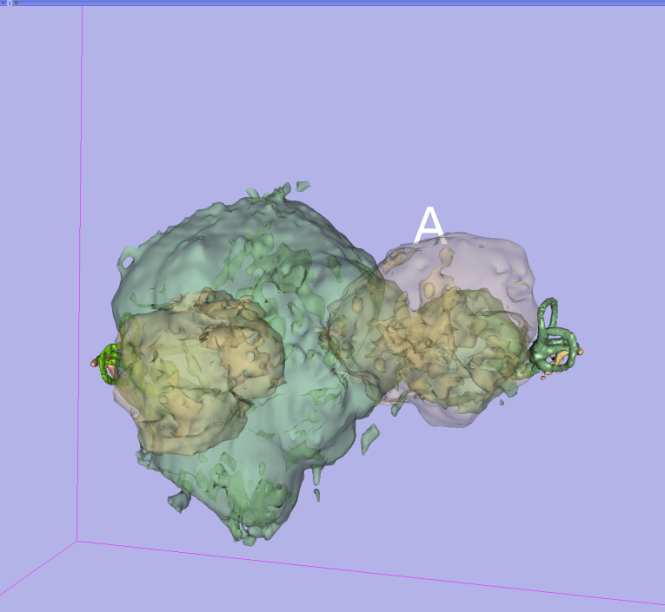
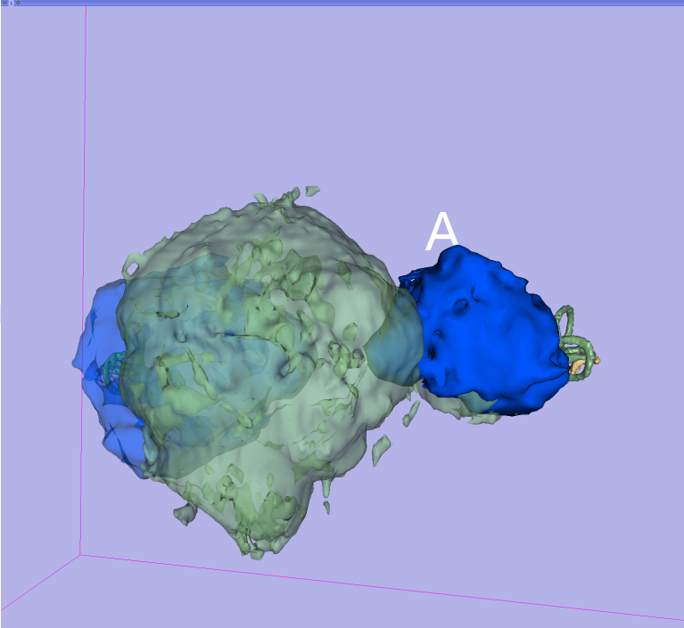
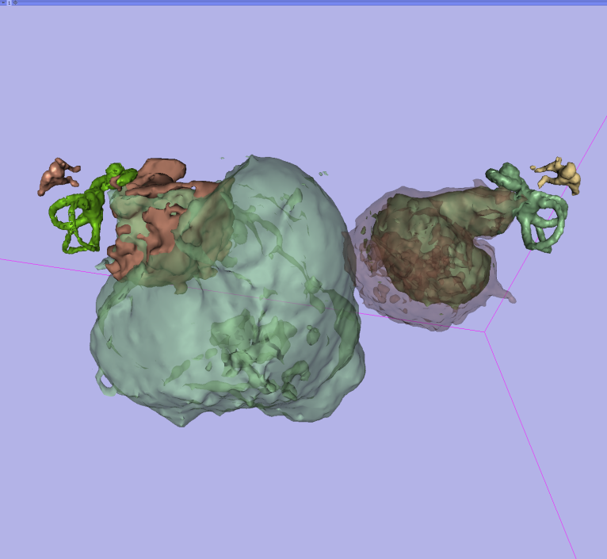
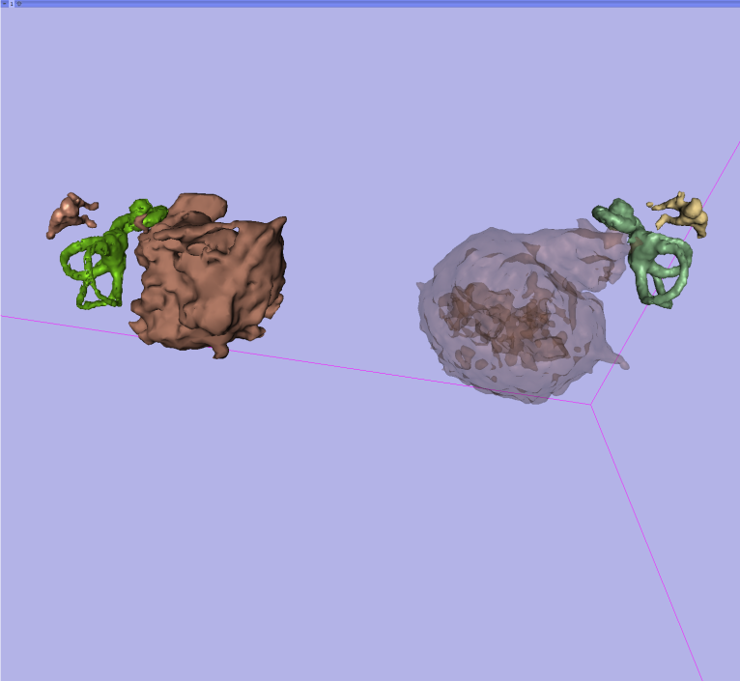
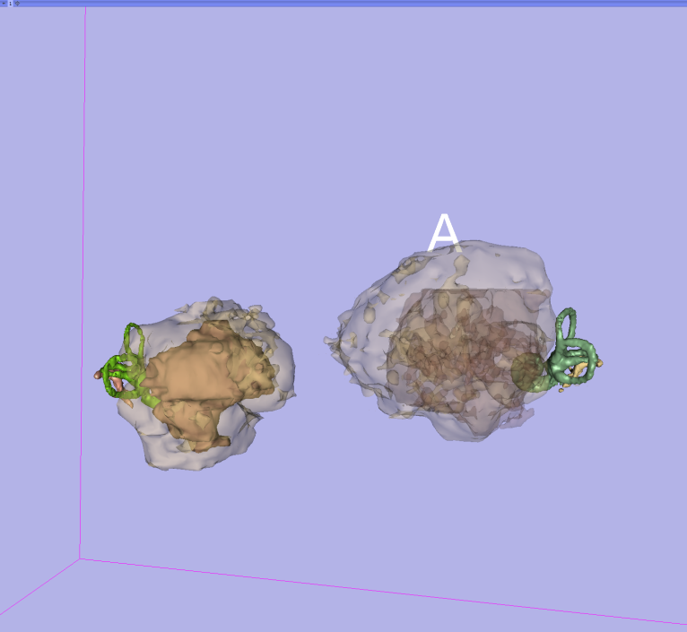
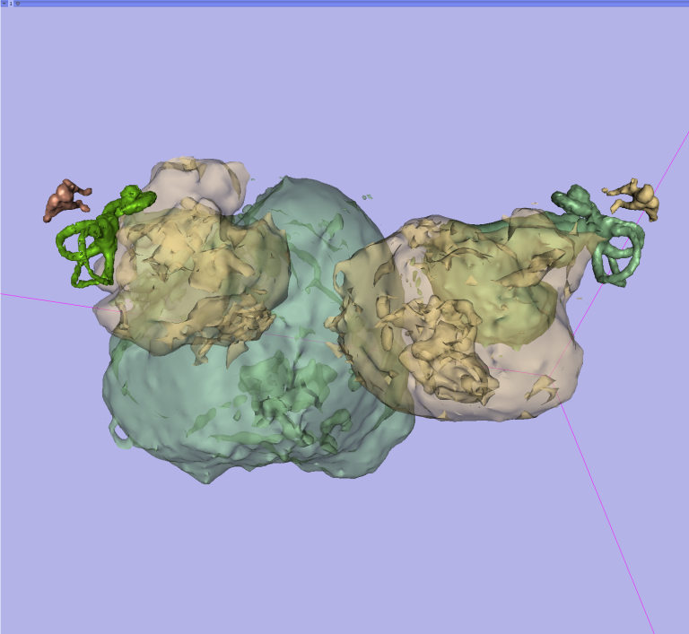
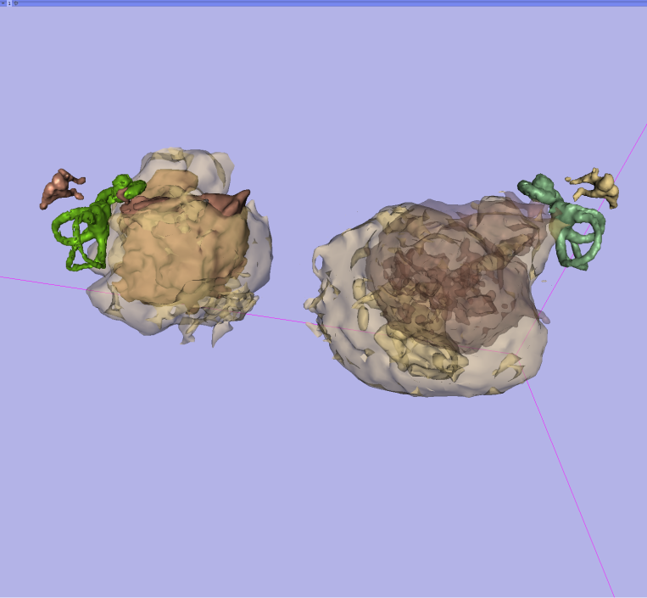
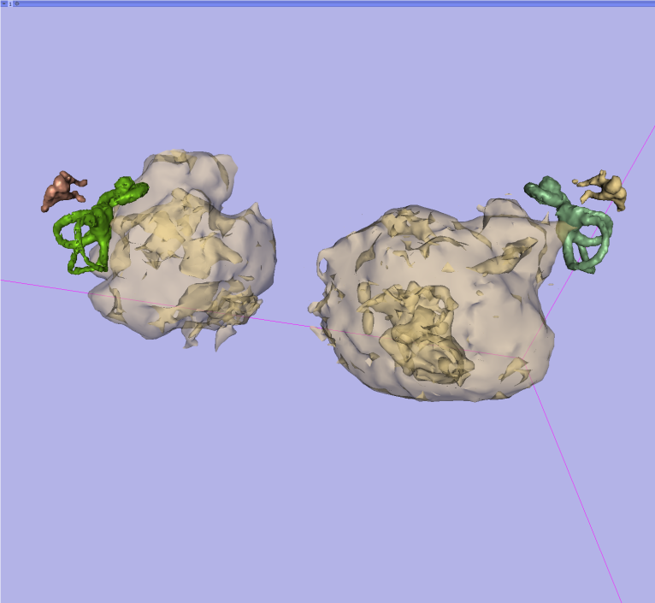
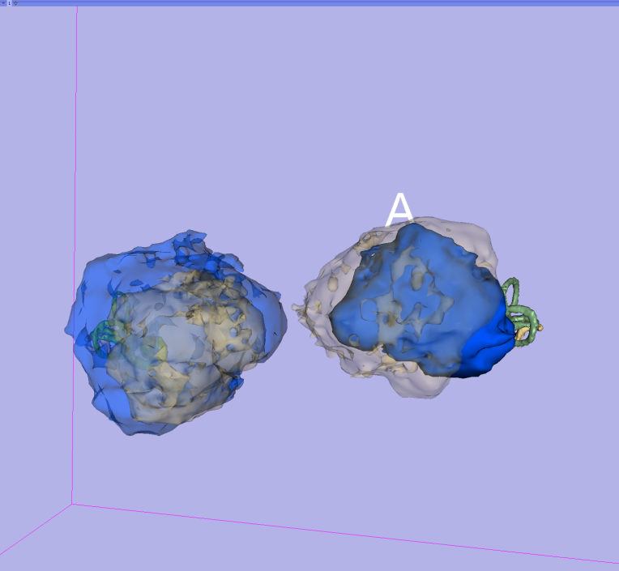
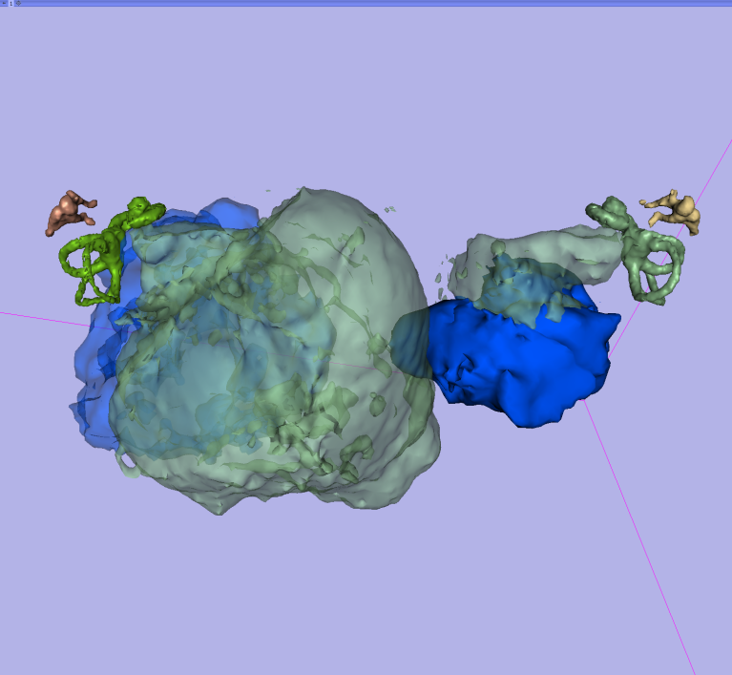
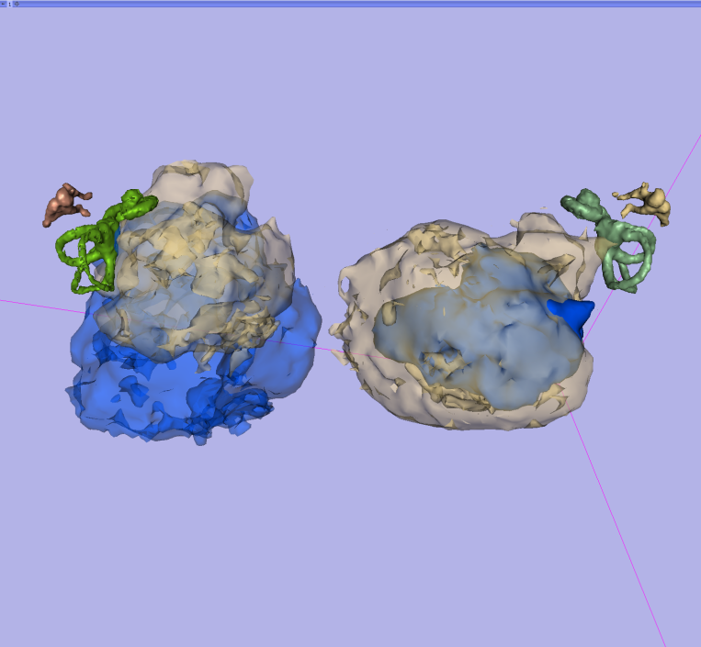
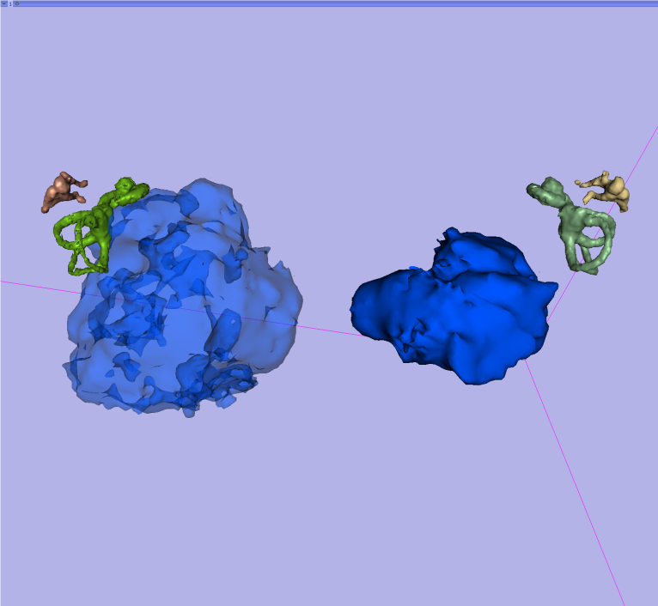
Imaging in audiology: a case report of a patient with bilateral acoustic neuroma
Attila L Nagy^{1,5}, János Jarabin¹, Ferenc Tóth¹, László Rovó¹, József Géza Kiss¹
¹University of Szeged, Department of Oto-rhino-laryngology and Head and Neck Surgery, Szeged, Hungary
⁵University of Szeged, Department of Medical Physics and Medical Informatics, Szeged, Hungary
Patient's condition begins to deteriorate
Treatment due to facial nerve palsy
Short patient history
Female patient born in 1985
First symptoms at the age of 21 (2006)
First partial surgery in 2006
First stereotaxic irradiation in 2007 Oct
Second stereotaxic irradiation in 2008 Feb
Second partial surgery in 2011
Anacusis
Brainstem implant candidate
20.11.2007
1.3.2006
Treatment due to facial nerve palsy
Partial surgical resection of acoustic neuroma on the right
Patient's condition became very bad (severe headache, vomiting), hospitalized
30.4.2008
Treatment due to facial nerve palsy
22.9.2011
1.9.2006
Treatment due to facial nerve palsy
14.5.2008
EABR, SSEP, nerve conduction speed
25.9.2007
Treatment due to facial nerve palsy
4.9.2006
Stereotaxic irradiation on the right side (14 Gy)
8.10.2008
Audiological examination
17.10.2007
28.9.2011
Stereotaxic irradiation on the left side (16 Gy)
Hospitalized due to tetraataxy
Audiologycal examination
27.2.2008
Audiologycal examination
10.10.2011
10.9.2006
23.3.2009
Partial surgical resection of acoustic neuroma on the left
Treatment due to facial nerve palsy
14.9.2006
11.5.2009
Today
2006
2007
2008
2009
2010
2011
2012
2013
MR
MR
MR
1.12.2010
CT
11.2.2013
3.11.2006
24.10.2011
MR
CT
CT
MR
CT
29.6.2010
23.10.2011
25.1.2013
4.2.2008
23.2.2009
MR
CT
MR
First MR: "enormous bilateral acoustic neuromas"
MR
MR
12.1.2010
27.9.2011
19.10.2012
1.10.2007
13.11.2008
CT
7.9.2006
MR
22.9.2011
5.6.2008
These scans are shown below
In the intersections of the table’s rows and columns visual comparisons between the given years can be found.
2006 | 2008 | 2010 | 2012
 |  |  |  | 2006
 |  |  | View from posterior to anterior | 2008
 |  |  |  | 2010
 | View from superior anterior to inferior posterior |  |  | 2012

Slide 2
Timeline: 2006.03.01. - 2013.02.11.
Milestone(s)
Date | Description
1.3.2006 | Patient's condition begins to deteriorate
1.9.2006 | Patient's condition became very bad (severe headache, vomiting), hospitalized
4.9.2006 | EABR, SSEP, nerve conduction speed
7.9.2006 | First MR: "enormous bilateral acoustic neuromas"
10.9.2006 | Audiologycal examination
14.9.2006 | Partial surgical resection of acoustic neuroma on the left
3.11.2006 | MR
25.9.2007 | Treatment due to Bell's palsy
1.10.2007 | MR
17.10.2007 | Stereotaxic irradioaton on the right side (14 Gy)
20.11.2007 | Treatment due to Bell's palsy
4.2.2008 | MR
27.2.2008 | Stereotaxic irradioaton on the left side (16 Gy)
30.4.2008 | Treatment due to Bell's palsy
14.5.2008 | Treatment due to Bell's palsy
5.6.2008 | MR
8.10.2008 | Treatment due to Bell's palsy
13.11.2008 | MR
23.2.2009 | CT
23.3.2009 | Audiologycal examination
11.5.2009 | Treatment due to Bell's palsy
12.1.2010 | MR
29.6.2010 | MR
1.12.2010 | MR
22.9.2011 | CT
22.9.2011 | Partial surgical resection of acoustic neuroma on the right
27.9.2011 | CT
28.9.2011 | Audiological examination
10.10.2011 | Hospitalized due to tetraataxy
23.10.2011 | CT
24.10.2011 | CT
19.10.2012 | MR
25.1.2013 | CT
11.2.2013 | MR

