Slide 1
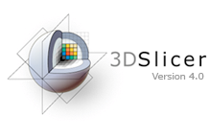
Slicer Welcome Tutorial
Sonia Pujol, Ph.D.
Brigham and Women’s Hospital
Harvard Medical School

Slide 2
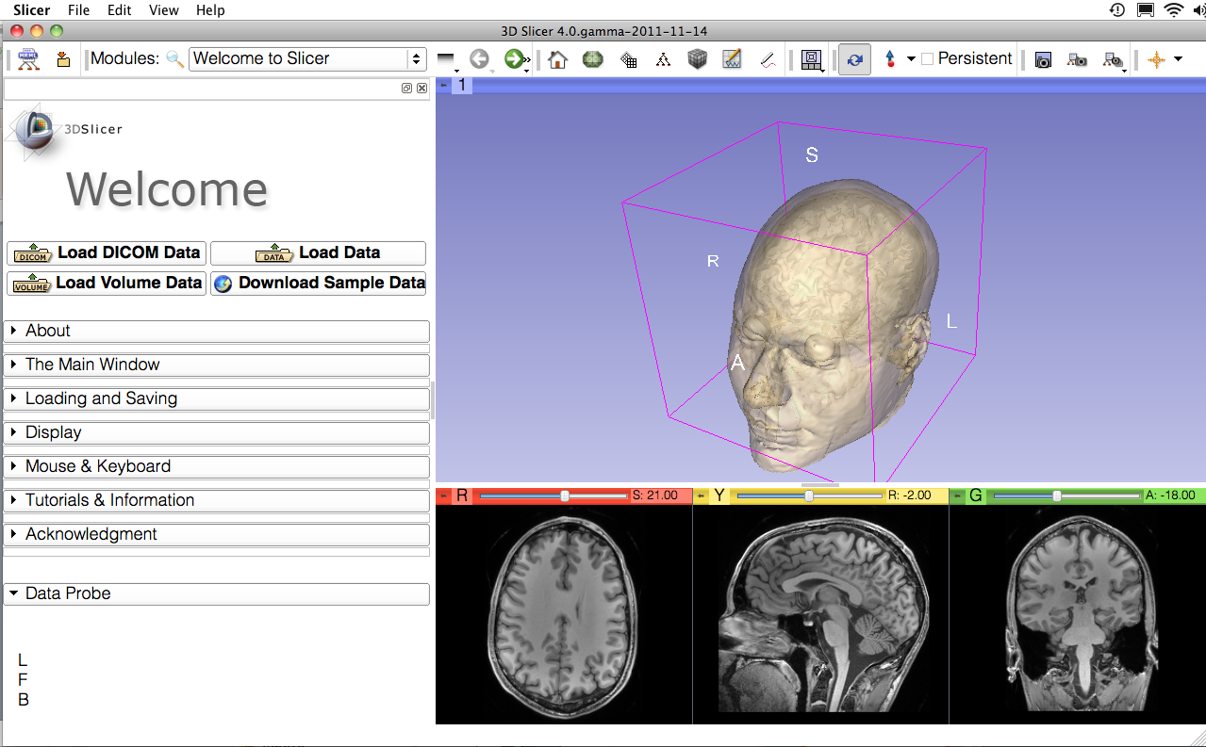
Goal
This tutorial is a short introduction to the Welcome module of the 3D Slicer open-source software.

Slide 3
Slicer4 Basics
Slicer is an open-source software for segmentation, registration and visualization of medical imaging data
The platform is developed through a multi-institution effort of several NIH funded large-scale consortia
Slicer is for medical research only, and is not FDA approved

Slide 4
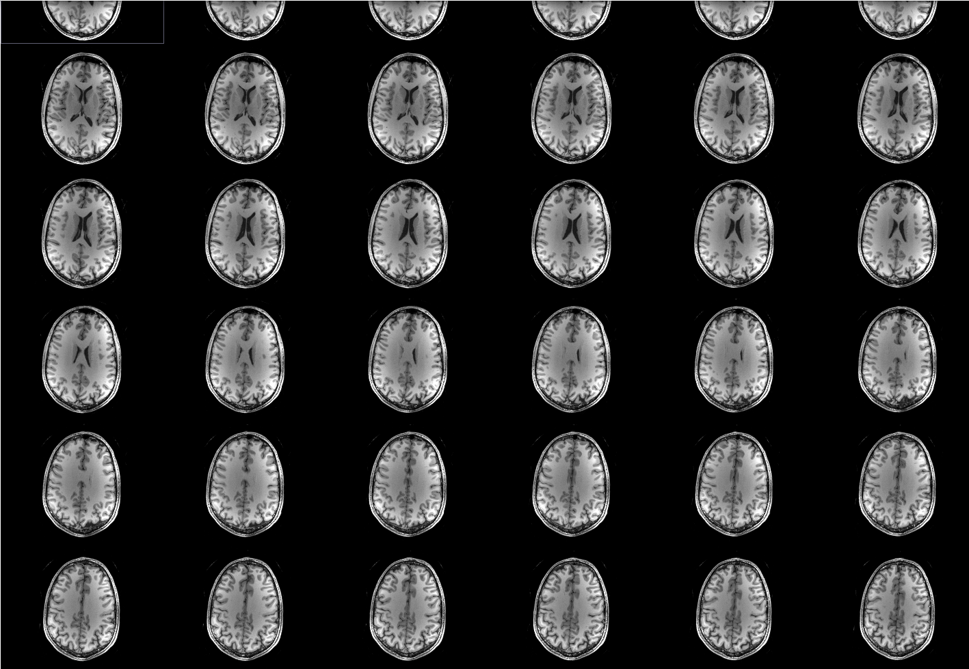
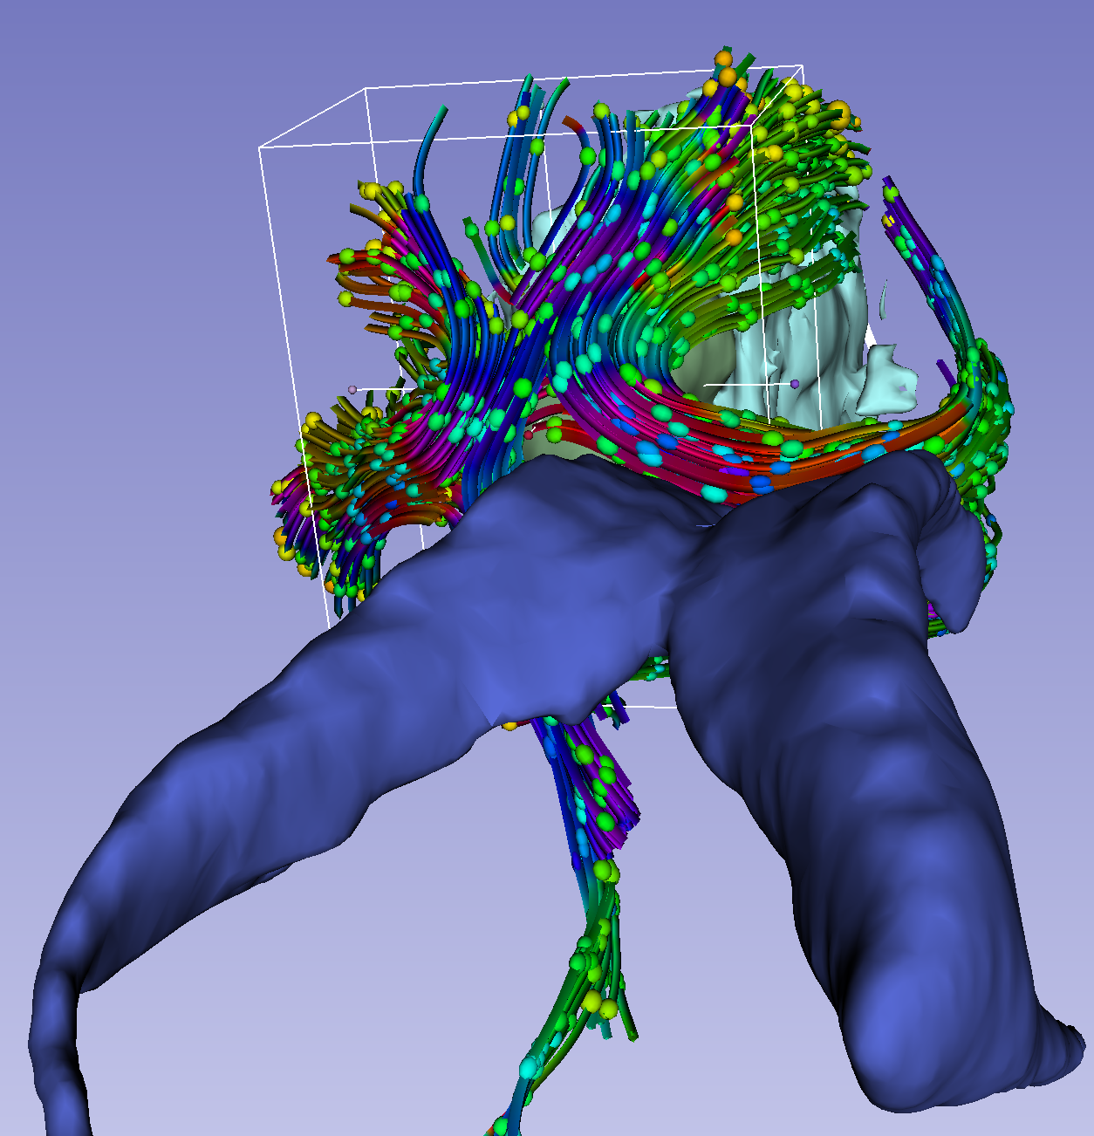
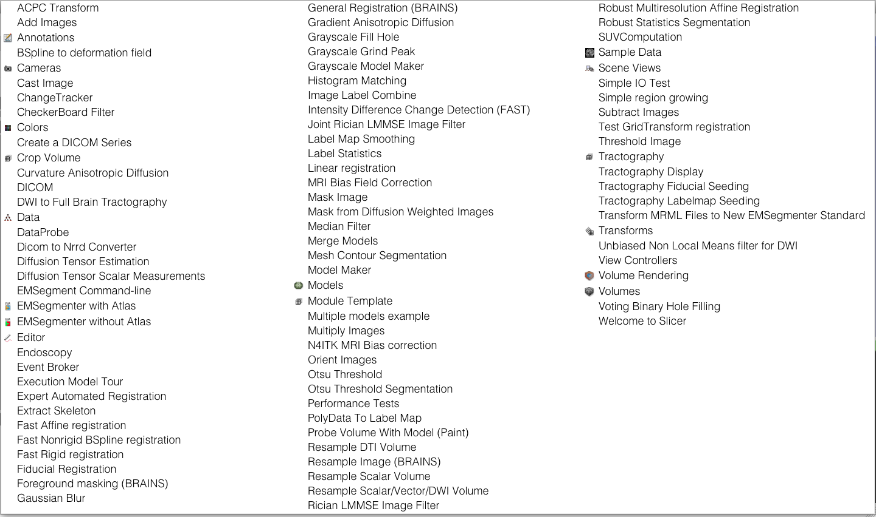
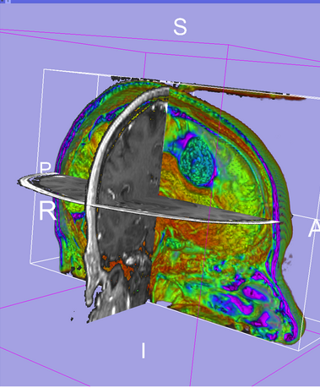
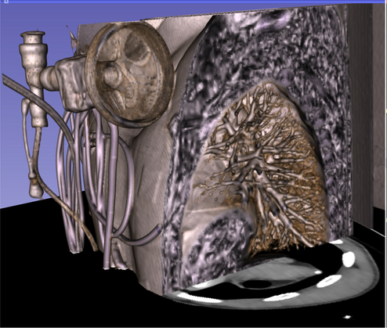
Slicer4 Basics
Slicer4 contains 92 modules for image segmentation, registration and 3D visualization of medical imaging data.
Images courtesy of Ron Kikinis, MD

Slide 5
Supported Platforms
Slicer is a multi-platform software developed and maintained on Mac OSX, Linux 64 & 32, and Windows 64 & 32.
Slicer requires a minimum of 2 GB of RAM and a dedicated graphic accelerator with 64 MB of on-board graphic memory.

Slide 6
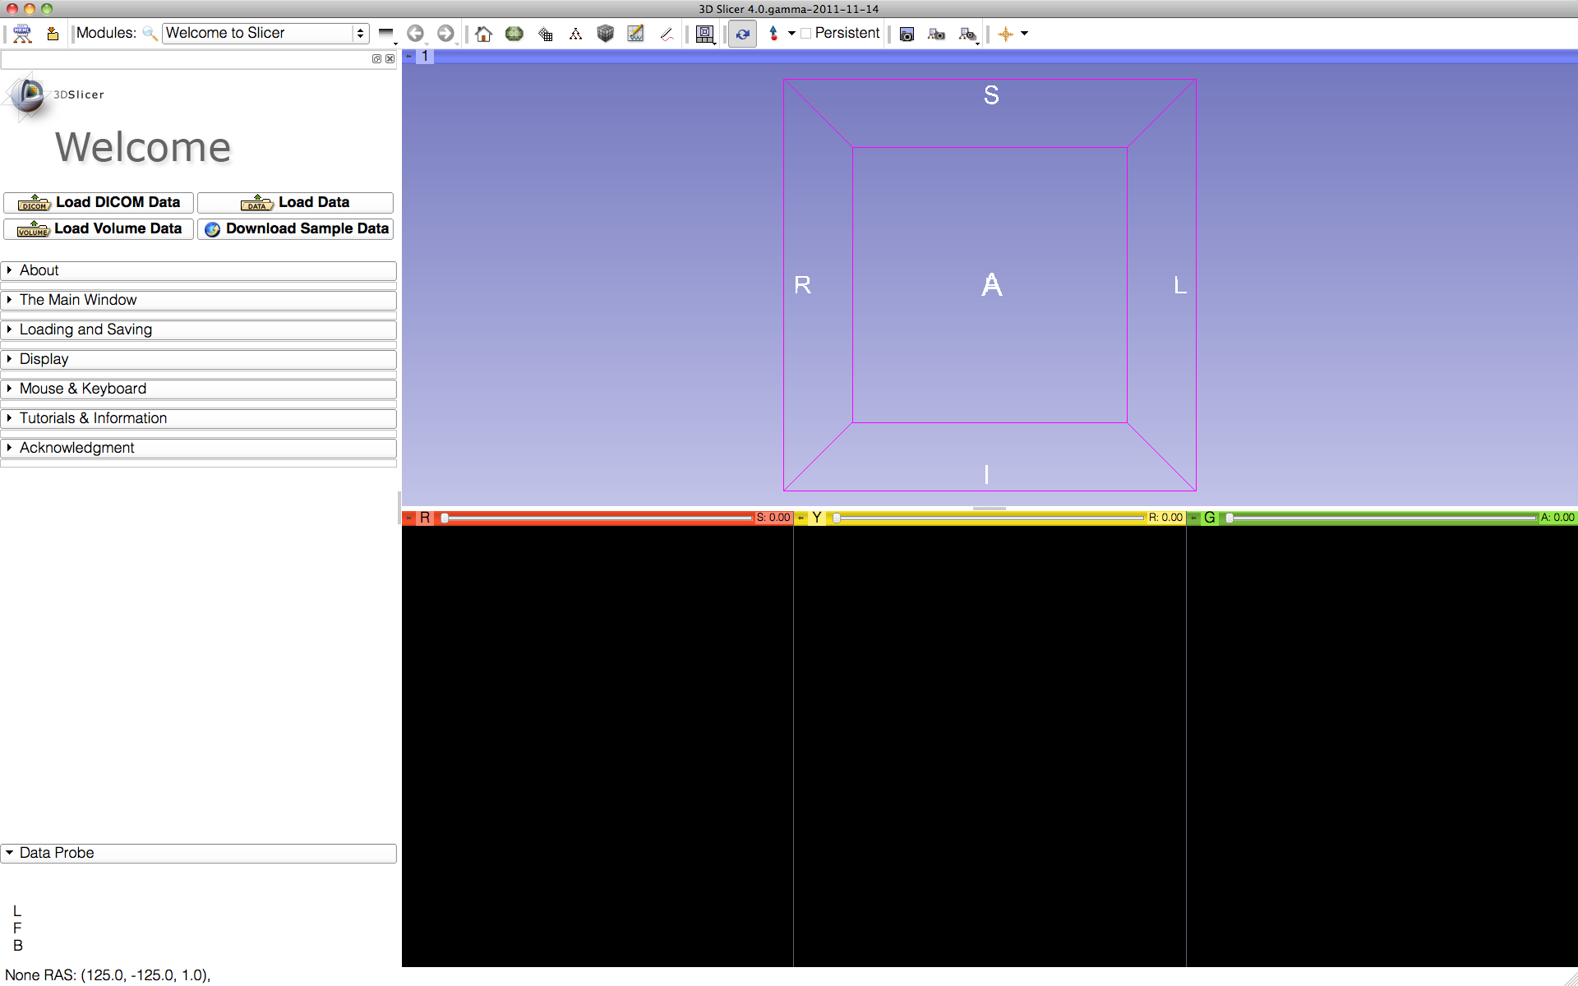
3DSlicer version 4.0
The Welcome module is the default start-up module.

Slide 7
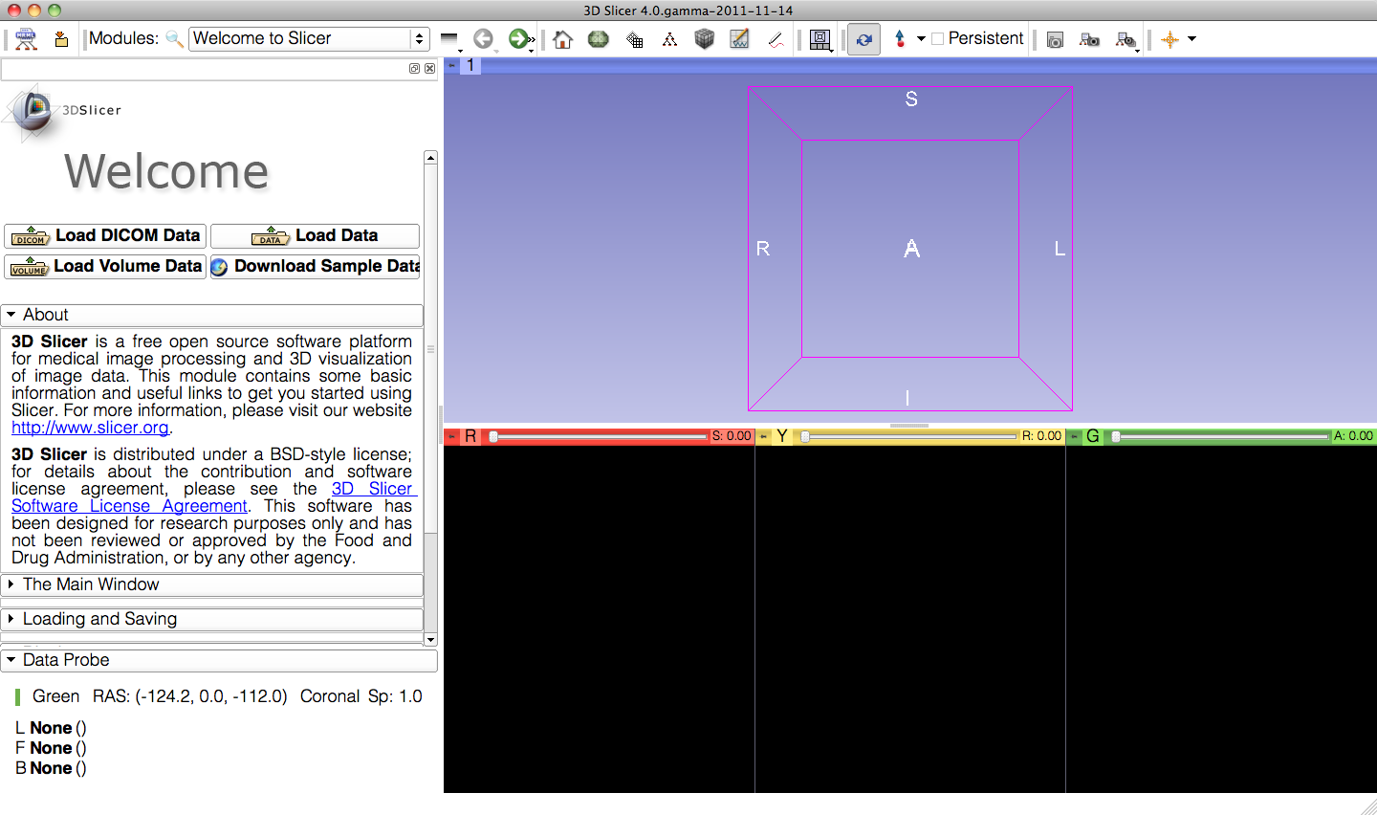
Welcome to Slicer
Each module of Slicer includes a series of tabs, which give access to different functionalities.
Click on the arrow symbol to display the content of each tab.

Slide 8
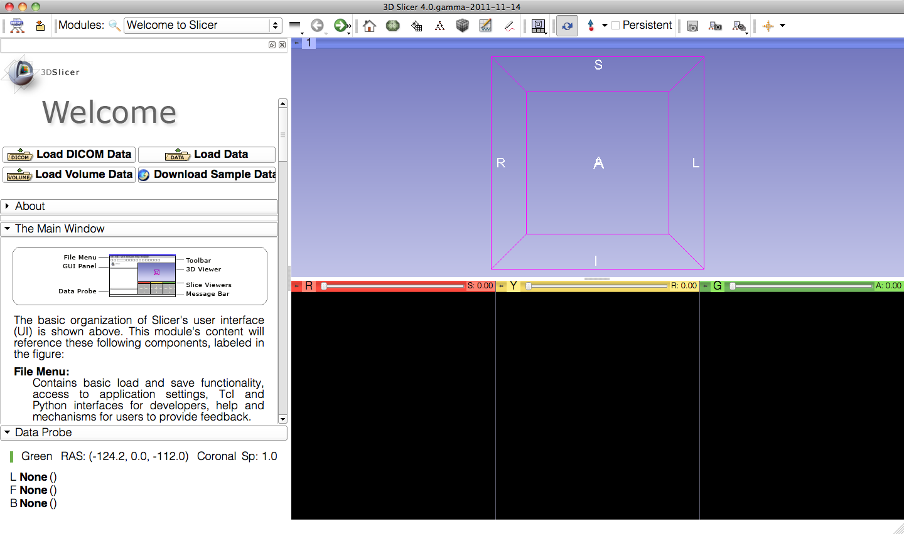
Slicer Welcome
The Main Window tab contains information on the basic organization of Slicer’s user interface.

Slide 9
Slicer User Interface
Main Menu
Toolbar
3D viewer
User Interface (UI) panel
of the Slicer Welcome Module
Data Probe
2D anatomical viewers

Slide 10
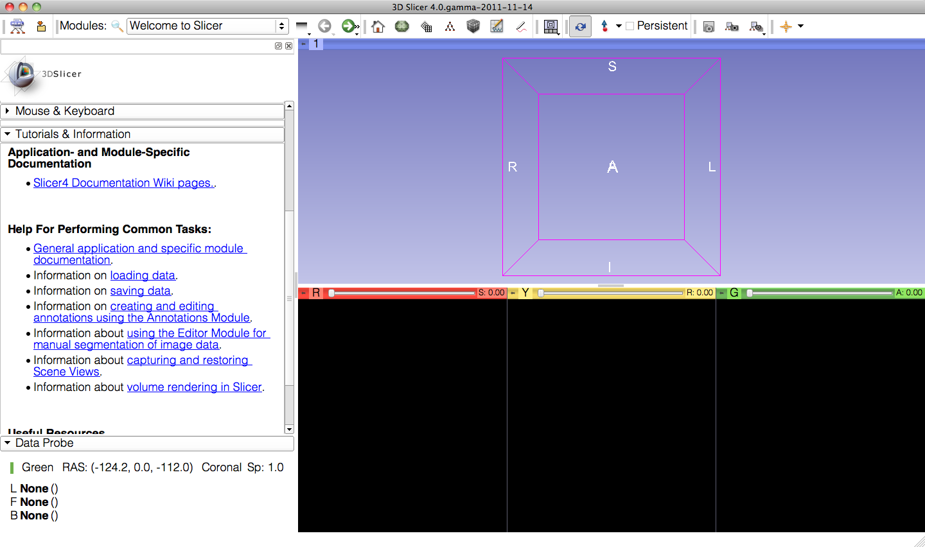
Welcome Module
The Tutorials & Information tab contains links to the Slicer4 training compendium and documentation.

Slide 11
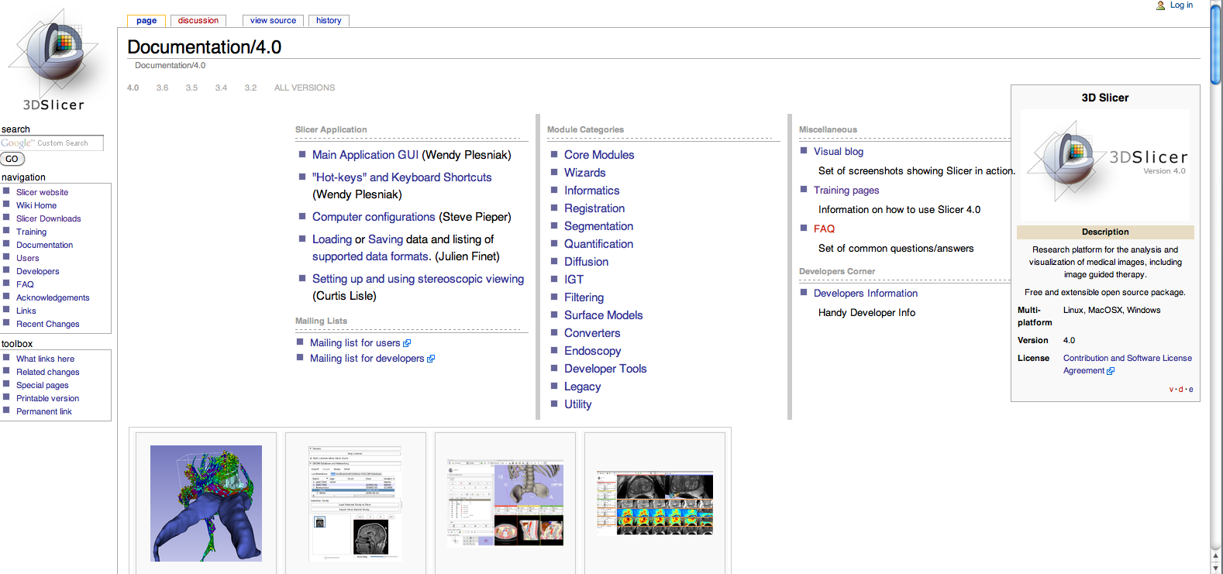
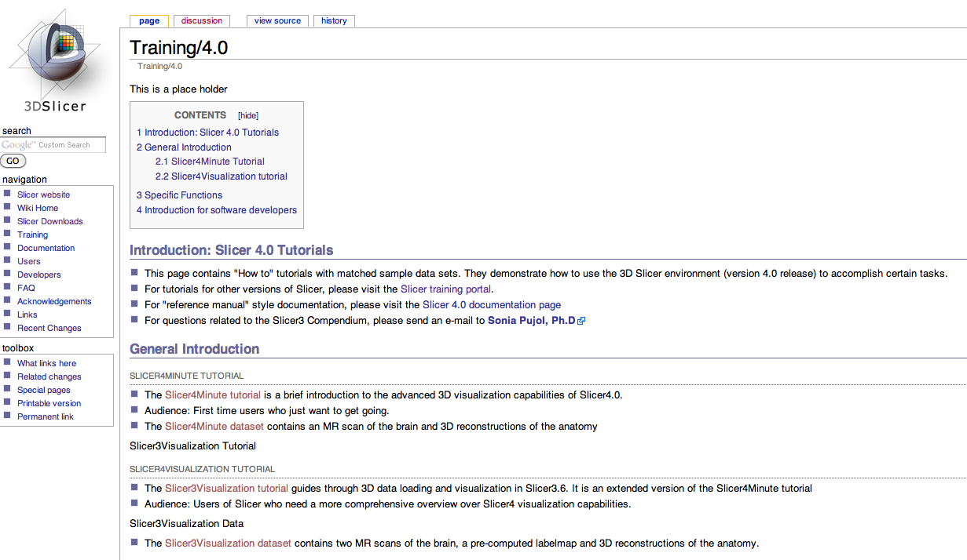
Slicer4.0 Documentation &Training
http://www.slicer.org/slicerWiki/index.php/Documentation/4.0
http://www.slicer.org/slicerWiki/index.php/Documentation/4.0/Training

Slide 12
Welcome Module
The Welcome module panel contains shortcuts for loading different types of data. A series of sample data are also available.
Click on Download Sample Data to access the Sample Data Module

Slide 13
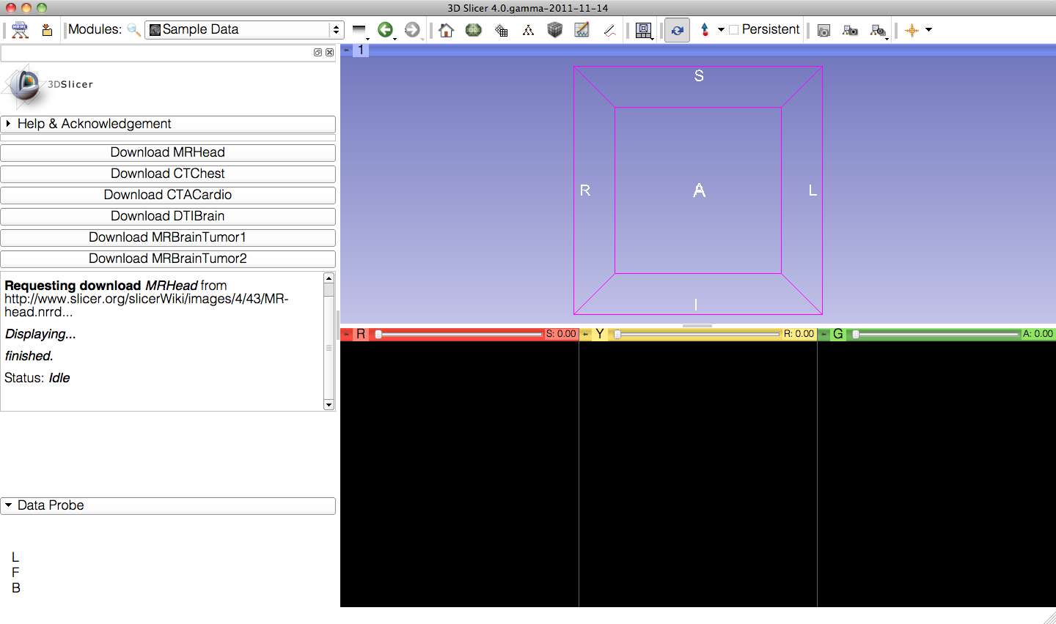
Sample Data
The Sample Data module contains links to six different sample datasets that can be downloaded into Slicer.

Slide 14
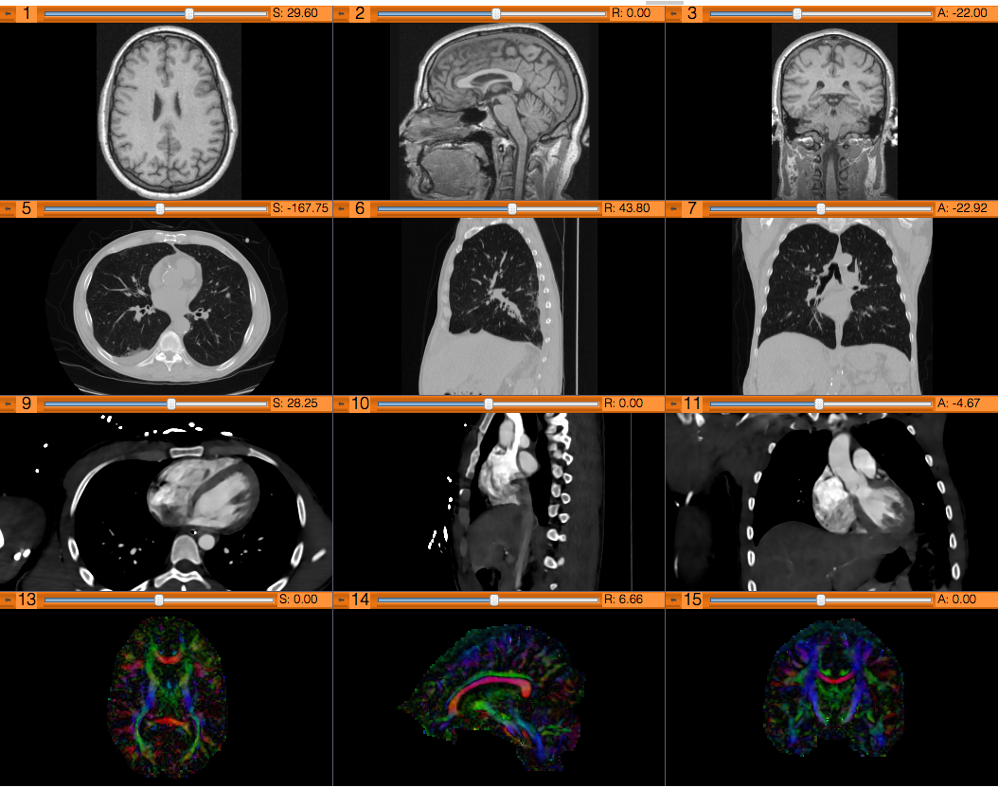
Sample Data
Brain MRI
Chest CT
Cardiac CT
Diffusion Tensor Imaging (DTI) Dataset
Brain MRI (tumor patient)

Slide 15
Sample Data
Click on Download MRHead to download the dataset in Slicer.

Slide 16
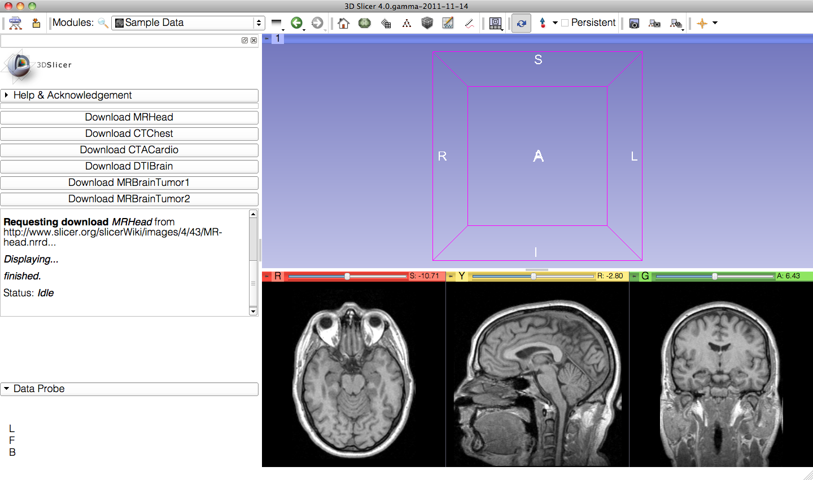
Welcome Module
The MR scan of the brain appears in the 2D viewers.

Slide 17
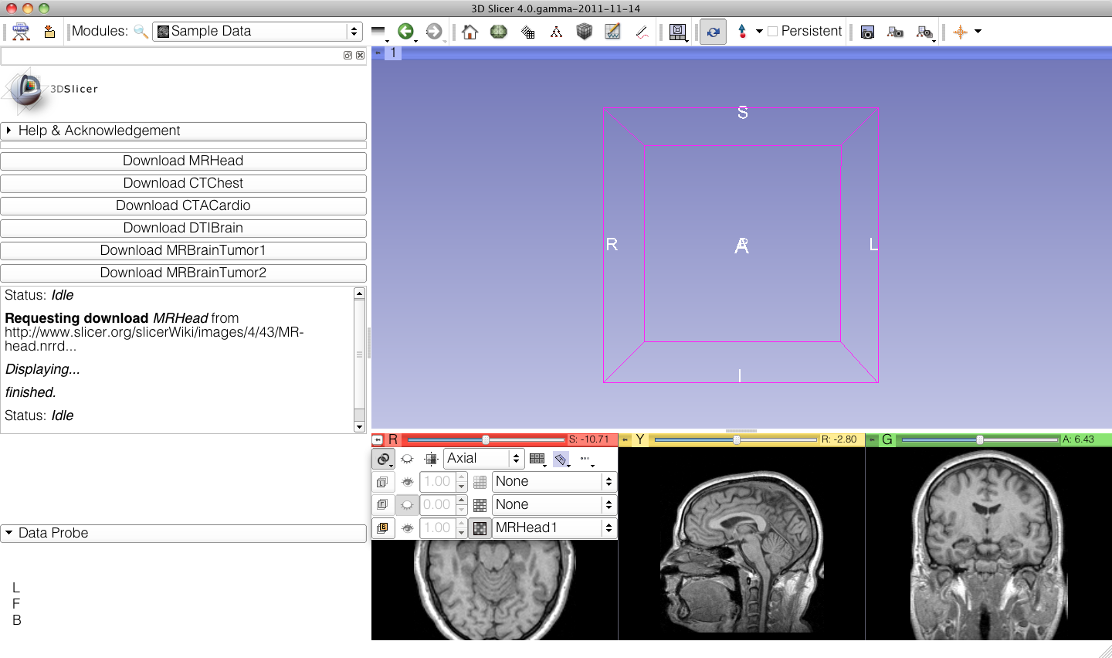
MR Brain Sample Dataset
Click on the pin icon at the top left corner of the red viewer to display the viewer menu

Slide 18
MR Brain Sample Dataset
Click on the link icon to link all three 2D viewers, and on the eye icon next to it to display the slices in the 3D viewer.

Slide 19
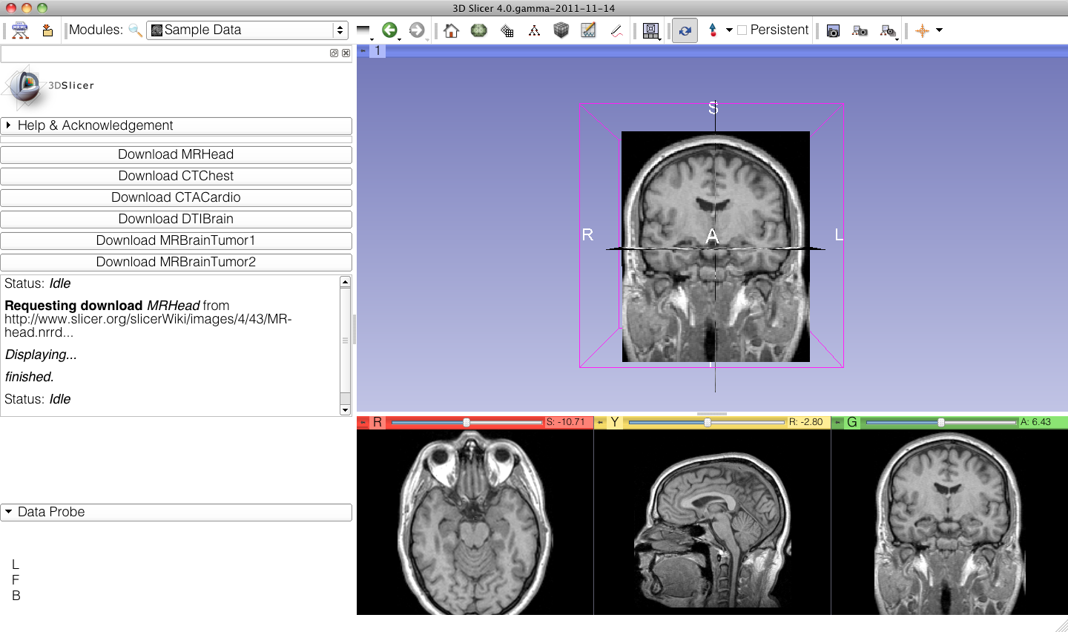
MR Brain Sample Dataset
The axial, coronal and sagittal slices appear in the 3D viewer.
Go back to the Welcome module using the green arrow in the toolbar.

Slide 20
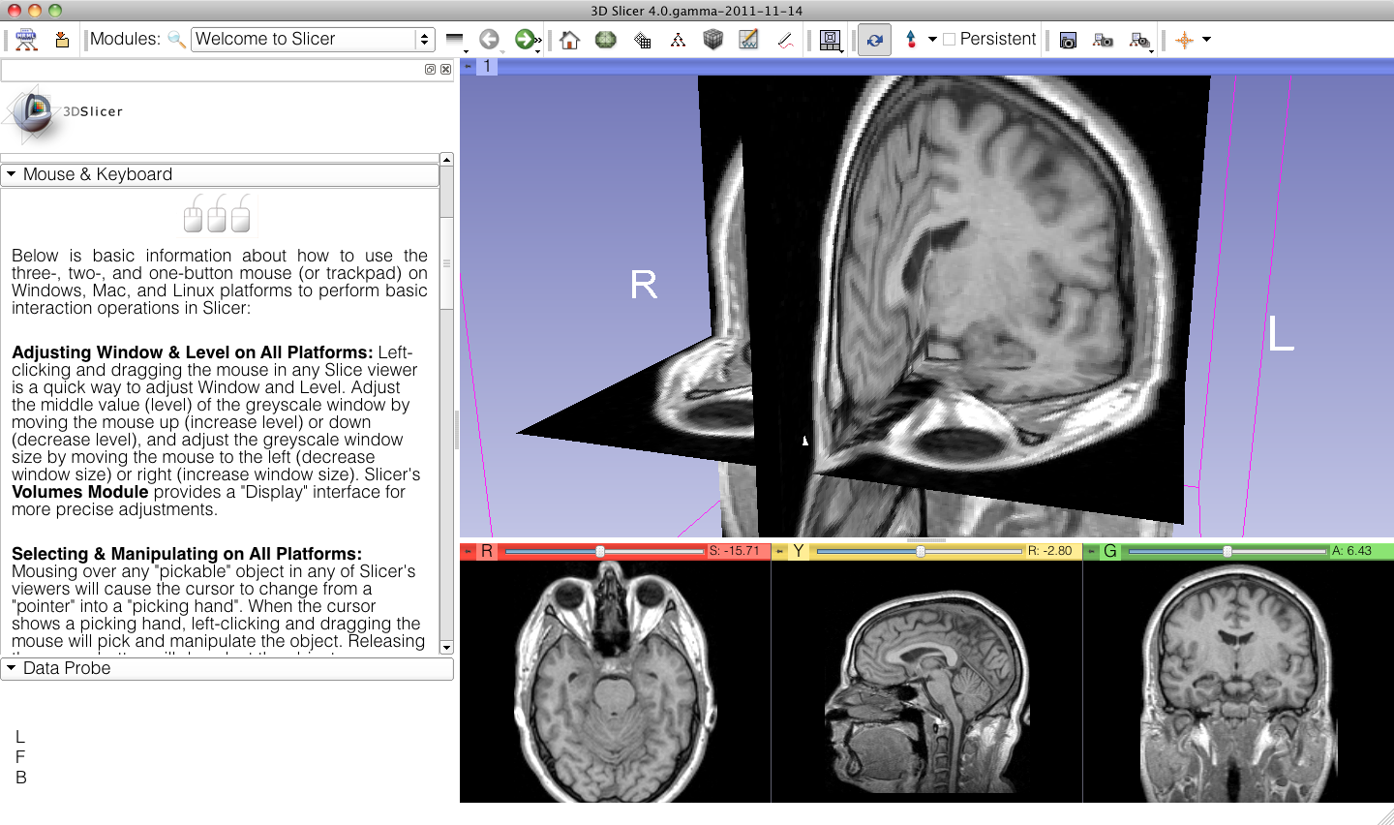
MR Brain Sample Dataset
Click on the tab Mouse & Keyboard to learn the different mouse actions to rotate the images and zoom in and out.

Slide 21
Going Further
To learn more about Slicer and its different functionalities, visit the Slicer4.0 training compendium.
http://www.slicer.org/slicerWiki/index.php/Documentation/4.0/Training

Slide 22
Acknowledgments
National Alliance for Medical
Image Computing
NIH U54EB005149
Neuroimage Analysis Center
NIH P41RR013218

